Slide 1
Investigation of EBW current drive in open magnetic flux surface using flux loop with HFS injection in QUEST
ZHOU Junyaoª, HANADA Kazuaki^{b}, KOJIMA Shinichiro^{c}, KONO Kaori^{b}, IDO Takeshi^{b}, EJIRI Akira^{d}, ONCHI Takumi^{b}, SEKIYA Izumi^{b}, KURODA Kengoh^{b}, YUE Qilinª,
IDEI Hiroshi^{b}, NAGASHIMA Yoshihiko^{b}, IKEZOE Ryuya^{b}, HASEGAWA Makoto^{b}, HIGASHIJIMA Aki^{b}, SHIMABUKURO Shun^{b}
ªIGSES, Kyushu University, ^{b}RIAM, Kyushu University, ^{c}QST, ^{d}GSFS, The University of Tokyo

Slide 2
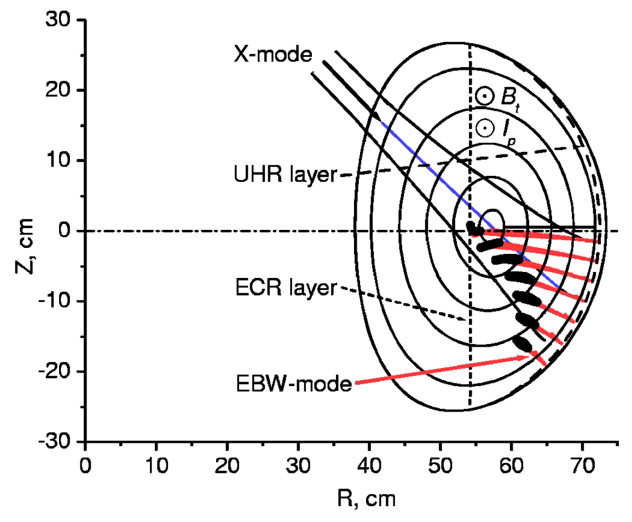
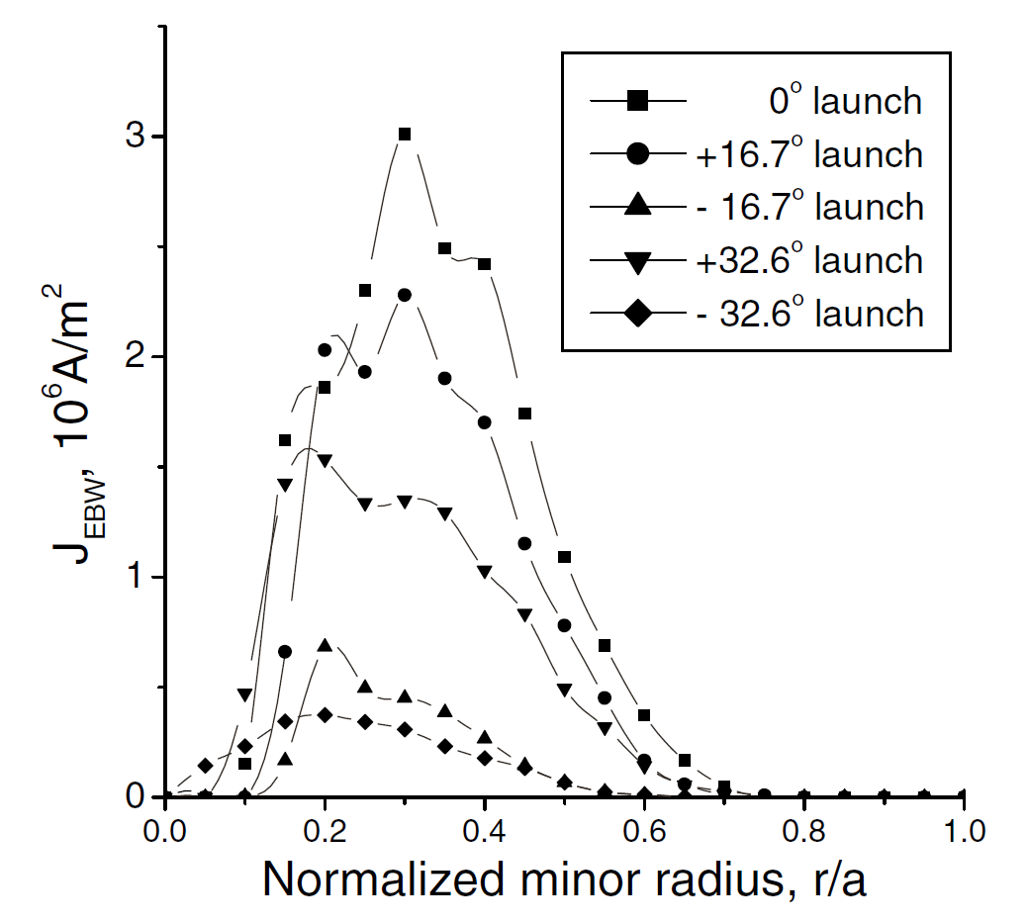
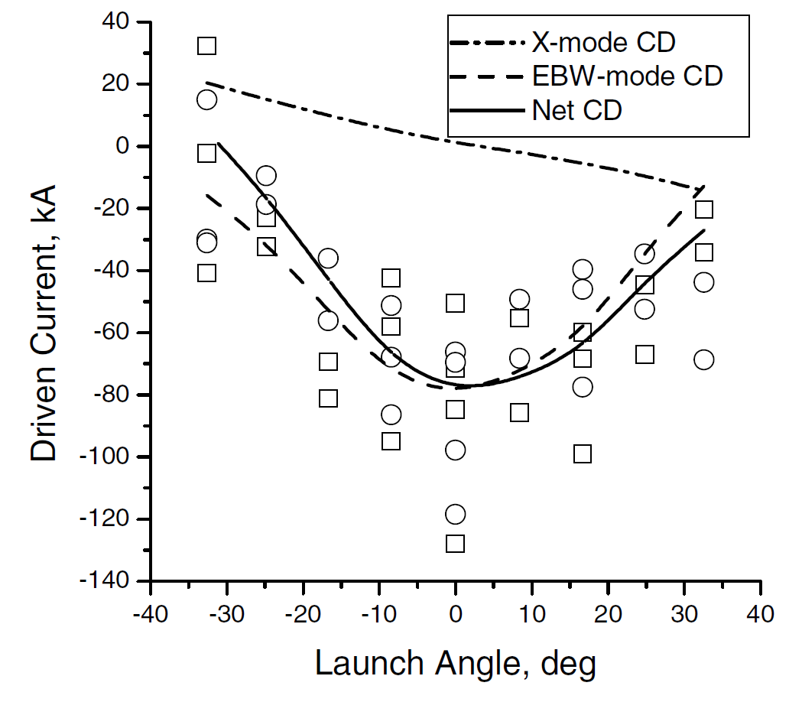
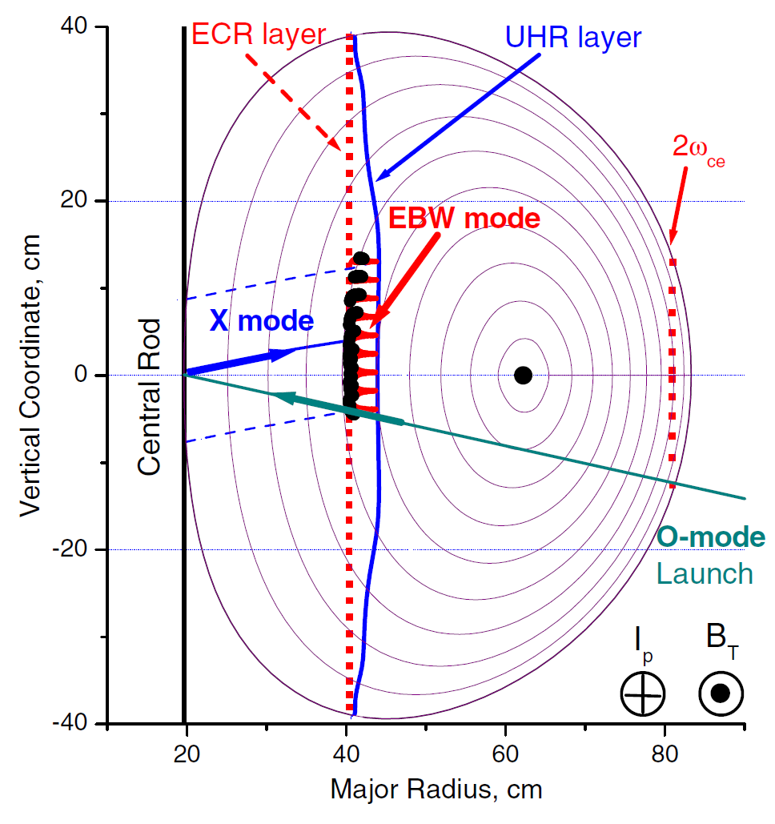
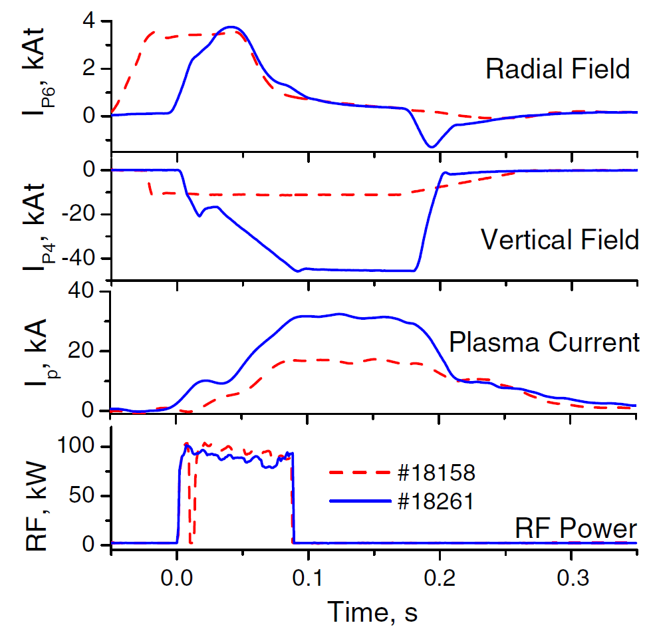
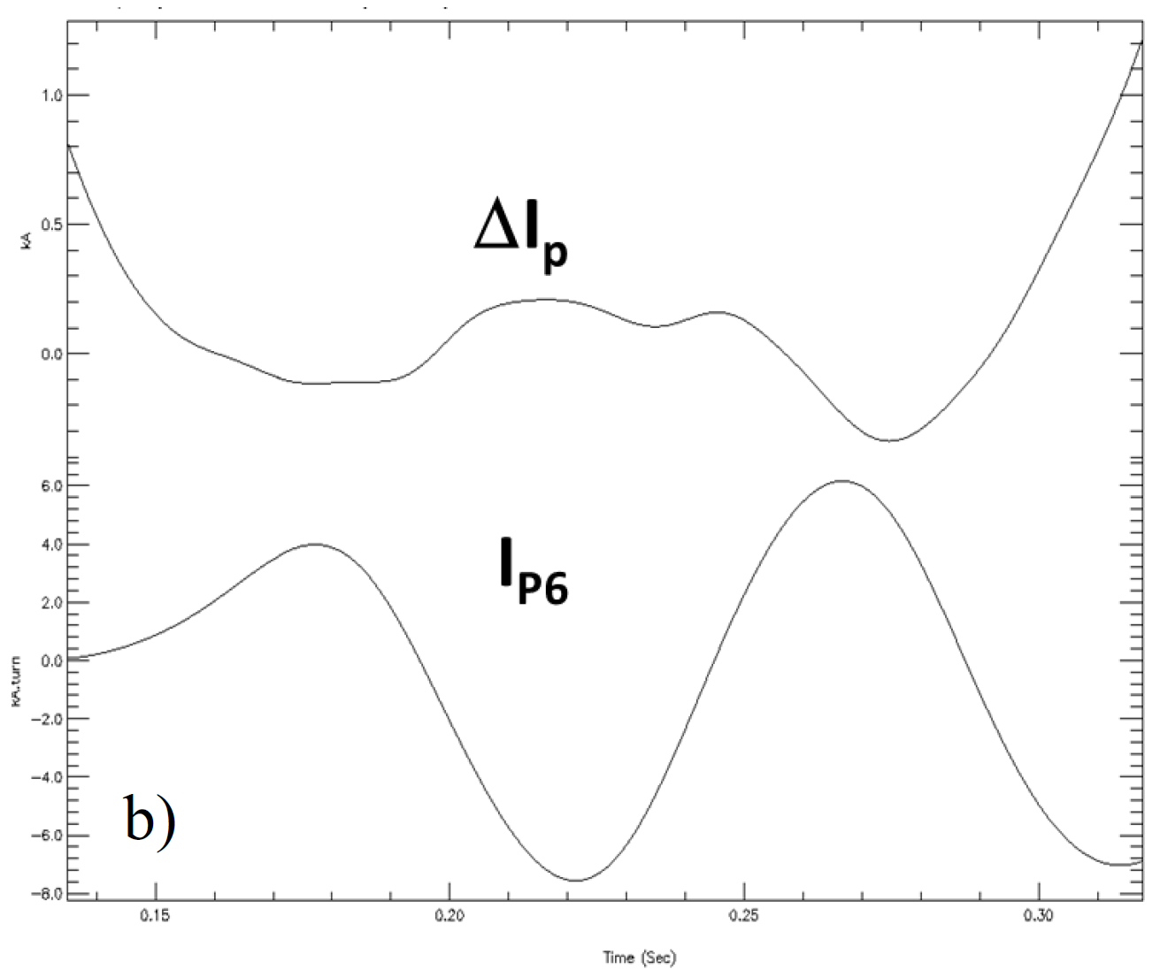
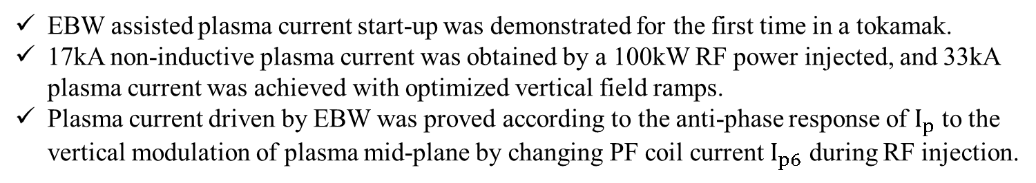
Review of X-B mode conversion experiments
COMPASS-D
https://doi.org/10.1103/PhysRevLett.89.265005
Shevchenko V, 2002, PRL 89(26): 265005.
Non-inductive current was driven by EBW after plasma current was started up, and the perpendicularly injected X-mode wave showed the most efficient EBWH/EBWCD.
MAST
Shevchenko V F, 2010, NF 50(2): 022004.
Shevchenko V F, 2015, EDP Sciences 87: 02007.
EBW assisted plasma current start-up was demonstrated for the first time in a tokamak.
17kA non-inductive plasma current was obtained by a 100kW RF power injected, and 33kA plasma current was achieved with optimized vertical field ramps.
Plasma current driven by EBW was proved according to the anti-phase response of $I_{p}$ to the vertical modulation of plasma mid-plane by changing PF coil current $I_{p6}$ during RF injection.
2
Reflection mirror was installed on center stack to reflect the X-mode wave from LFS.
The purity of reflected X-mode wave is difficult to confirm.
Installing antenna on the HFS is quite difficult.
8.2GHz RF system in QUEST.
A larger reflection mirror is necessary.
HFS injection system is possible.

Slide 3
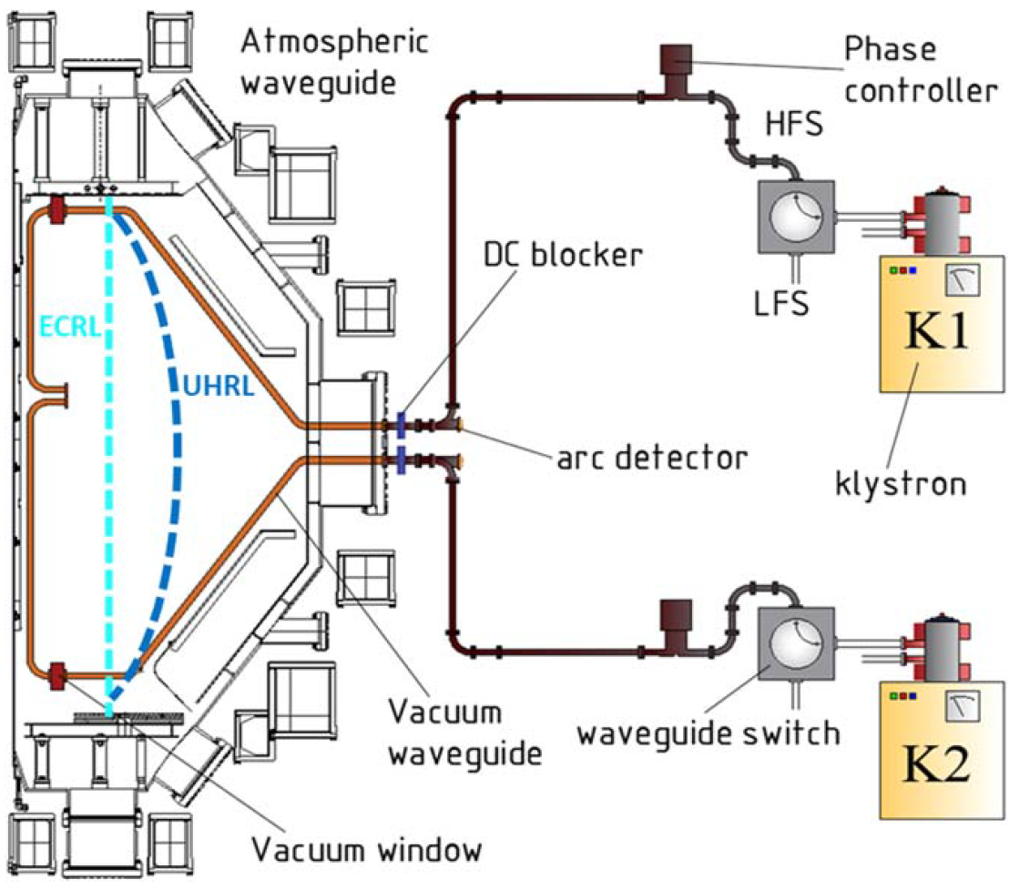
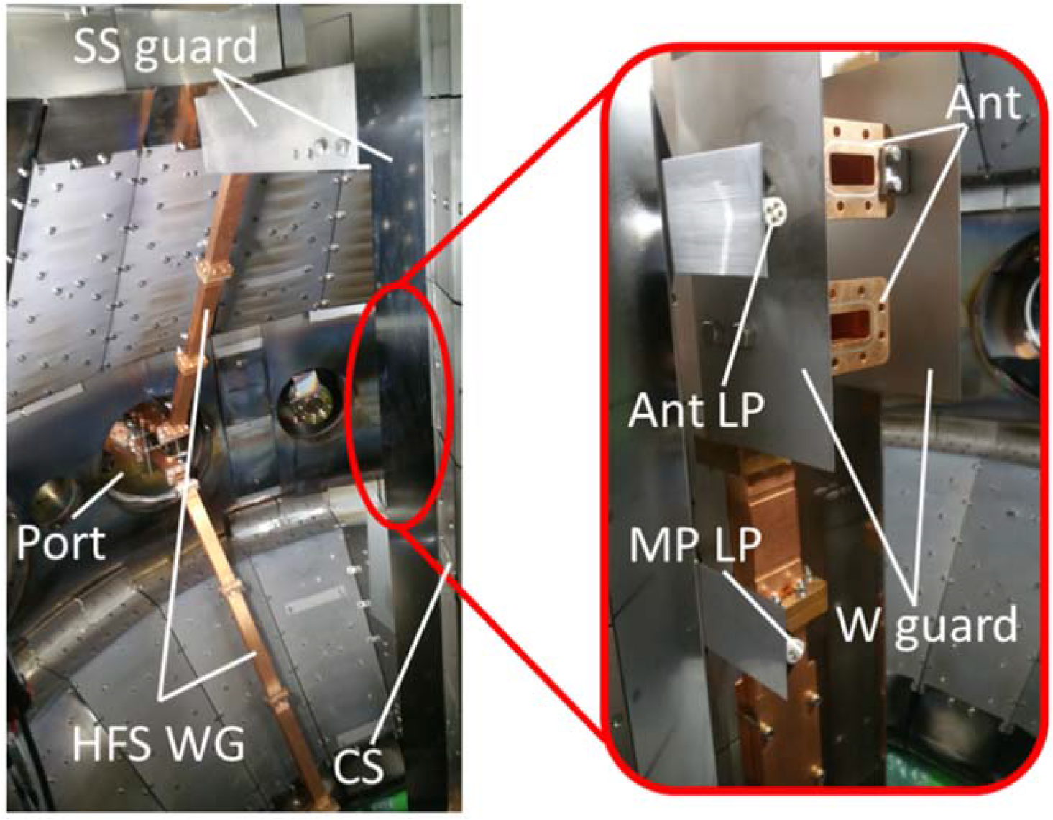
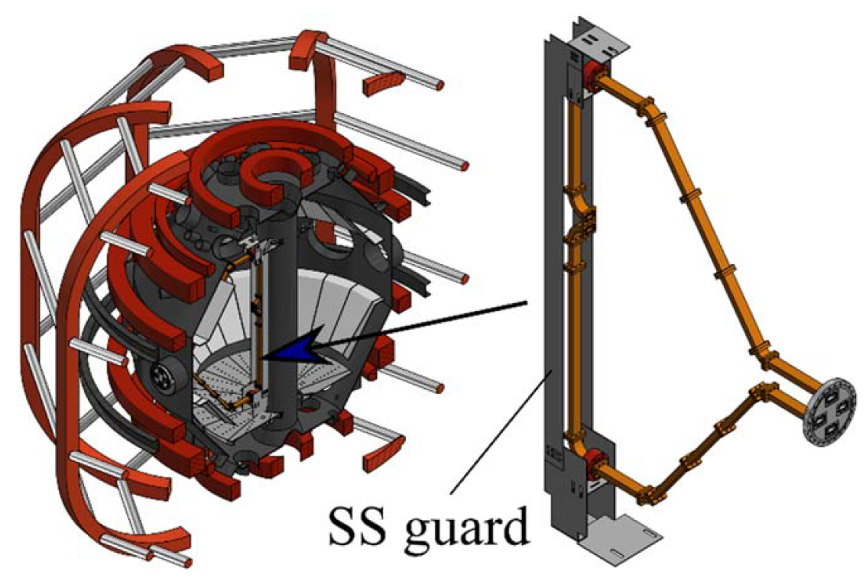
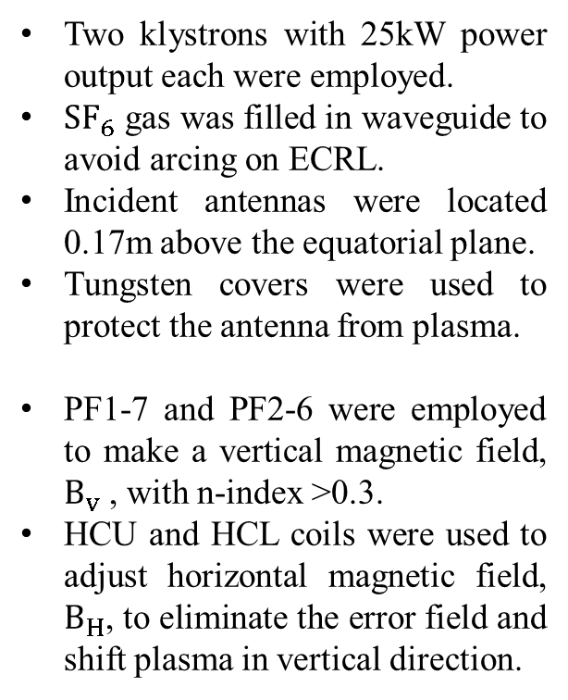
HFS injection system in QUEST
Two klystrons with 25kW power output each were employed.
$SF_{6}$ gas was filled in waveguide to avoid arcing on ECRL.
Incident antennas were located 0.17m above the equatorial plane.
Tungsten covers were used to protect the antenna from plasma.
PF1-7 and PF2-6 were employed to make a vertical magnetic field, $B_{v}$ , with n-index >0.3.
HCU and HCL coils were used to adjust horizontal magnetic field, $B_{H}$, to eliminate the error field and shift plasma in vertical direction.
https://doi.org/10.1088/1361-6587/ab6903
HCU
PF2
PF1
PF7
PF6
HCL
3

Slide 4
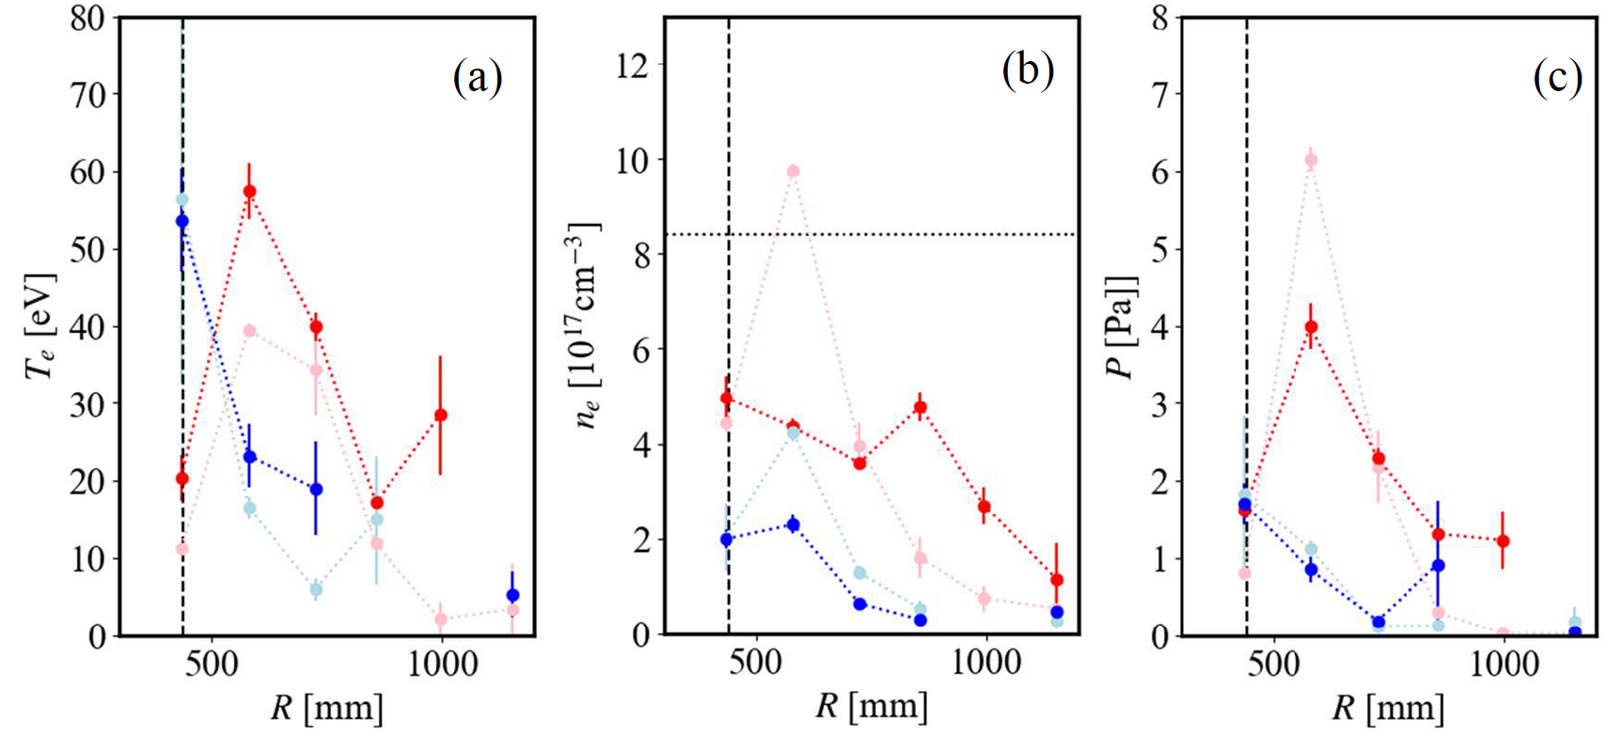
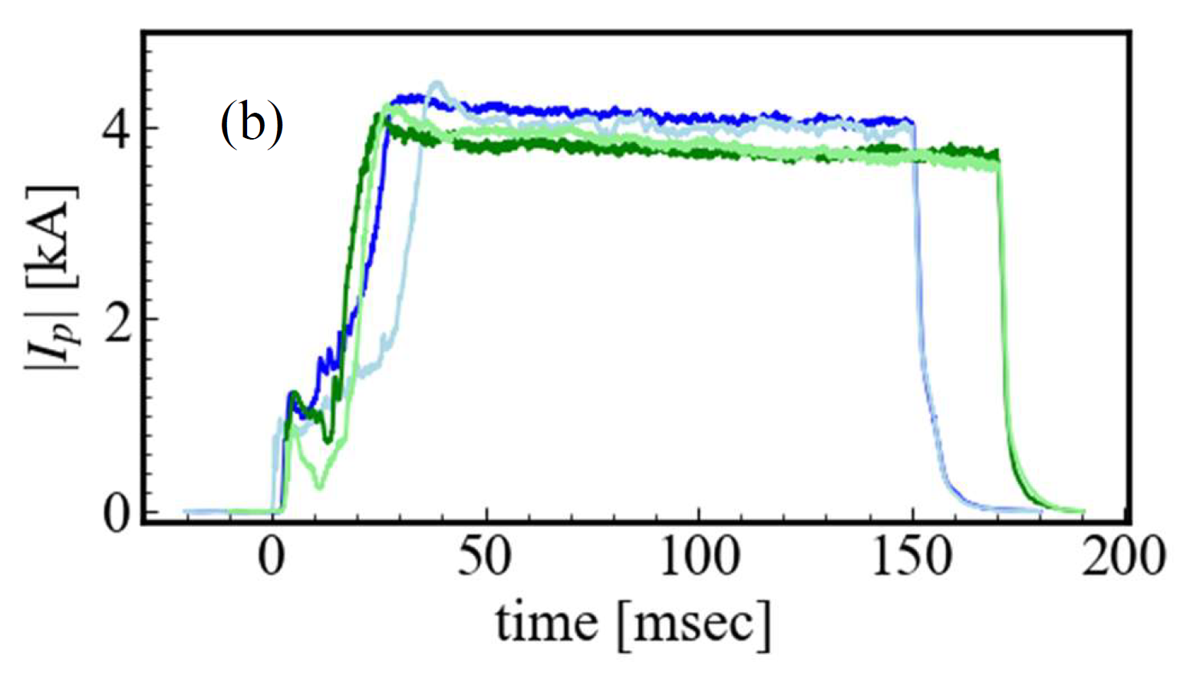

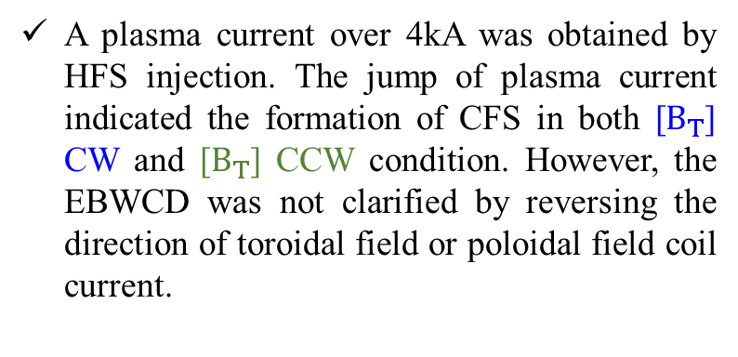
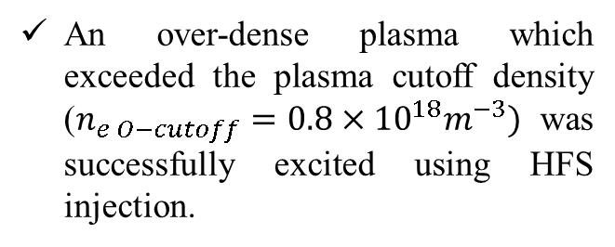

EBWCD couldn’t be clarified by measuring $I_{p}$ under different $B_{T}$
https://doi.org/10.1088/1361-6587/ab6903
Kojima S, 2021 [D]
https://doi.org/10.1585/pfr.14.1205038
An over-dense plasma which exceeded the plasma cutoff density ($n_{e O−cutoff}=0.8×{10}^{18}m^{−3})$ was successfully excited using HFS injection.
HFS injection at 21 msec LFS injection at 21 msec
HFS injection at 121 msec LFS injection at 121 msec
A plasma current over 4kA was obtained by HFS injection. The jump of plasma current indicated the formation of CFS in both [$B_{T}$] CW and [$B_{T}$] CCW condition. However, the EBWCD was not clarified by reversing the direction of toroidal field or poloidal field coil current.
$I_{p}$ on negative PF & positive TF $I_{p}$ on negative PF & negative TF
$I_{p}$ on positive PF & positive TF $I_{p}$ on positive PF & negative TF
4

Slide 5
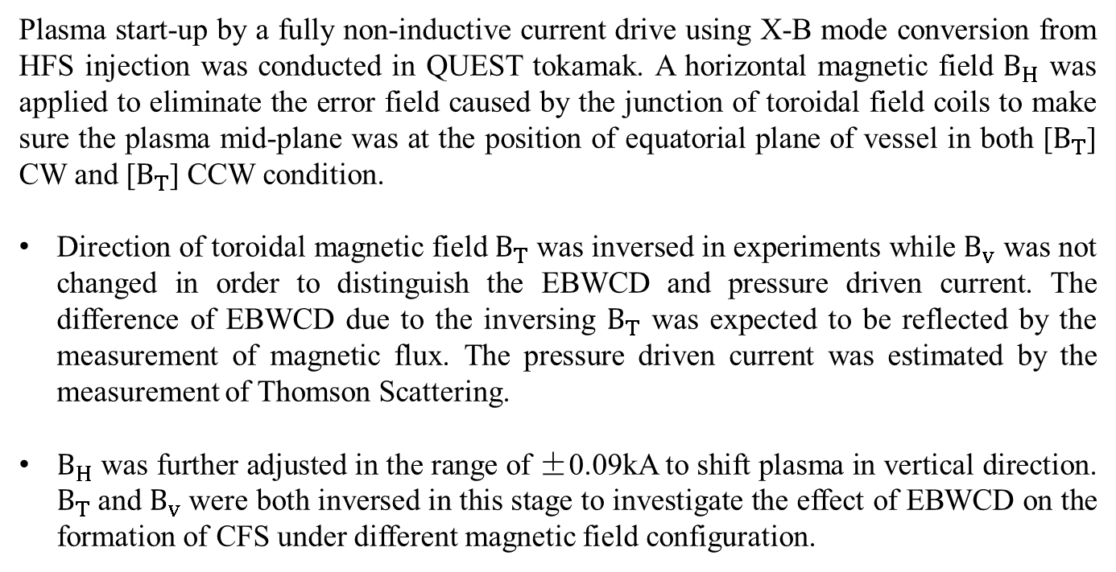
Object
Plasma start-up by a fully non-inductive current drive using X-B mode conversion from HFS injection was conducted in QUEST tokamak. A horizontal magnetic field $B_{H}$ was applied to eliminate the error field caused by the junction of toroidal field coils to make sure the plasma mid-plane was at the position of equatorial plane of vessel in both [$B_{T}$] CW and [$B_{T}$] CCW condition.
Direction of toroidal magnetic field $B_{T}$ was inversed in experiments while $B_{v}$ was not changed in order to distinguish the EBWCD and pressure driven current. The difference of EBWCD due to the inversing $B_{T}$ was expected to be reflected by the measurement of magnetic flux. The pressure driven current was estimated by the measurement of Thomson Scattering.
$B_{H}$ was further adjusted in the range of ±0.09kA to shift plasma in vertical direction. $B_{T}$and $B_{v}$were both inversed in this stage to investigate the effect of EBWCD on the formation of CFS under different magnetic field configuration.
5

Slide 6
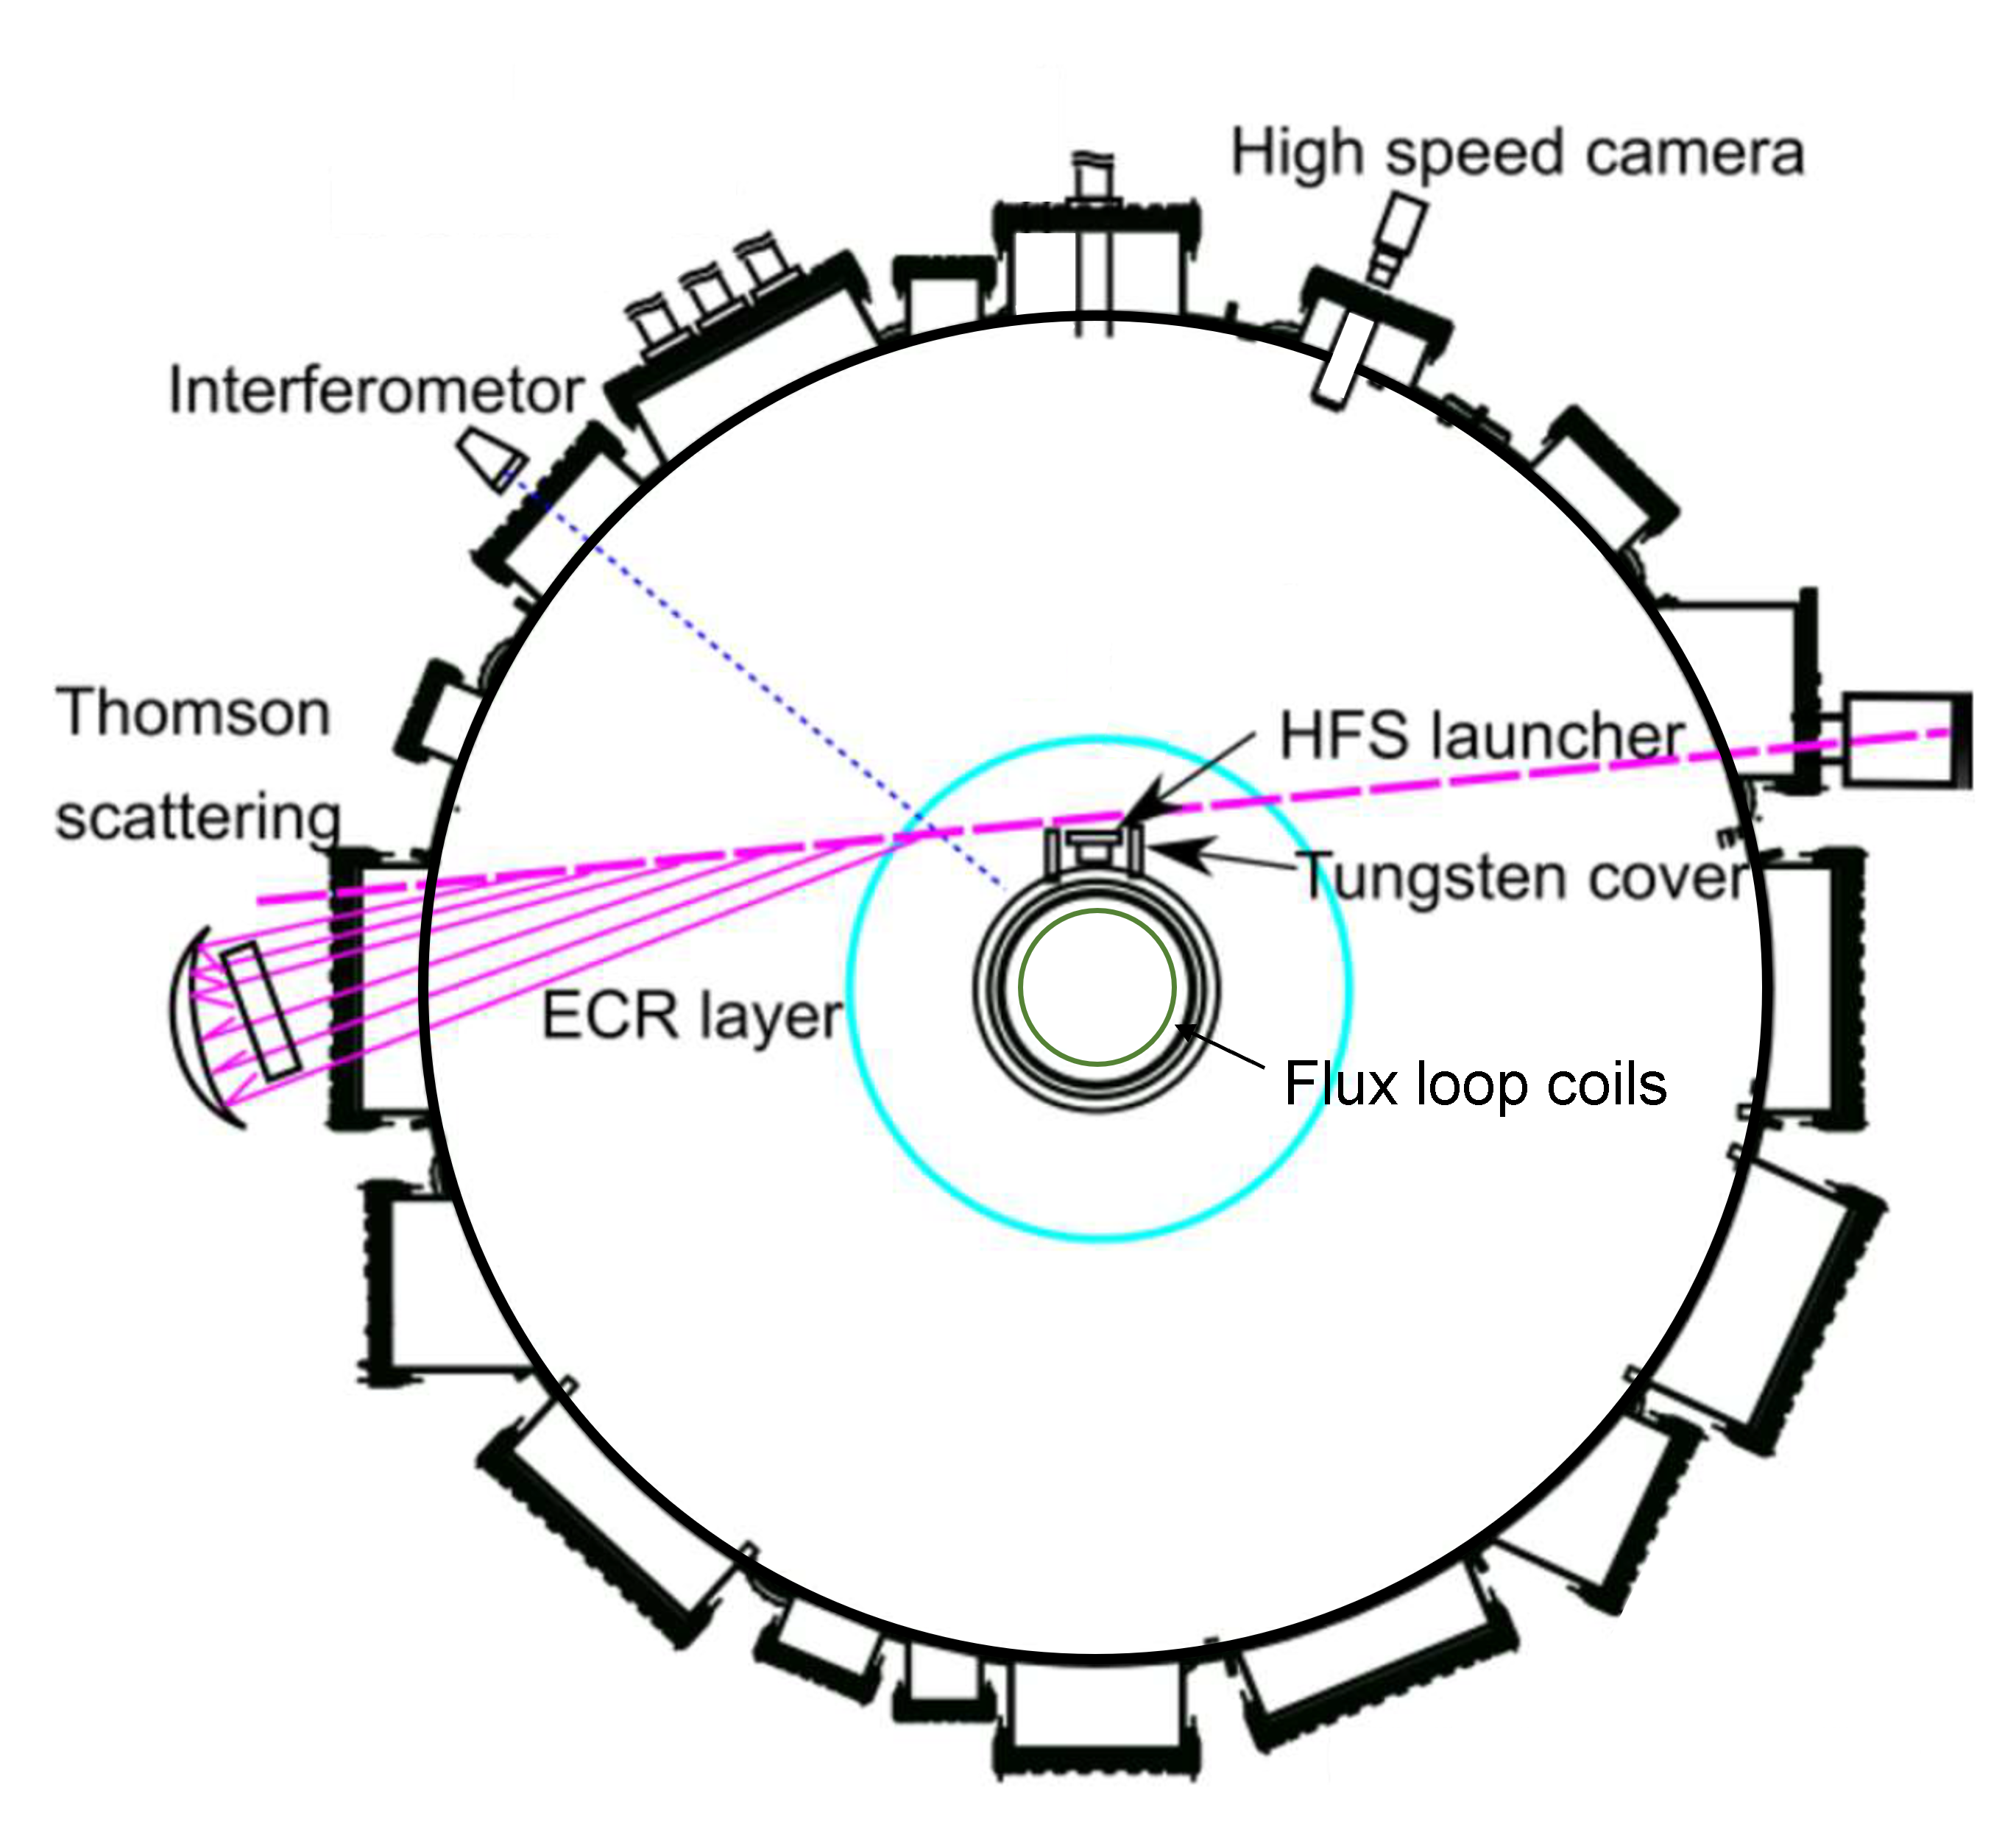
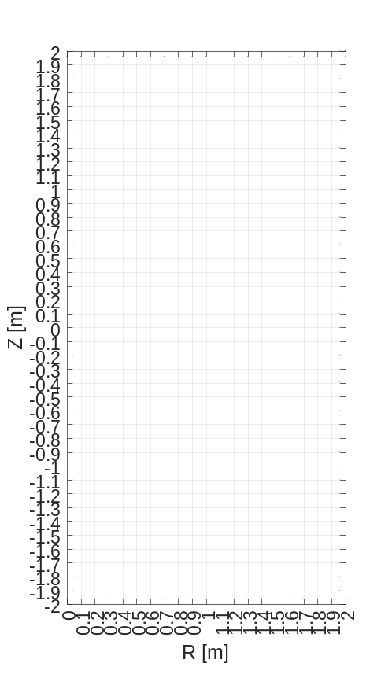
Measurements
https://doi.org/10.1585/pfr.15.2402063
https://www.triam.kyushu-u.ac.jp/community/
2.0
1.5
FLC1~24
1.0
0.5
0.0
-0.5
-1.0
-1.5
-2.0
1.0
1.5
2.0
0.0
0.5
Thomson scattering was employed to measure the electron density and temperature of 6 points (R=0.419m, 0.558m, 0.691m, 0.805m, 0.915m, 1.005m) on equatorial plane of vessel.
Interferometer was used to measure the line-integrated electron density.
24 flux loop coils were distributed longitudinally every 0.1m on the center stack to measure the vertical magnetic flux generated by plasma current.
6

Slide 7
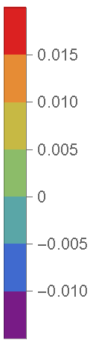
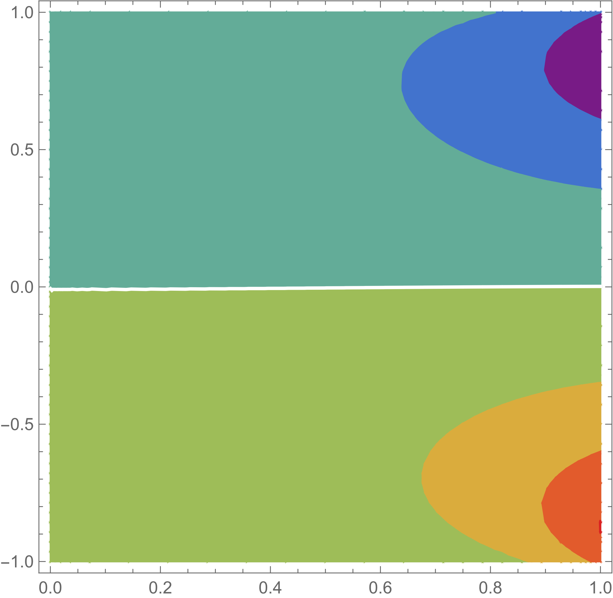
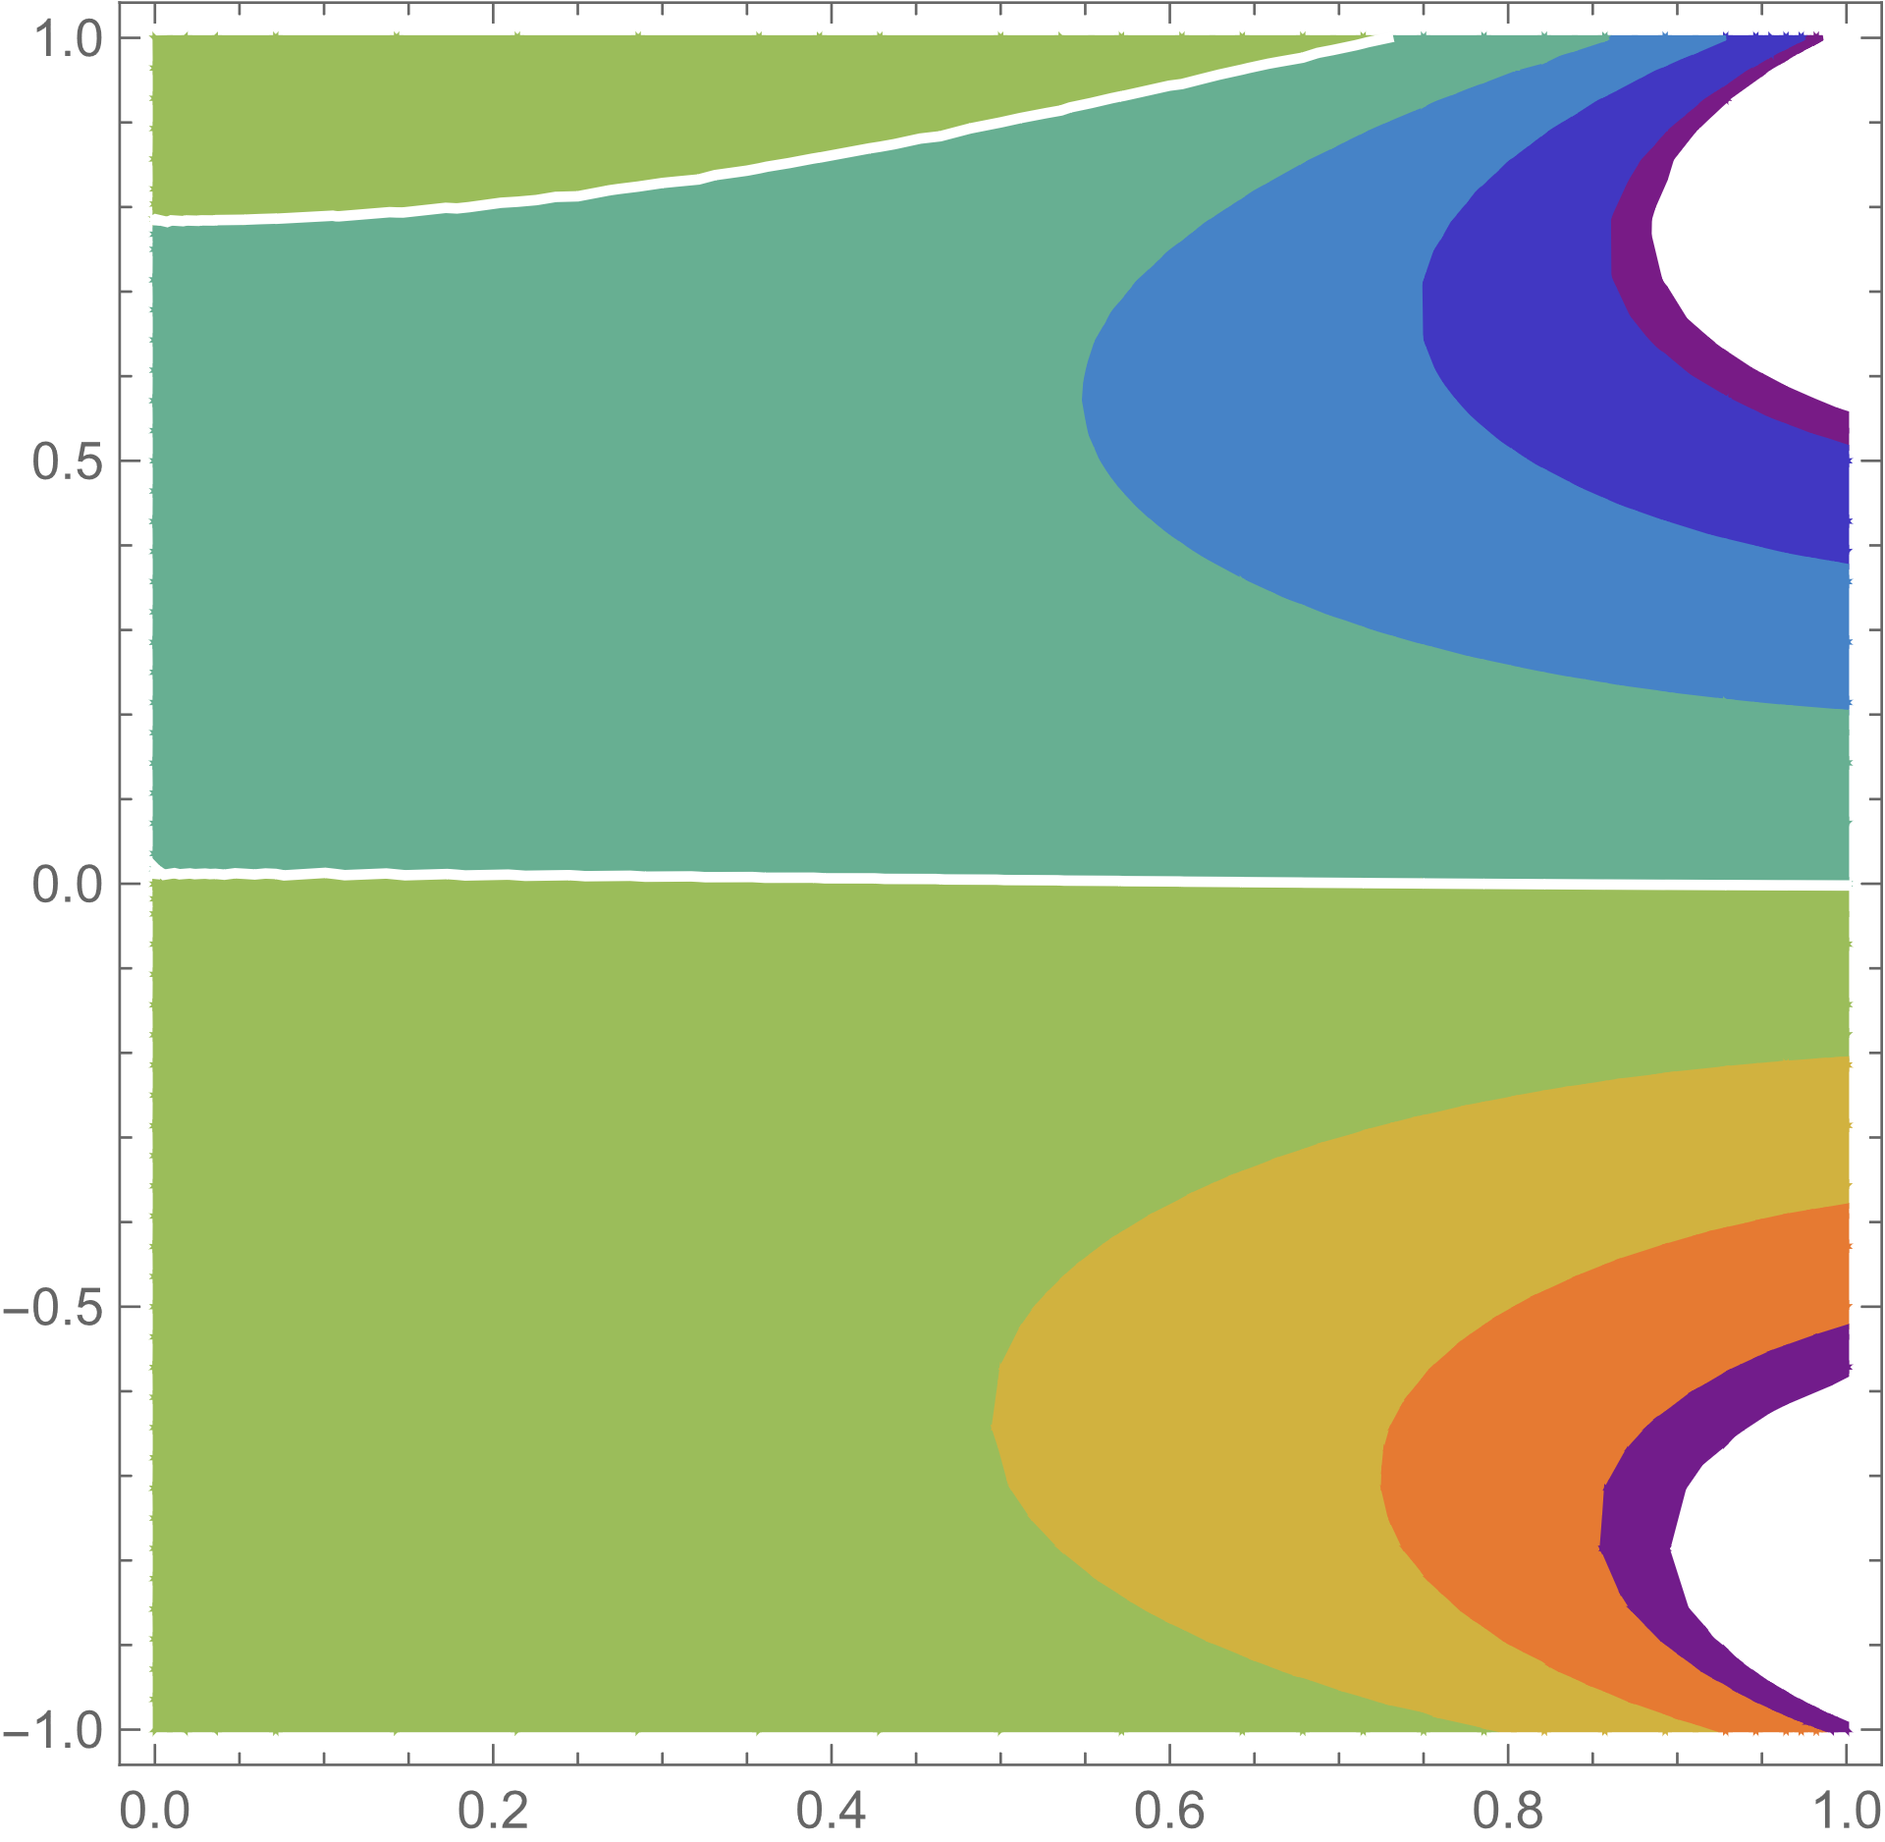






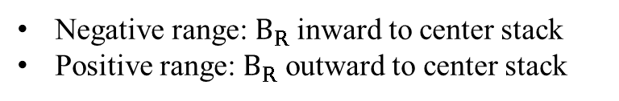

Inversing $B_{T}$for changing the direction of BWCD
$B_{T}$ direction was inversed to distinguish the EBWCD from pressure driven current.
[$B_{T}$] CCW [$B_{Z}$] up
[$B_{T}$] CW [$B_{Z}$] up
1.0
#48480 $I_{HCUL}=−0.02kA$
1.0
#48532 $I_{HCUL}=0.02kA$
0.5
0.5
Z [m]
Equilibrium
Z [m]
Anti-equilibrium
0.0
0.0
Anti-equilibrium
Equilibrium
-0.5
-0.5
-1.0
-1.0
0.0
0.2
0.4
0.6
0.8
1.0
0.0
0.2
0.4
0.6
0.8
1.0
R [m]
R [m]
$B_{R}$ [T] in R-Z plane
$B_{R}$ [T] in R-Z plane
Negative range: $B_{R}$ inward to center stack
Positive range: $B_{R}$ outward to center stack
White line: plasma mid-plane
$I_{HCUL}=−0.02kA$ & $0.02kA$ was applied respectively to eliminate the error field
7

Slide 8
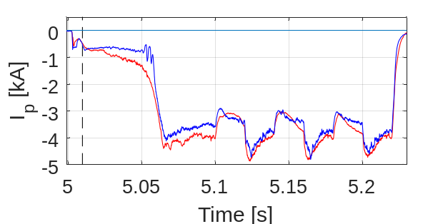
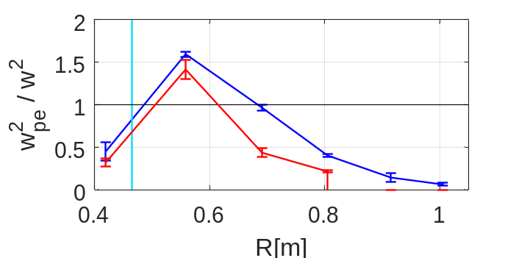
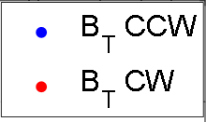

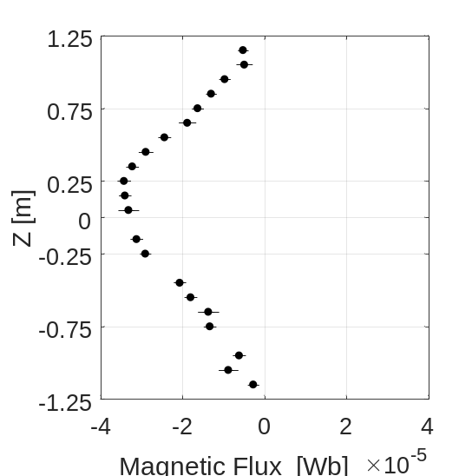
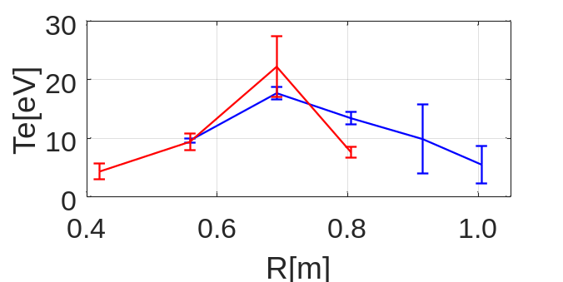
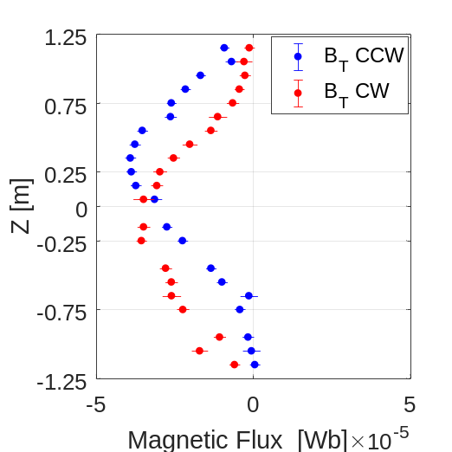

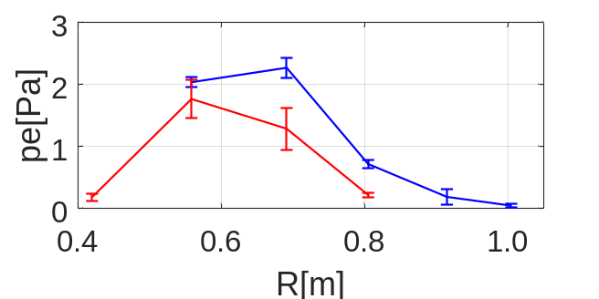
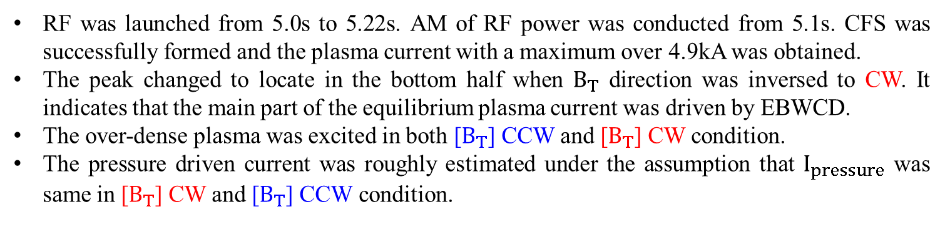
Peak of magnetic flux moved by inversing $B_{T}$
Plasma cutoff ($ω_{pe}=ω$)
5.01s
ECRL
R=0.465m
Peak of driven current
RF was launched from 5.0s to 5.22s. AM of RF power was conducted from 5.1s. CFS was successfully formed and the plasma current with a maximum over 4.9kA was obtained.
The peak changed to locate in the bottom half when $B_{T}$ direction was inversed to CW. It indicates that the main part of the equilibrium plasma current was driven by EBWCD.
The over-dense plasma was excited in both [$B_{T}$] CCW and [$B_{T}$] CW condition.
The pressure driven current was roughly estimated under the assumption that $I_{pressure}$ was same in [$B_{T}$] CW and [$B_{T}$] CCW condition.
8

Slide 9
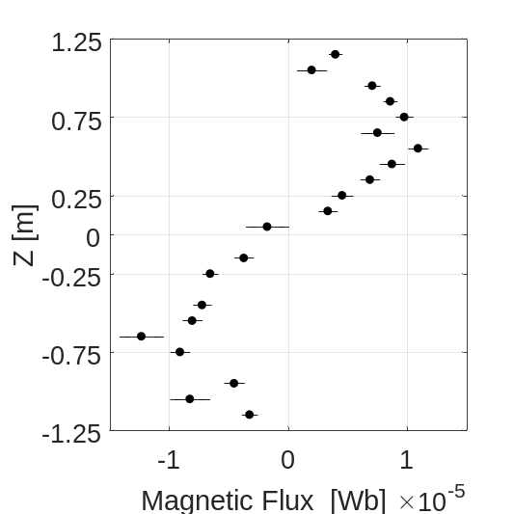
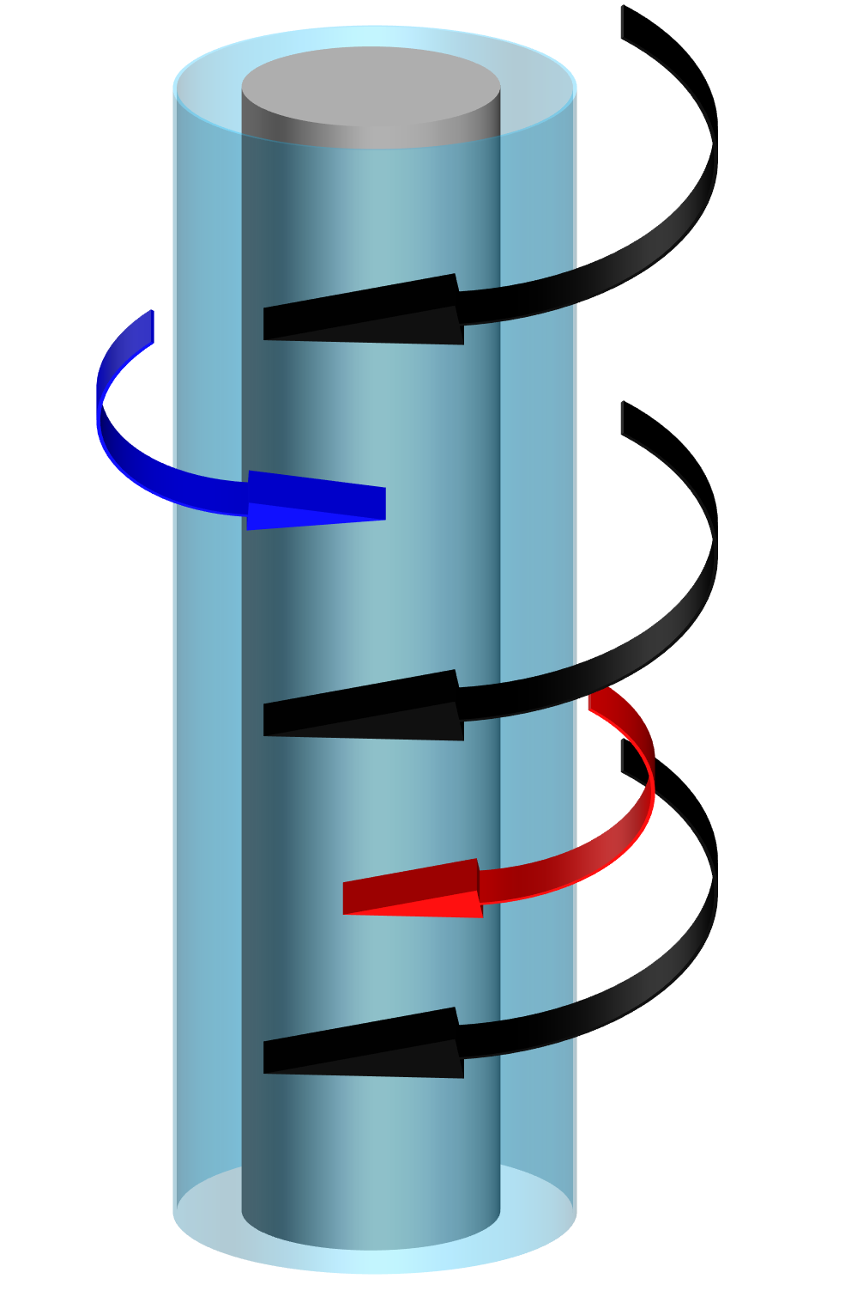
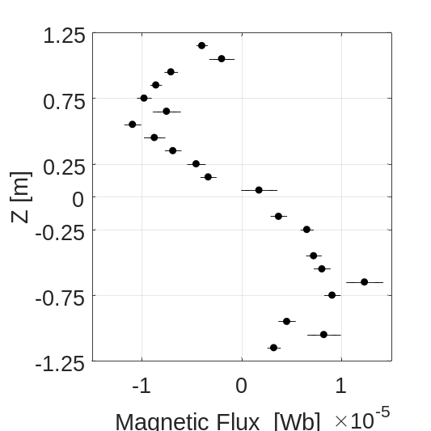
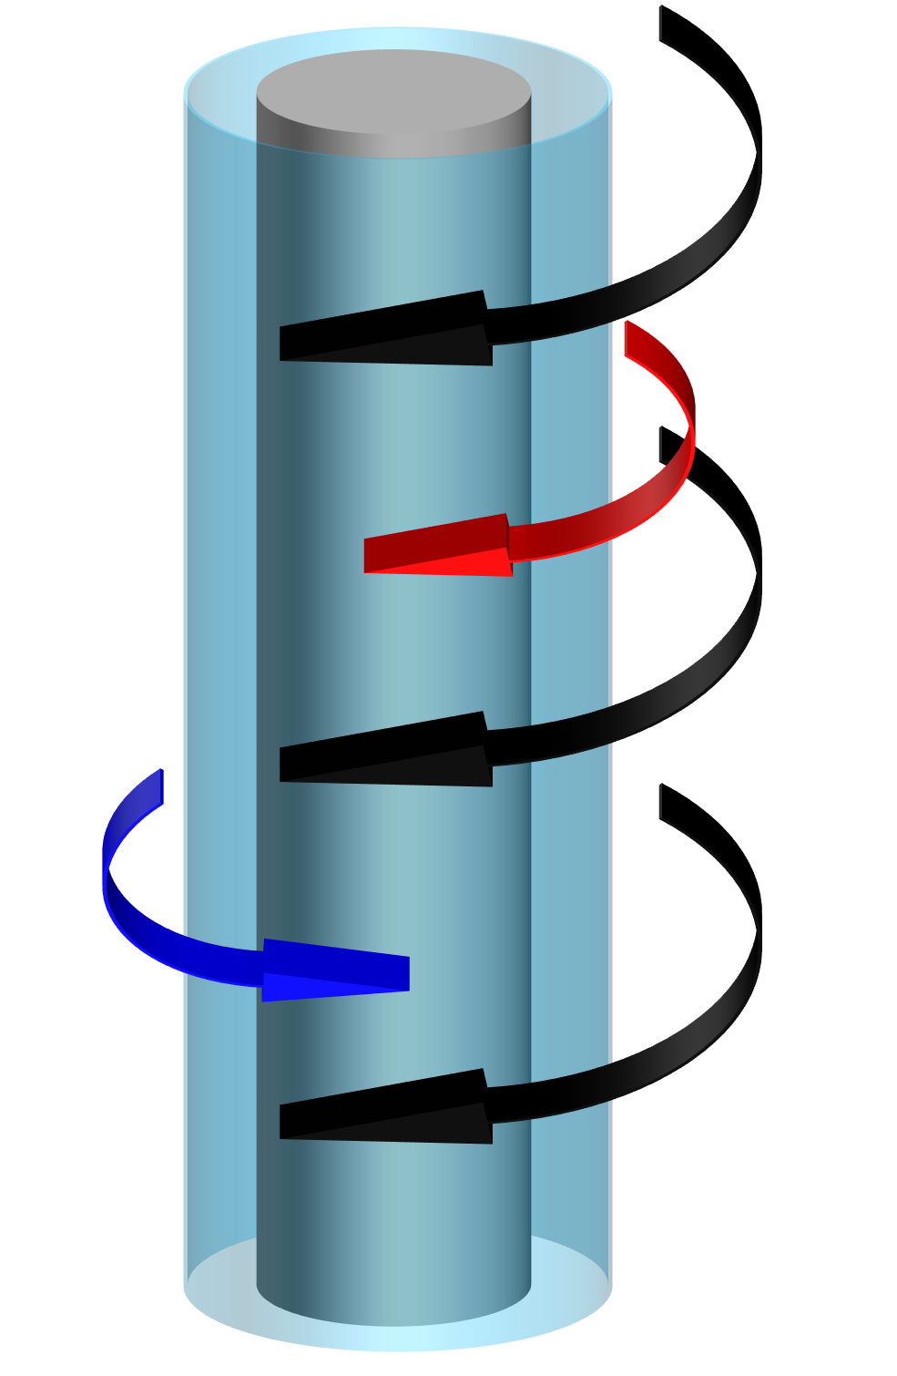







EBWCD with opposite directions in [$B_{T}$] CW and [$B_{T}$] CCW conditions
[$B_{T}$ ] CW
#48532 $I_{HCUL}=0.02kA$
EBWCD [CCW]
1.0
Center Stack
0.5
ECRL
Anti-equilibrium
Direction of $I_{pressure}$
Z [m]
EBWCD in CW
0.0
EBWCD in CCW
Equilibrium
-0.5
Ion drift direction
EBWCD [CW]
-1.0
0.0
0.2
0.4
0.6
0.8
1.0
R [m]
[$B_{T}$ ] CCW
#48480 $I_{HCUL}=−0.02kA$
EBWCD [CW]
1.0
Center Stack
0.5
ECRL
Z [m]
Equilibrium
Direction of $I_{pressure}$
0.0
EBWCD in CW
Anti-equilibrium
EBWCD in CCW
EBWCD [CCW]
-0.5
Ion drift direction
-1.0
0.0
0.2
0.4
0.6
0.8
1.0
R [m]
9

Slide 10
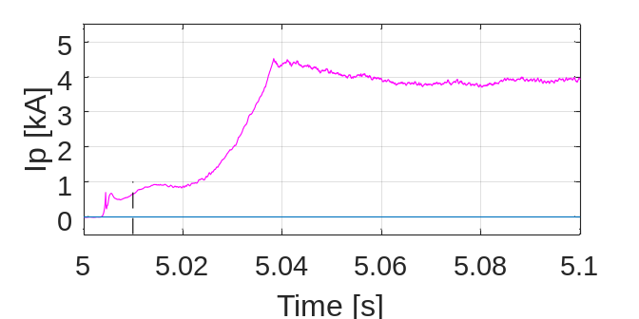
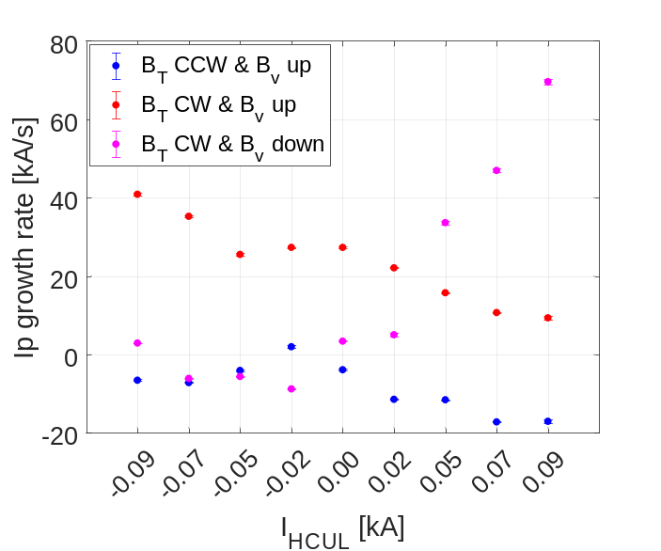
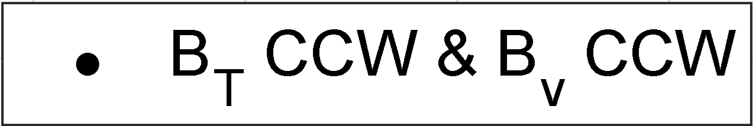



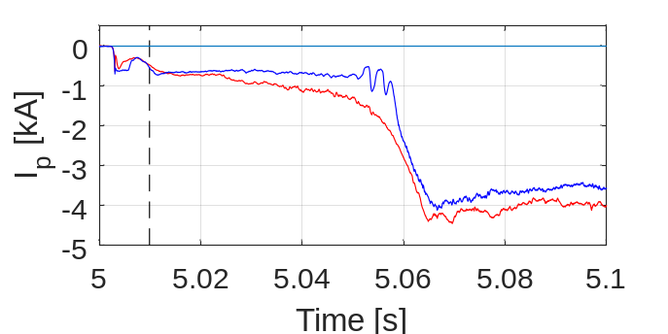


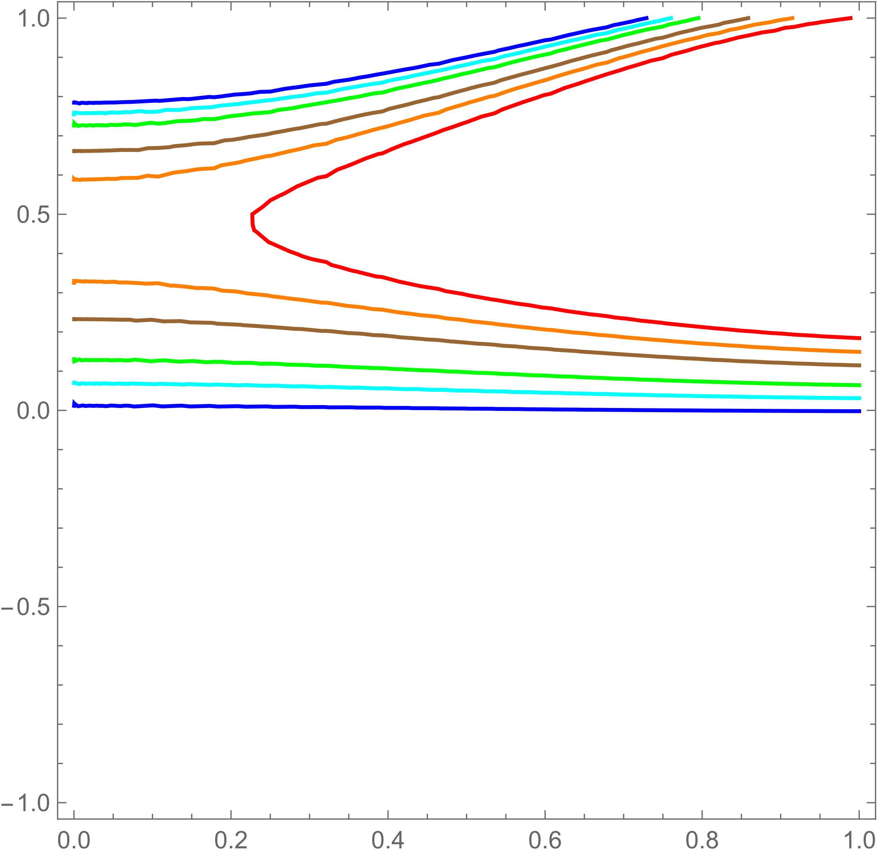
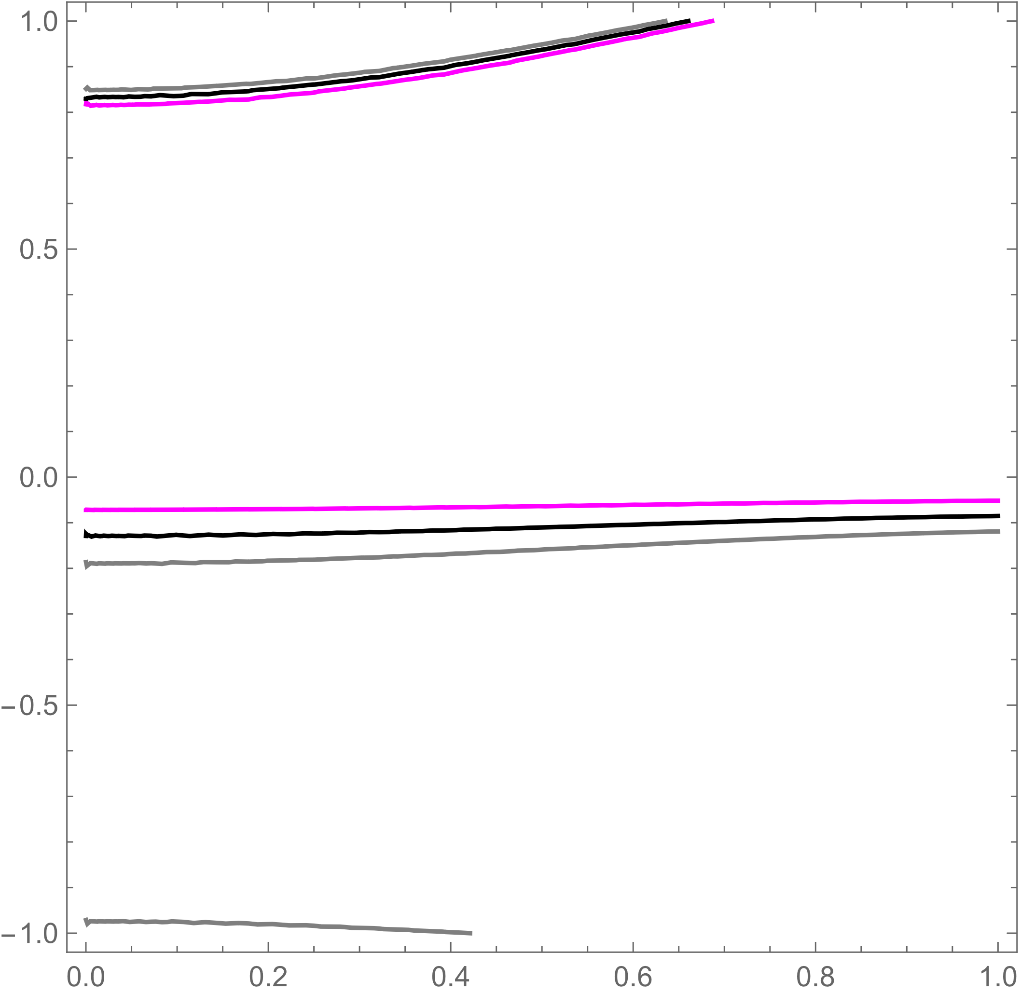

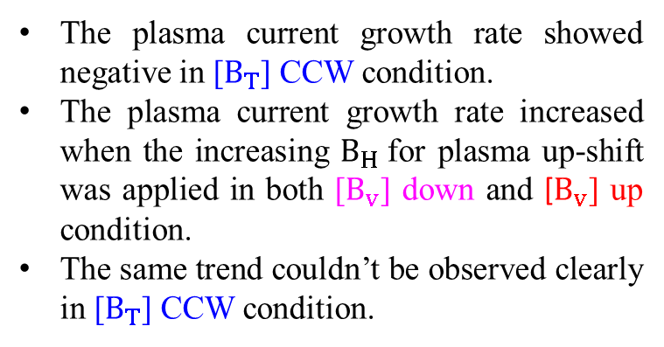

Plasma current behavior in OFS depending on magnetic field configuration
The plasma current showed different behavior in OFS.
[$B_{T}$] CCW
Almost constant in OFS, then jumped suddenly to the maximum.
[$B_{T}$] CW
Gradually increased in OFS until the maximum.
Plasma up-shift
Plasma failed to start-up
The plasma current growth rate showed negative in [$B_{T}$] CCW condition.
The plasma current growth rate increased when the increasing $B_{H}$for plasma up-shift was applied in both [$B_{v}$] down and [$B_{v}$] up condition.
The same trend couldn’t be observed clearly in [$B_{T}$] CCW condition.
1.0
1.0
0.5
Anti-equilibrium
0.5
Anti-equilibrium
Z [m]
Z [m]
0.0
-0.09kA
0.0
-0.07kA
0.05kA
-0.5
Equilibrium
-0.05kA
-0.5
Equilibrium
0.07kA
-0.02kA
0.09kA
-0.00kA
-1.0
0.02kA
-1.0
0.0
0.2
0.4
0.6
0.8
1.0
0.0
0.2
0.4
0.6
0.8
1.0
R [m]
R [m]
10

Slide 11
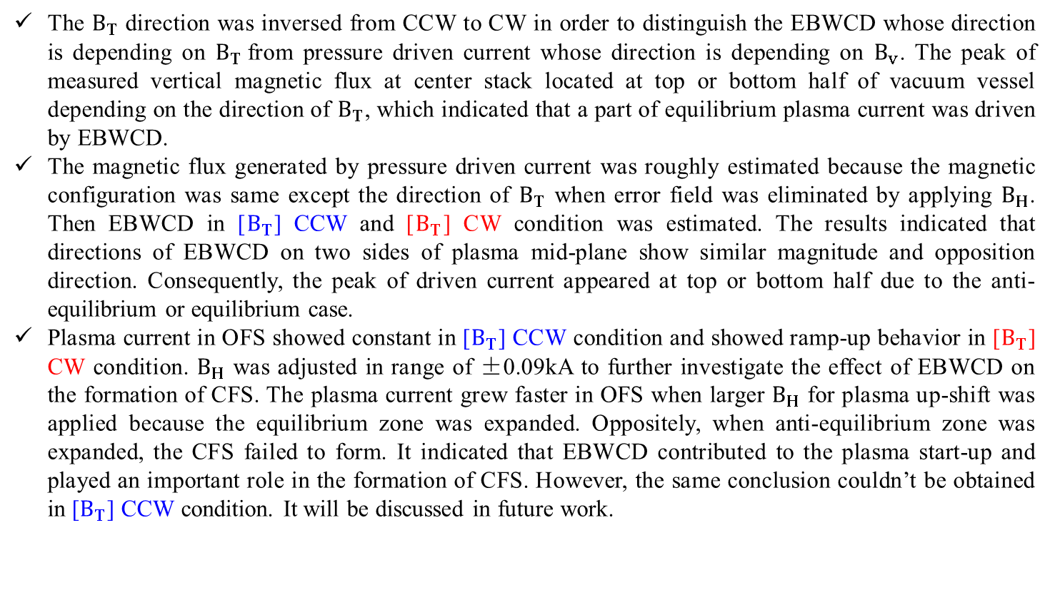
Conclusions
The $B_{T}$ direction was inversed from CCW to CW in order to distinguish the EBWCD whose direction is depending on $B_{T}$from pressure driven current whose direction is depending on $B_{v}$. The peak of measured vertical magnetic flux at center stack located at top or bottom half of vacuum vessel depending on the direction of $B_{T}$, which indicated that a part of equilibrium plasma current was driven by EBWCD.
The magnetic flux generated by pressure driven current was roughly estimated because the magnetic configuration was same except the direction of $B_{T}$ when error field was eliminated by applying $B_{H}$. Then EBWCD in [$B_{T}$] CCW and [$B_{T}$] CW condition was estimated. The results indicated that directions of EBWCD on two sides of plasma mid-plane show similar magnitude and opposition direction. Consequently, the peak of driven current appeared at top or bottom half due to the anti-equilibrium or equilibrium case.
Plasma current in OFS showed constant in [$B_{T}$] CCW condition and showed ramp-up behavior in [$B_{T}$] CW condition. $B_{H}$ was adjusted in range of ±0.09kA to further investigate the effect of EBWCD on the formation of CFS. The plasma current grew faster in OFS when larger $B_{H}$ for plasma up-shift was applied because the equilibrium zone was expanded. Oppositely, when anti-equilibrium zone was expanded, the CFS failed to form. It indicated that EBWCD contributed to the plasma start-up and played an important role in the formation of CFS. However, the same conclusion couldn’t be obtained in [$B_{T}$] CCW condition. It will be discussed in future work.
11

