Slide 1


The 21st International Spherical Torus Workshop, Oct. 31 ~ Nov. 4, 2022, Remote e-conference
Electron Bernstein waves heating experiments in SUNIST
Shouzhi Wang, Binbin Wang, Yi Tan, Zhe Gao
SUNIST, Tsinghua University
Notes:
Ok, Thank you. I’m Shouzhi Wang from Tsinghua University. My talk is about electron Bernstein waves heating experiments in SUNIST.

Slide 2
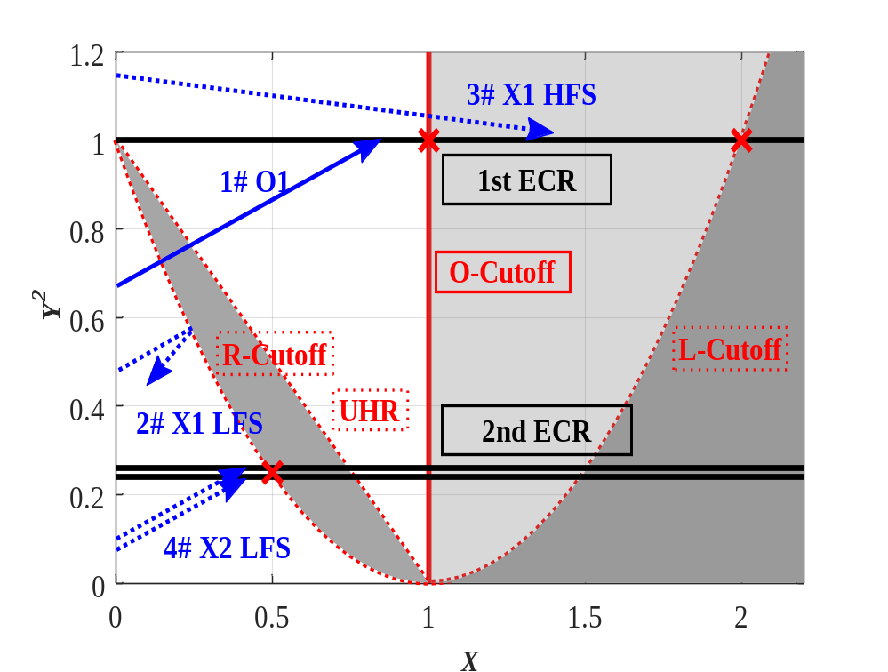
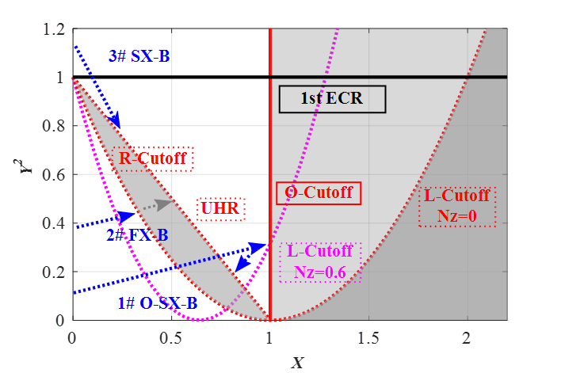
EBW Research Background
ECW heating is limited by the accessibility problem, while EBW can overcome this limit.
EBW can be generated through mode conversion(FX-B, SX-B, O-SX-B).
Notes:
As we kwon, ECW heating is limited by the accessibility problem, while EBW can overcome this density limit. EBW can be generated through mode conversion.

Slide 3
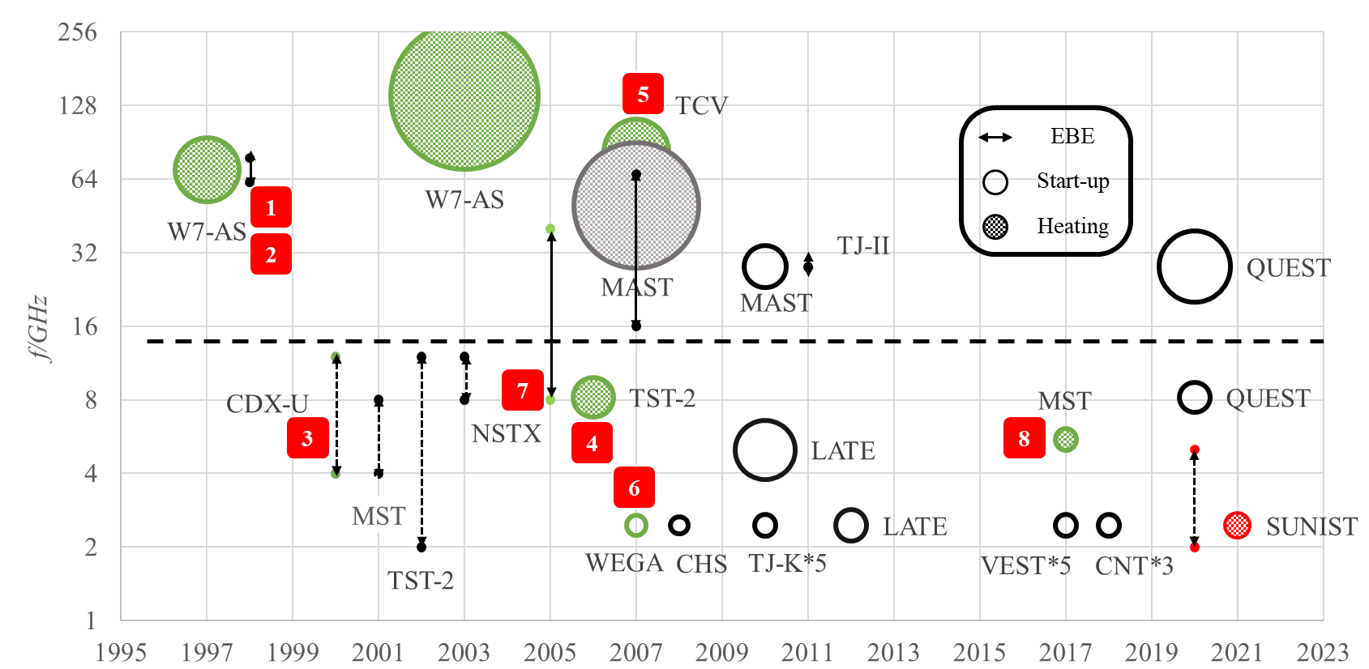
EBW Research Map
EBW heating and emission measurements have been researched broadly and deeply.
There have been 8 PRL articles in about 20 years.
O-SX-B region
8 PRL articles
FX-B region
Notes:
EBW heating and emission measurements have been studied broadly and deeply since 1997. There have been eight PRL articles in about 20 years.

Slide 4
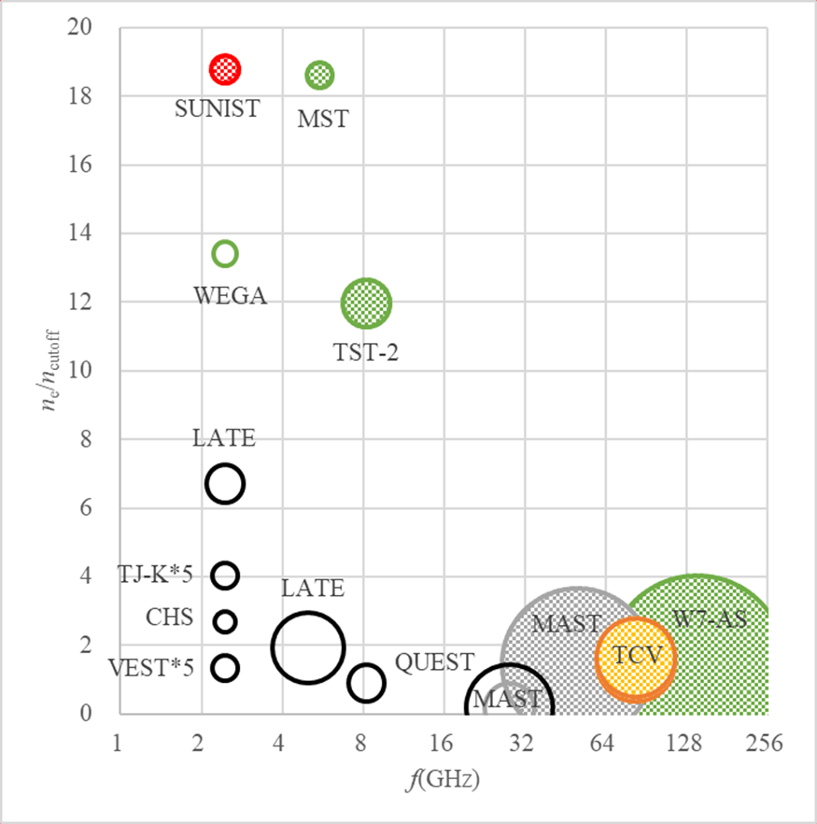
EBW Heating Map
EBW energy injection experiments can be divided into 3 types:
  High frequency & Heating
    Weak accessibility problem
  Low frequency & Start-up
    ECW & EBW mixed
    Complicated and Unclear
  Low frequency & heating
    Significant accessibility problem
    Edge energy deposition mechanisms
      Energetic electrons/Parametric instabilities/Collisional damping/…
Start-up
Heating
Density Limit
Core heting is only found in TST-2’s experiment.
Notes:
The third is low frequency heating experiments, the electron density is about 10 times the cutoff density, EBW is necessary. But there many edge energy deposition methods for EBW such as : energetic electrons absorption, PDI process, collisional damping and so on. In fact ,core heating effect is only found in TST-2‘s experiment.

Slide 5
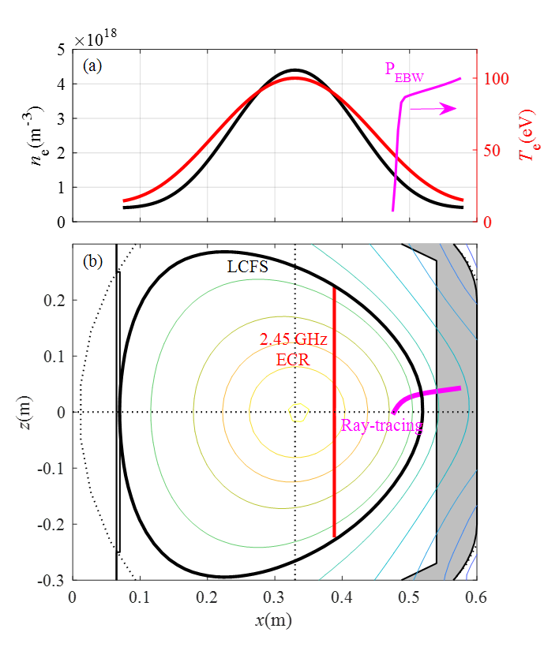
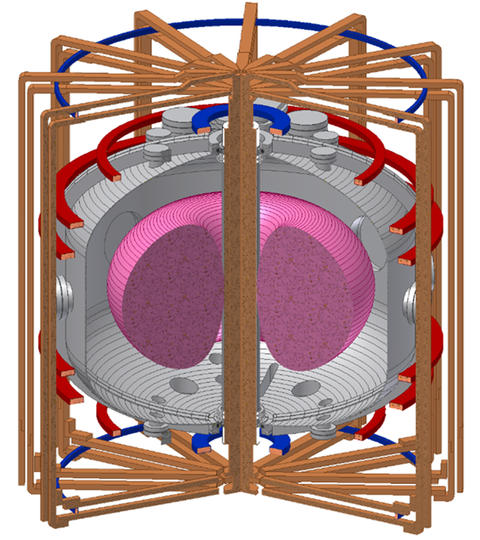
Experimental motivation
Generate EBW in the SUNIST through FX-B(typical L_{n} is 3 cm) method.
Study EBW energy deposition processes in SUNIST.
Investigate how to achieve core heating in SUNIST.
B_{t} | < 0.3T
f_{RF} | 2.45 GHz
n_{e0} | 4e18 m⁻³
n_{e0}/n_{ec} | >10
k₀L_{n} | 1.5

Slide 6
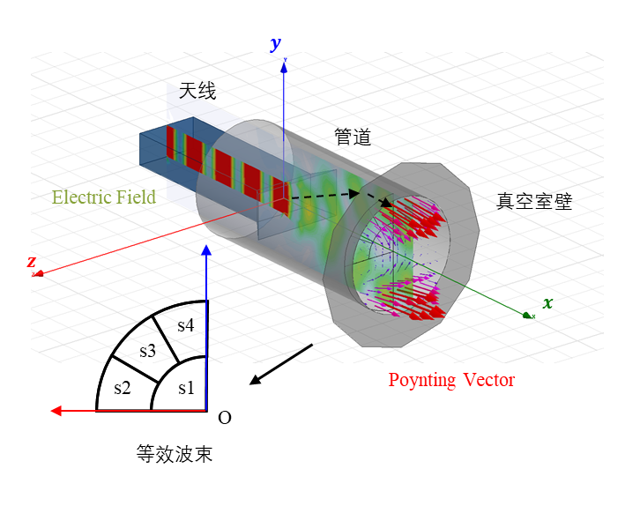
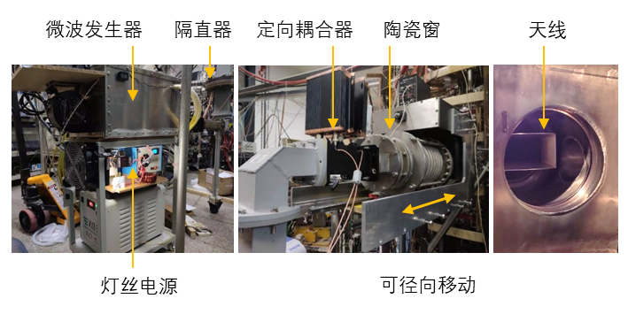
Experimental Setup
Stable and similar discharges with different n_{e} and B_{t} separately.
A 2.45 GHz RF (max@30kW) source with adjustable P_{input} and t_{input}.
A set of numerical calculation tools(HFSS + Full-wave + Ray-tracing).
RF source
Numerical mode to evaluate MC
Notes:
Our experimental setup are as follows:

Slide 7
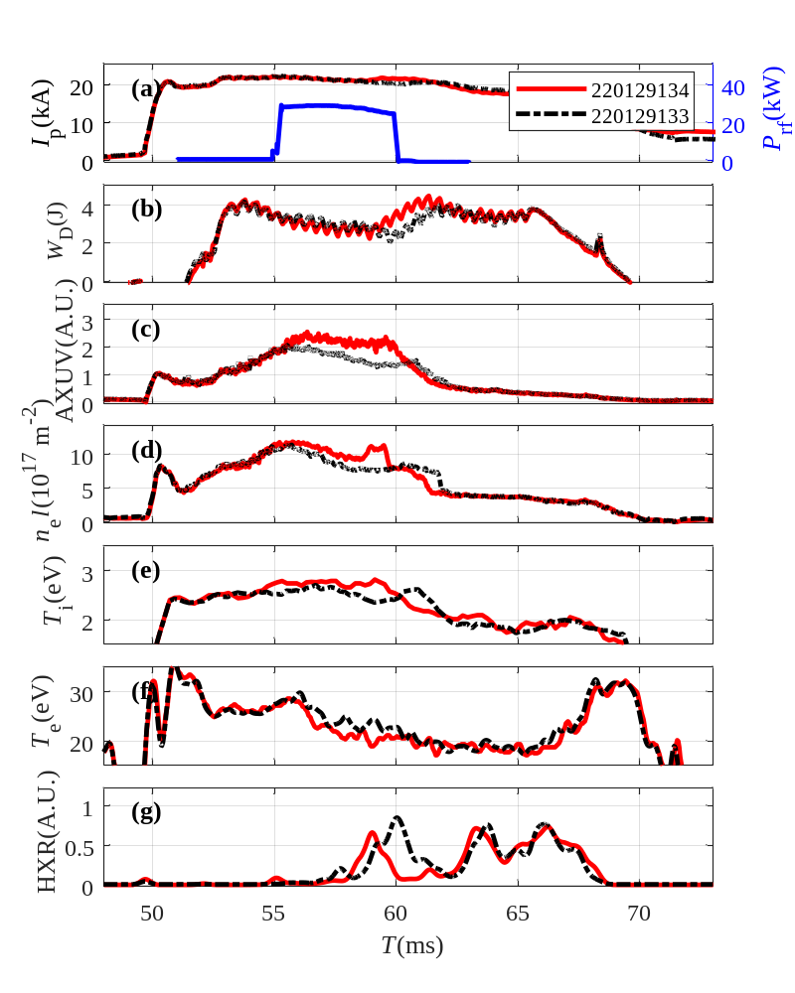
Typical Experimental Results
Diagnostics changes during RF injection can be divided into 3 types:
  Synchronous
    AXUV (c)
    Electron density (d)
    Ion temperature (e)
  Delayed(from Minor disruptions)
    plasma current (a)
    Store Energy (b)
    HXR (g)
  Reversed
    Edge electron temperature (f)
Notes:
This is our result.

Slide 8
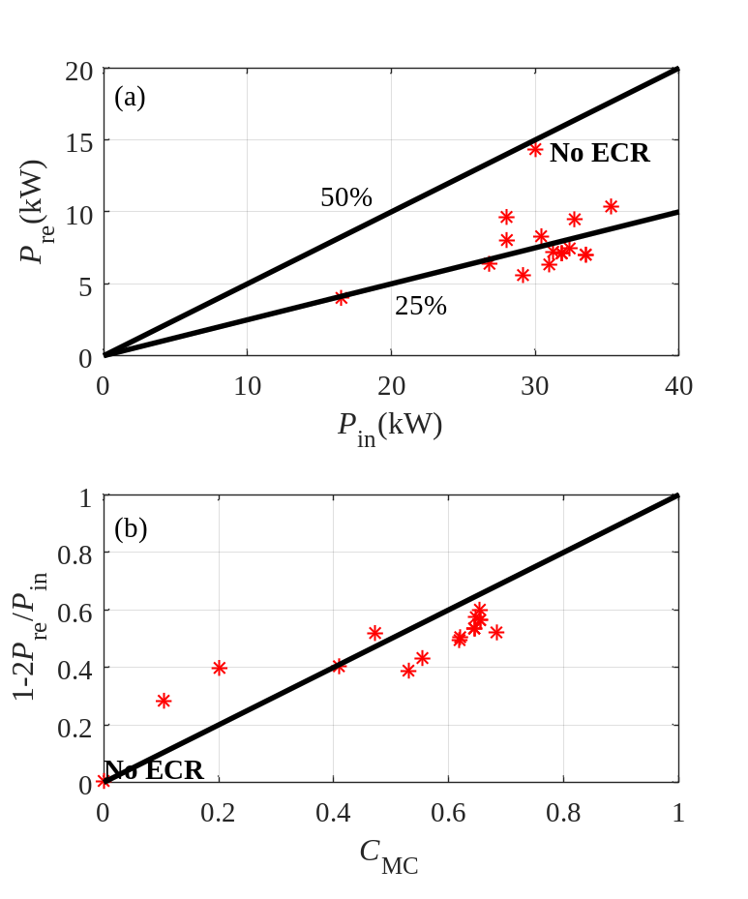
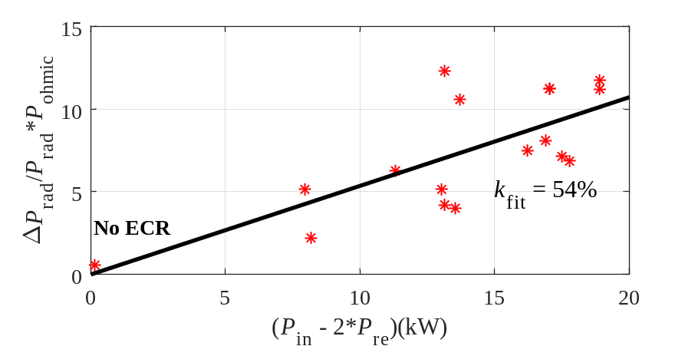

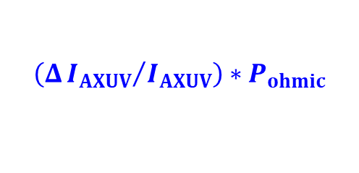

Power Balance
Scans with different n_{e} and B_{t} ,different P_{input} and t_{input} & Compare with numerical results.
(P_{in} – 2P_{re}) is a suitable estimation for P_{EBW} .
The P_{EBW} (max 18 kW) mainly converts to the enhanced radiation loss.
$$\left(Δ{I_{AXUV}}/{I_{AXUV}}\right)∗P_{ohmic}$$
The store energy didn’t increase.
$$P_{EBW}=ΔP_{rad}+{ΔP}_{con}$$
$$k_{MC}≈60\%$$
Numerical results

Slide 9
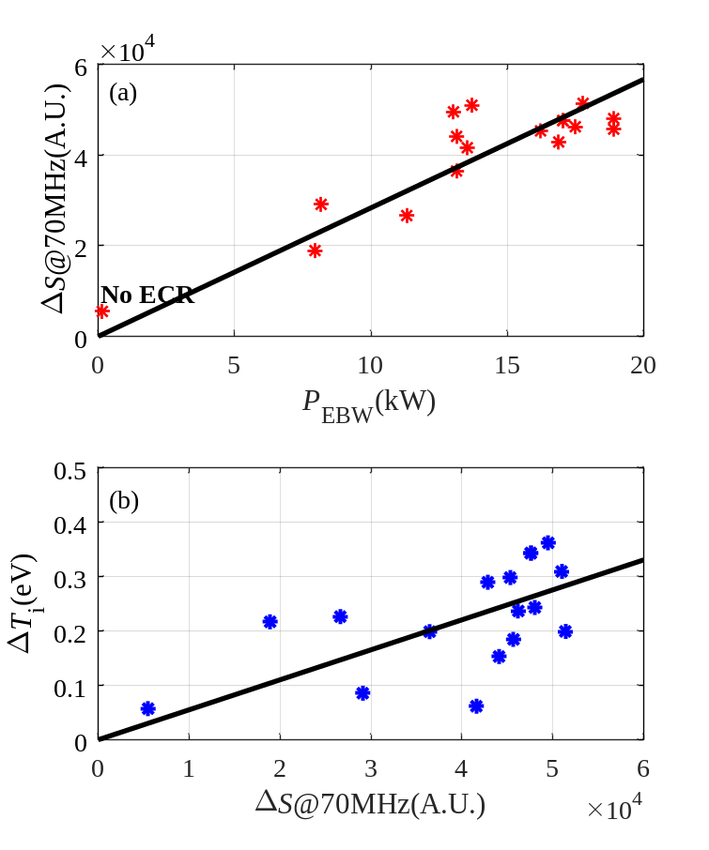
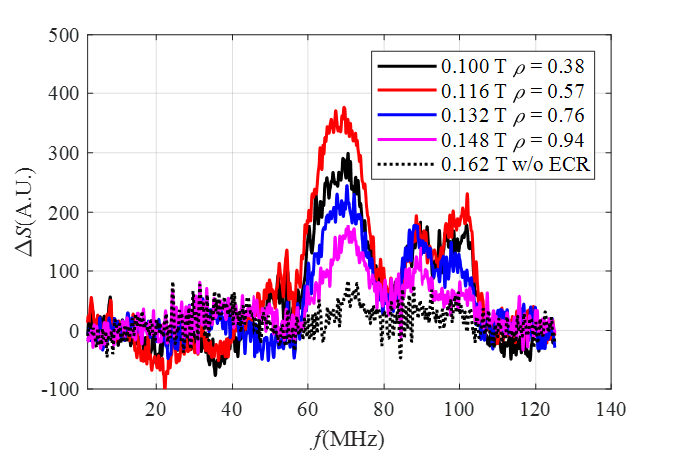

PDI Process
Low hybrid frequency electrostatic perturbations are observed (fit Hansen’s model).
The amplitude of perturbations(ΔS ) is proportional to ΔT_{i} & P_{EBW}.
Based on Hansen 2017

Slide 10
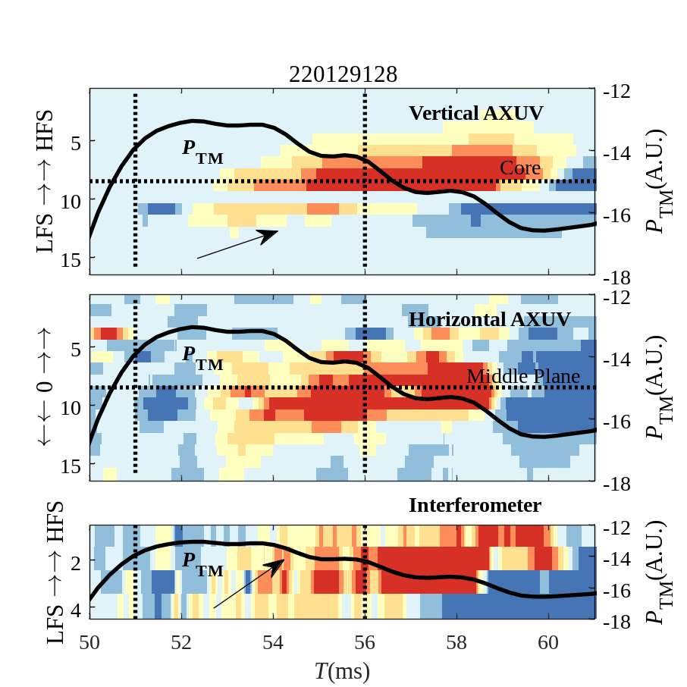
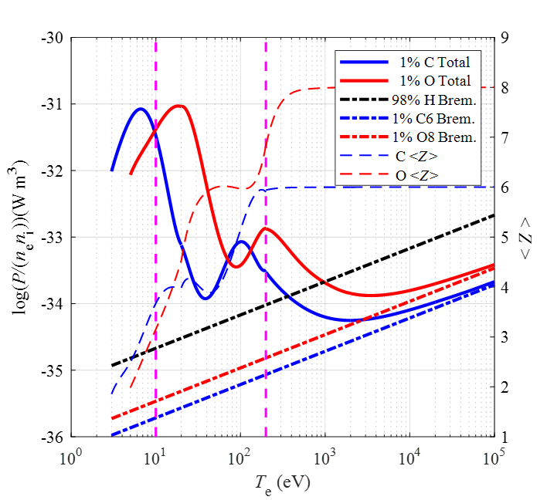
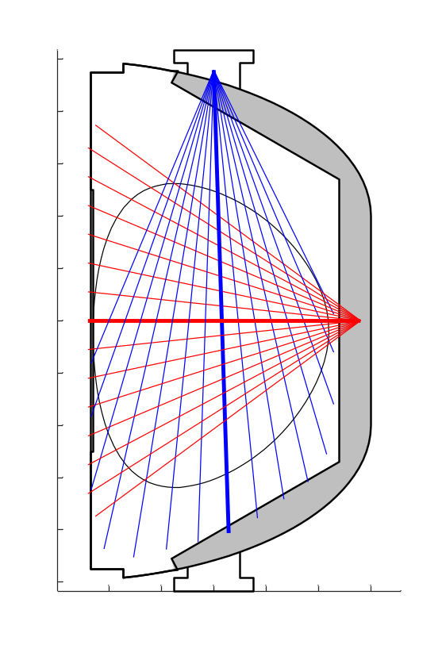
Impurity Accumulation
ΔI_{AXUV} (mainly from C & O instead of electron bremsstrahlung radiation)propagates from edge to the core. ΔI_{AXUV} is modulated by the tearing mode.
ΔI_{AXUV} and Δn_{e} in the core come from edge energy deposition and inward transport instead of direct core heating.
Vertical AXUV
Horizontal AXUV

Slide 11
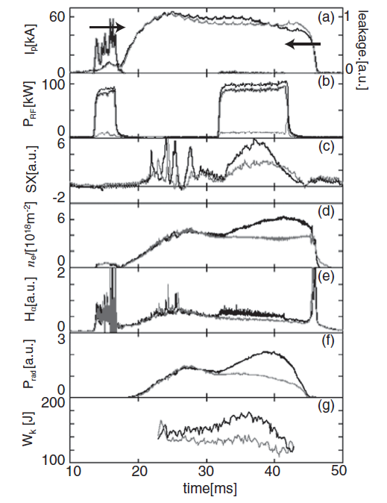
Compared with TST-2
Heating experiment results in SUNIST are similar with TST-2 in 2006(AXUV, core n_{e} , edge Hα).
The heating effect in the core probably comes from PDI in the edge & impurity accumulation process subsequently.
Start-up
Heating
No successful core heating in highly overdense heating.

Slide 12
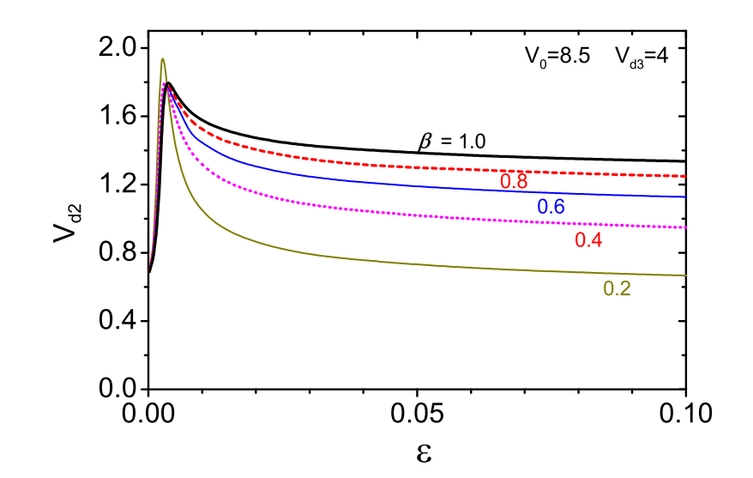
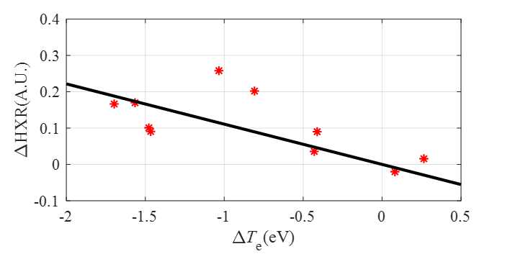
Energetic Electrons Absorption
The edge electron temperature(through Langmuir probe) decrease may be caused by the increased ratio of energetic electrons(Use -ΔT_{e} as a representative).
ΔHXR in the late stage is proportional to -ΔT_{e} during RF injection，which suggests obvious energetic electrons absorption.
Energetic electrons ratio
From S. Biswas

Slide 13
Summary
There are many edge energy deposition mechanisms for EBW.
Core EBW heating in the highly dense plasma is difficult.
RF injection
SUNIST EBW heating process
Mode conversion
(60% in SUNIST)
Impurity accumulation
Core AXUV increment
PDI process
Energetic electrons damping
Energetic electrons increase
T_{e}（Probe）decrease
EBW
Others…

Slide 14
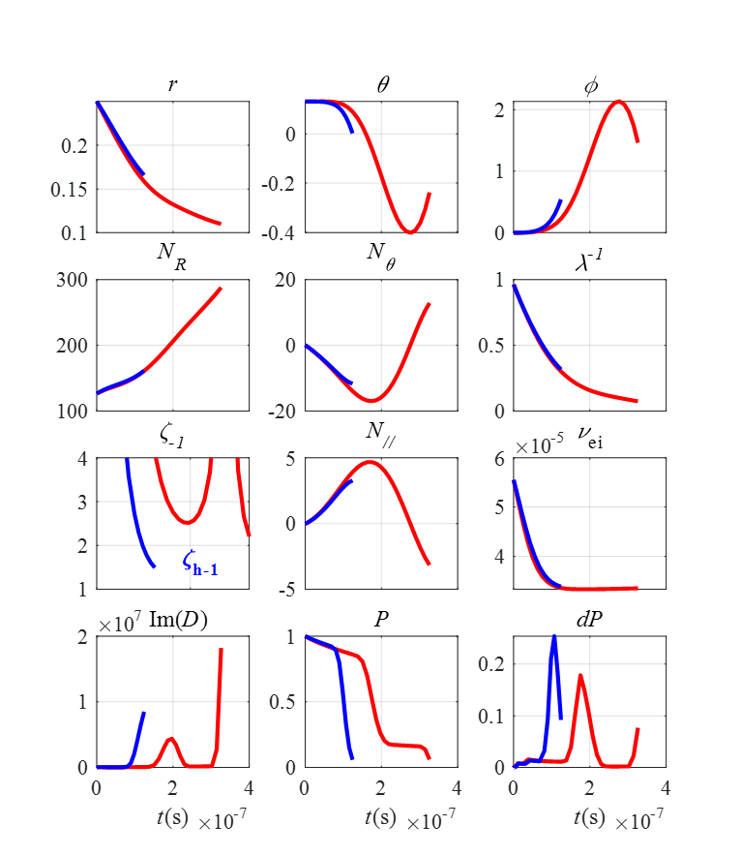
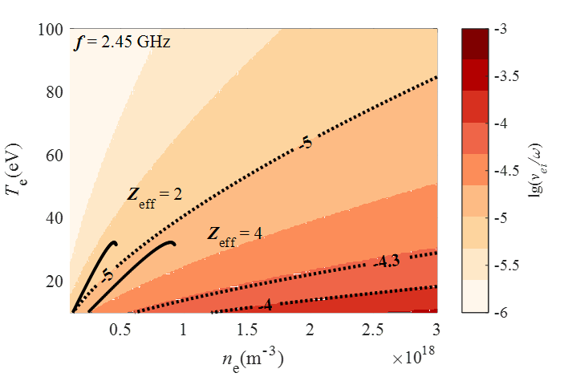
Raytracing results
Raytracing with energetic electrons(500eV 8e17m⁻³)

