Slide 1
Development of full electromagnetic plasma start-up model for analysis and prediction of Ohmic discharges in Versatile Experiment Spherical Torus
ISTW 2022 (Monday, Oct. 31 – Friday, Nov. 4)
The 21st International Spherical Torus Workshop
Seongcheol Kim¹, Hongsik Yun¹, Hyun-Tae Kim², Jae Young Jang^{1,3}, Jung-Hwa Kim¹, TaeHee Eom¹ and Y. S. Hwang¹
¹Department of Nuclear Engineering, Seoul National University, Korea
²United Kingdom Atomic Energy Authority, Culham Science Centre, United Kingdom of Great Britain and Northern Ireland
³Korea Institute of Fusion Energy, Daejeon, Korea

Slide 2
Contents
1. Introduction
2. Plasma current ramp-up phase
3. Plasma burn-through phase
4. Reproduction of two Ohmic discharges with different loop voltage using reduced start-up model
5. Summary and Future works

Slide 3
1. Introduction
1.1. Background & Motivation
1.2. Research objectives

Slide 4
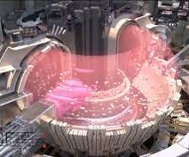
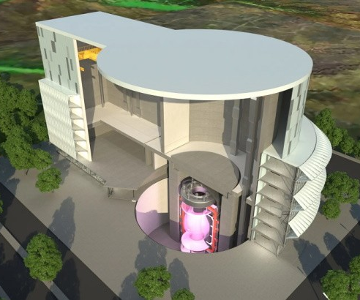
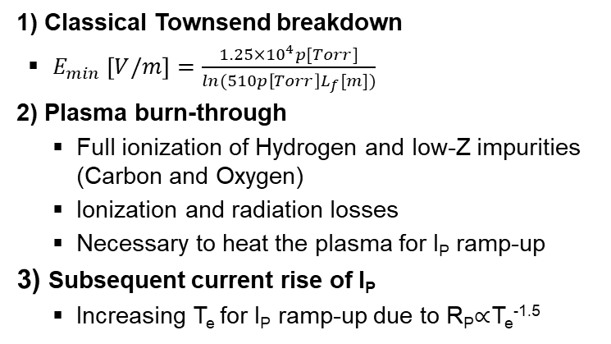
1. Introduction
1.1. Background & Motivation
Prefill neutral pressure
Feedback control
[Nucl. Fusion 39 (1999) 2577]
Plasma
breakdown
Plasma
burn-through
I_{P} ramp-up
    1) Classical Townsend breakdown
    $E_{min} \left[V/m\right]=\frac{1.25×10^{4}p[Torr]}{ln(510p\left[Torr\right]L_{f}[m])}$
  2) Plasma burn-through
    Full ionization of Hydrogen and low-Z impurities (Carbon and Oxygen)
    Ionization and radiation losses
    Necessary to heat the plasma for I_{P} ramp-up
  3) Subsequent current rise of I_{P}
    Increasing T_{e} for I_{P} ramp-up due to R_{P}$∝$T_{e}^{-1.5}
Plasma current
Loop
voltage
Hydrogen-α
Tokamak start-up diagram
Start-up issues in future fusion devices
https://www.iter.org/
https://step.ukaea.uk/
1) Use of superconducting magnets for PF coils
2) Thick vacuum vessel
→ Limited toroidal electric field ~0.3 V/m
Fusion reactor based on spherical tokamak
→ Restriction of central solenoid coil space in center stack
ITER
STEP
Necessity of reliable tokamak start-up modelling
Operation scenarios for successful start-up
Design parameters in a new device

Slide 5
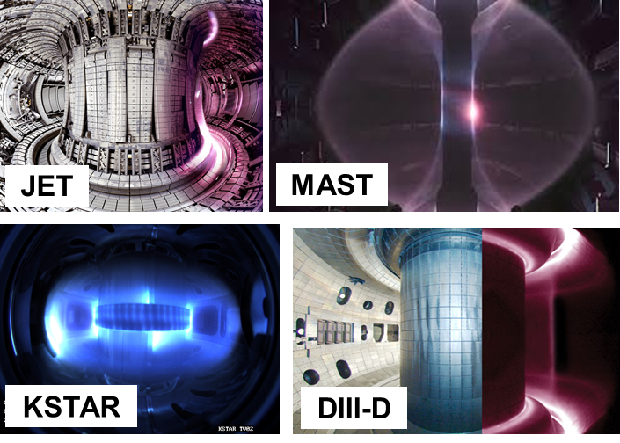
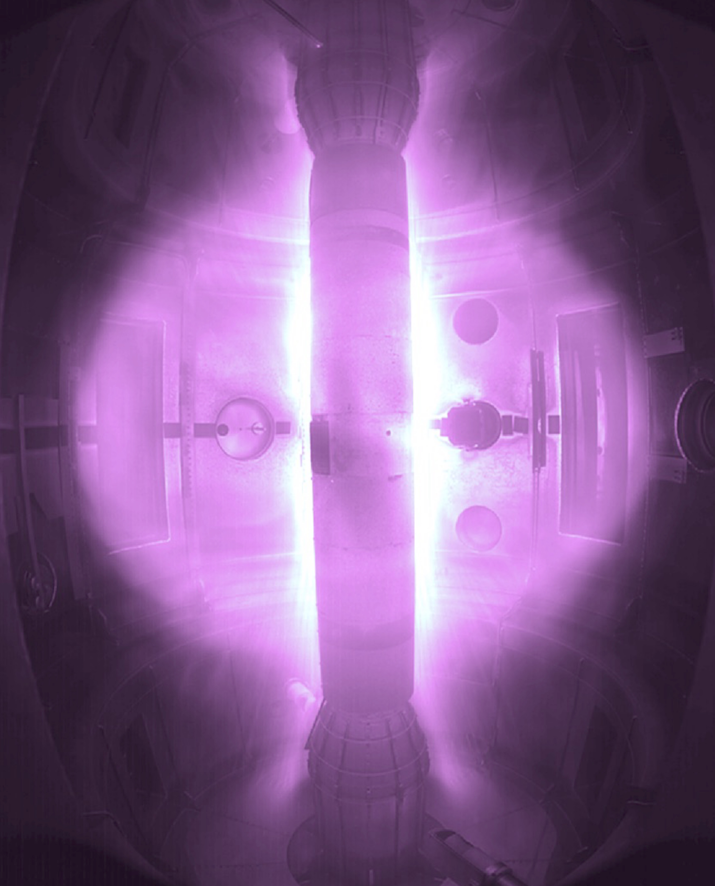
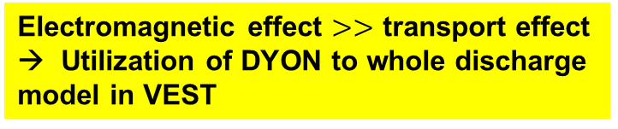
1. Introduction
1.2. Research objectives
Nucl. Fusion 52 (2012) 103016
Nucl. Fusion 53 (2013) 083024
Research objectives: overall structure
Development of start-up model with DYON
DYON
Zero dimensional burn-through simulator (particle + power balance & circuit model)
Dedicated physical model (atomic, confinement, PSI, ECH models)
Experimentally validated at several machines (JET & MAST)
Compact ST devices
VEST
Model development for extension of utility
Spherical torus plasma
Short pulse discharges (< 30ms)
Validation diagnostics targeted to relatively low performance plasmas
Electromagnetic effect $>>$ transport effect
→ Utilization of DYON to whole discharge model in VEST
Focus on the plasma burn-through and current ramp-up phases
Interpretative
Predictive
Reproduction and analysis of start-up in VEST discharges
Application to the
VEST-U for ~300 kA OH discharge

Slide 6
2. Plasma current ramp-up phases
2.1. Magnetic equilibrium reconstruction
2.2. Electric circuit parameters in circuit model
2.3. Target discharge and simulation results

Slide 7
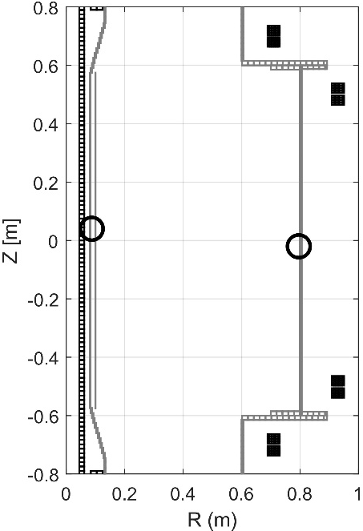
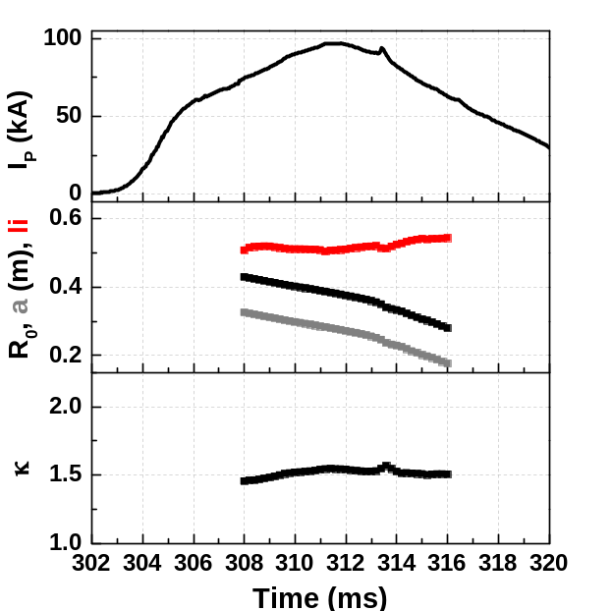
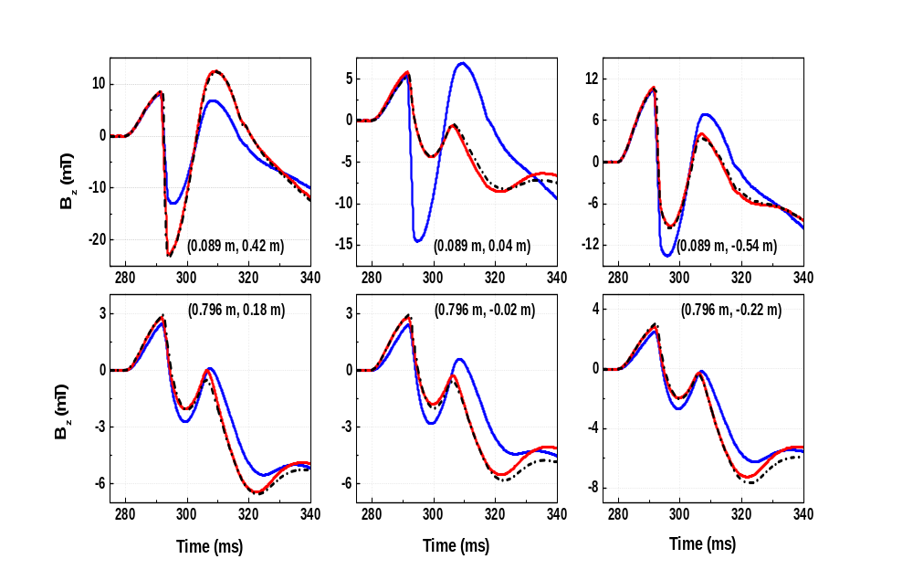
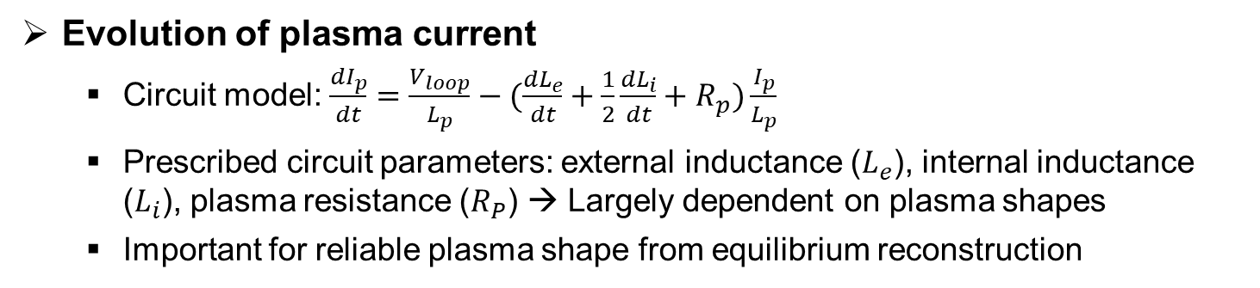
2. Plasma current ramp-up phases
2.1. Magnetic equilibrium reconstruction
Evolution of plasma current
  Circuit model: $\frac{{dI}_{p}}{dt}=\frac{V_{loop}}{L_{p}}−(\frac{{dL}_{e}}{dt}+\frac{1}{2}\frac{{dL}_{i}}{dt}+R_{p})\frac{I_{p}}{L_{p}}$
  Prescribed circuit parameters: external inductance ($L_{e}$), internal inductance ($L_{i}$), plasma resistance ($R_{P}$) → Largely dependent on plasma shapes
  Important for reliable plasma shape from equilibrium reconstruction
  Equilibrium reconstruction in VEST
    Typical EFIT-like Grad-Shafranov solver with external magnetics constraints
    Eddy current model with effective wall resistance compensation
Measurements
Synthetic (before Rw compens.)
Synthetic (after Rw compens.)
B_{z} (mT)
Time (ms)

Slide 8
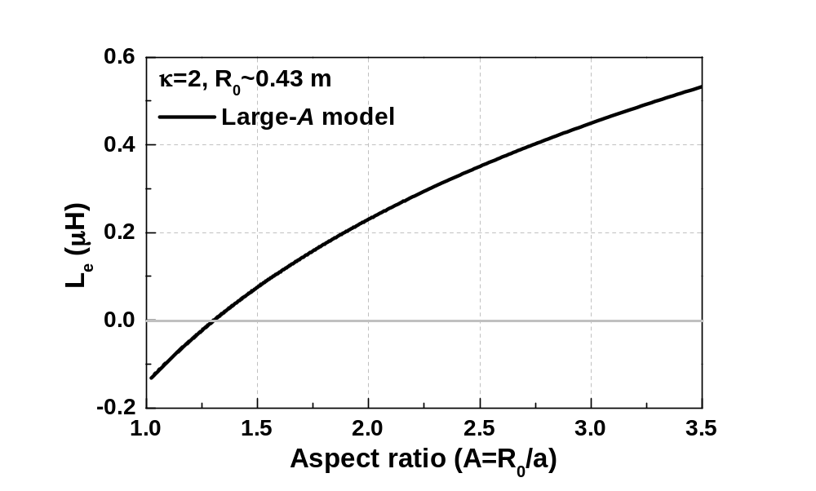
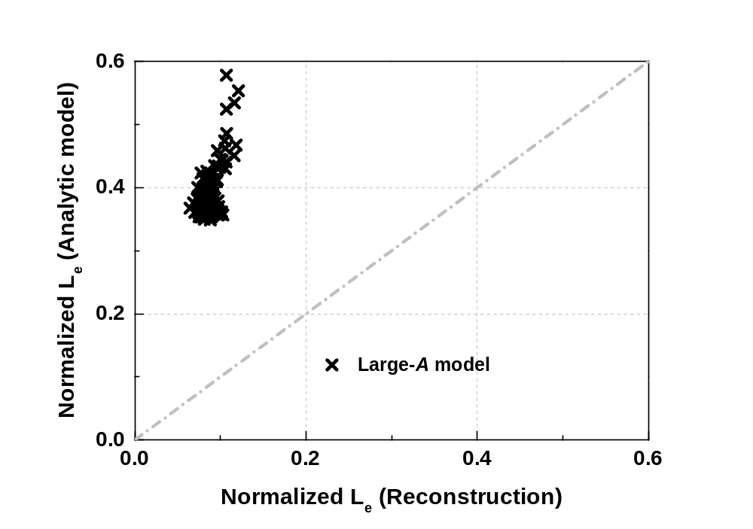
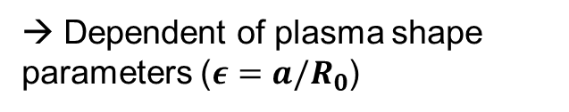
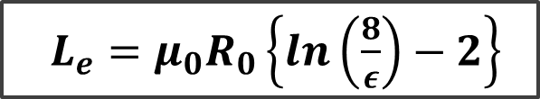

2. Plasma current ramp-up phases
2.2. Electric circuit parameters in circuit model
Plasma external inductance model
High aspect ratio L_{e} model (previous DYON model)
$L_{e}=μ_{0}R_{0}\left\{\ln\left(\frac{8}{ε}\right)−2\right\}$
→ Dependent of plasma shape parameters ($ε=a/R_{0}$)
High-A model
$$ψ_{L_{e}}/(μ_{0}I_{P}R_{0})$$
VEST
Pegasus
Typical A range in ST
Comparison of plasma external inductance with A between two models

Slide 9
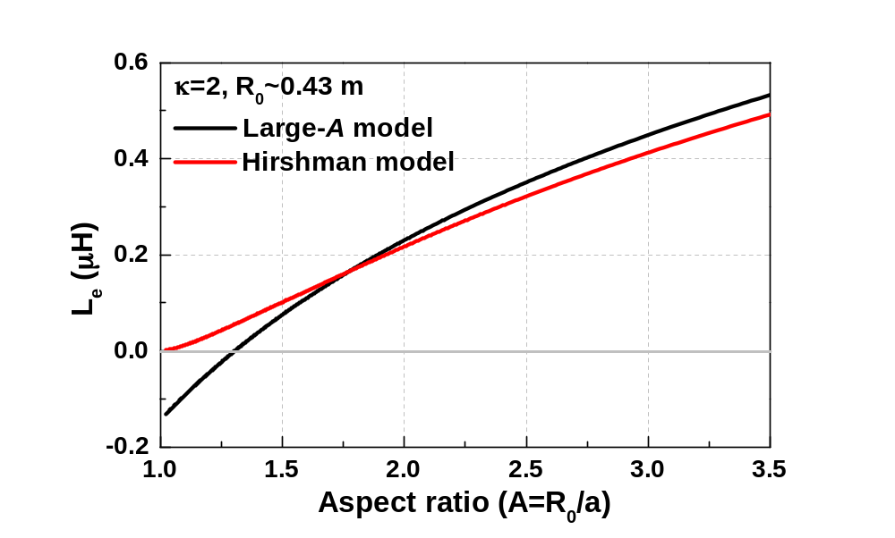
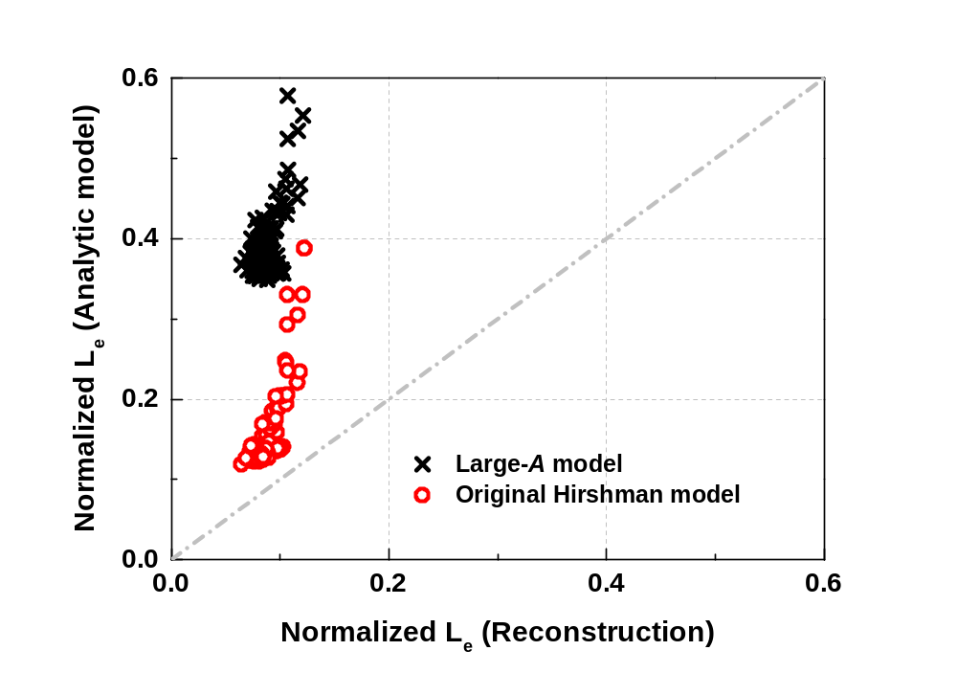
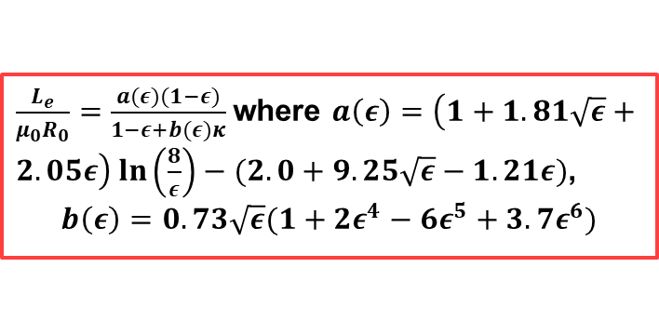
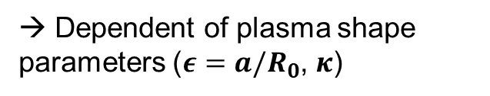
2. Plasma current ramp-up phases
2.2. Electric circuit parameters in circuit model
Plasma external inductance model
[Phys. of Fluids 29 (1986) 790]
High aspect ratio L_{e} model (previous DYON model)
Low aspect ratio L_{e} model derived by Hirshman [Ref]
$L_{e}=μ_{0}R_{0}\left\{\ln\left(\frac{8}{ε}\right)−2\right\}$
$\frac{L_{e}}{μ_{0}R_{0}}=\frac{a(ε)(1−ε)}{1−ε+b(ε)κ}$where $a\left(ε\right)=\left(1+1.81\sqrt{ε}+2.05ε\right)\ln\left(\frac{8}{ε}\right)−(2.0+9.25\sqrt{ε}−1.21ε)$,
$$b\left(ε\right)=0.73\sqrt{ε}(1+2ε^{4}−6ε^{5}+3.7ε^{6})$$
→ Dependent of plasma shape parameters ($ε=a/R_{0}$, $κ$)
High-A model vs Hirshman model
$$ψ_{L_{e}}/(μ_{0}I_{P}R_{0})$$
VEST
Pegasus
Typical A range in ST
Comparison of plasma external inductance with A between two models

Slide 10
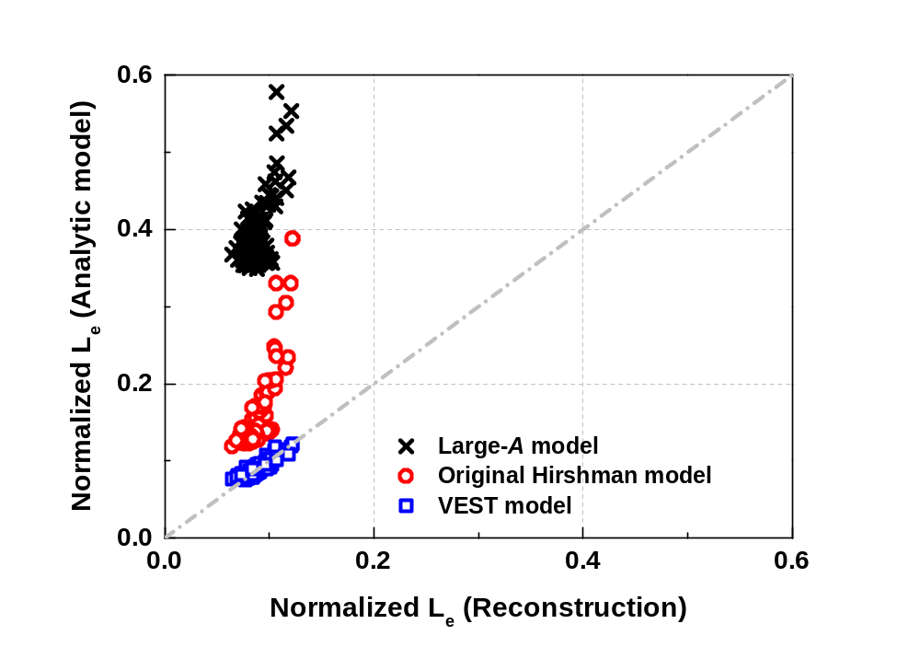
2. Plasma current ramp-up phases
2.2. Electric circuit parameters in circuit model
Plasma external inductance model
[Nucl. Fusion 58 (2018) 076011]
High aspect ratio L_{e} model (previous DYON model)
Low aspect ratio L_{e} model derived by Hirshman [Ref]
$L_{e}=μ_{0}R_{0}\left\{\ln\left(\frac{8}{ε}\right)−2\right\}$
$\frac{L_{e}}{μ_{0}R_{0}}=\frac{a(ε)(1−ε)}{1−ε+b(ε)κ}$where $a\left(ε\right)=\left(1+1.81\sqrt{ε}+2.05ε\right)\ln\left(\frac{8}{ε}\right)−(2.0+9.25\sqrt{ε}−1.21ε)$,
$$b\left(ε\right)=0.73\sqrt{ε}(1+2ε^{4}−6ε^{5}+3.7ε^{6})$$
→ Dependent of plasma shape parameters ($ε=a/R_{0}$, $κ$)
High-A model vs Hirshman model
Modified L_{e} model using VEST equilibrium
$$ψ_{L_{e}}/(μ_{0}I_{P}R_{0})$$
VEST
Pegasus
Typical A range in ST
Comparison of plasma external inductance with A between two models

Slide 11
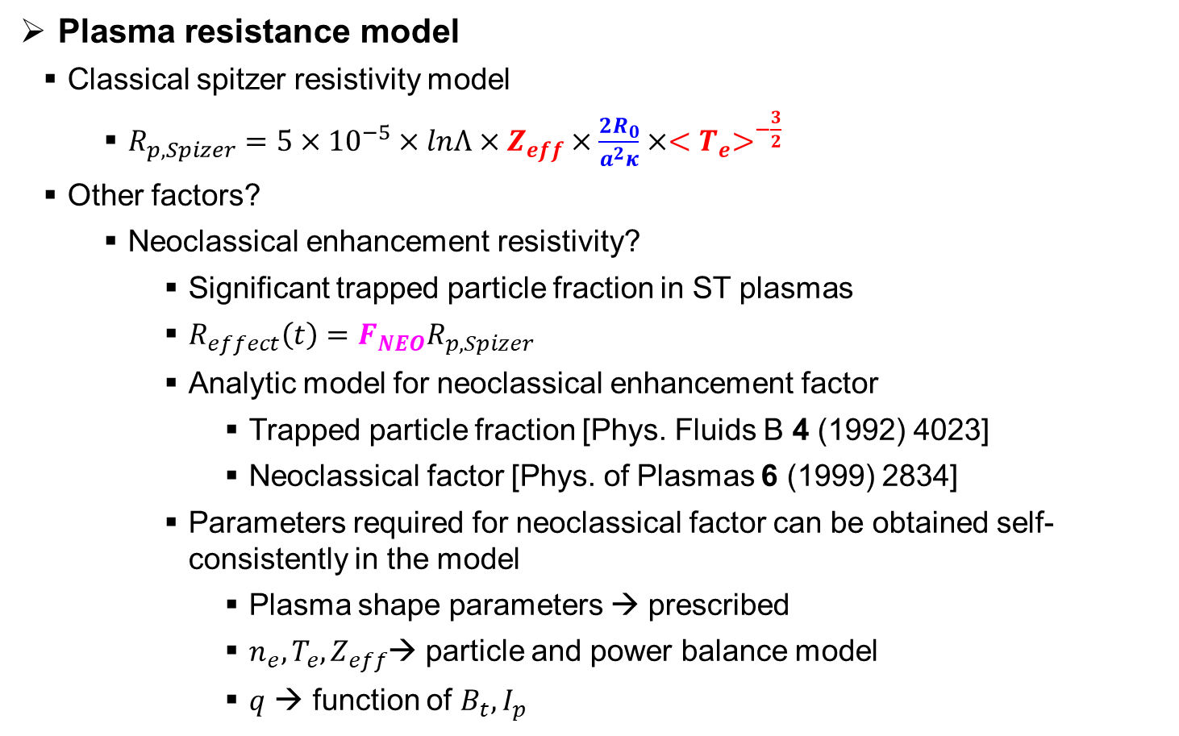
2. Plasma current ramp-up phases
2.2. Electric circuit parameters in circuit model
Plasma resistance model
  Classical spitzer resistivity model
    $R_{p,Spizer}=5×{10}^{−5}×lnΛ×Z_{eff}×\frac{2R_{0}}{a^{2}κ}×{<T}_{e}>^{−\frac{3}{2}}$
    Other factors?
      Neoclassical enhancement resistivity?
        Significant trapped particle fraction in ST plasmas
        $R_{effect}\left(t\right)=F_{NEO}R_{p,Spizer}$
        Analytic model for neoclassical enhancement factor
          Trapped particle fraction [Phys. Fluids B 4 (1992) 4023]
          Neoclassical factor [Phys. of Plasmas 6 (1999) 2834]
        Parameters required for neoclassical factor can be obtained self-consistently in the model
          Plasma shape parameters → prescribed
          $n_{e}, T_{e}, Z_{eff}$→ particle and power balance model
          $q$ → function of $B_{t}, I_{p}$
Prescribed plasma shapes
Self-consistently obtained by power & particle balance models

Slide 12
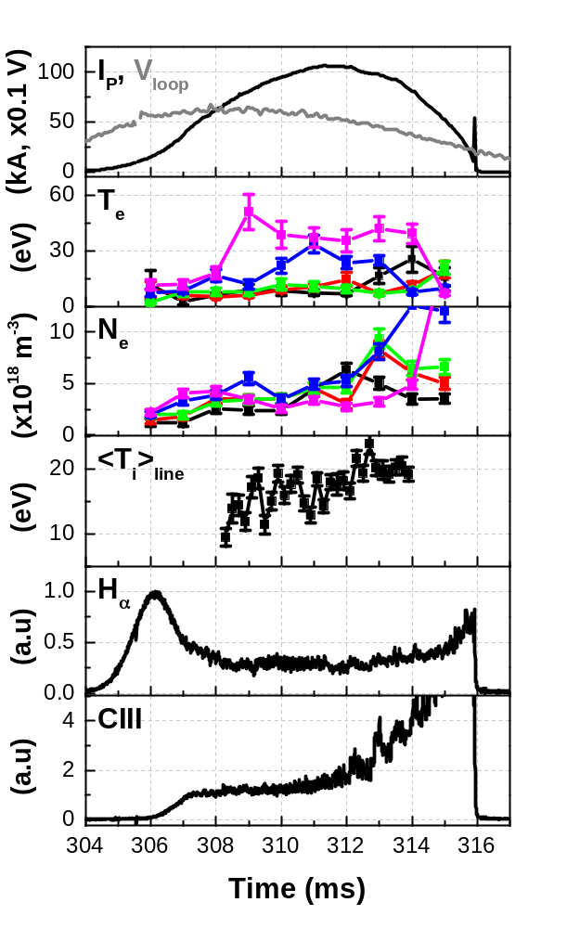
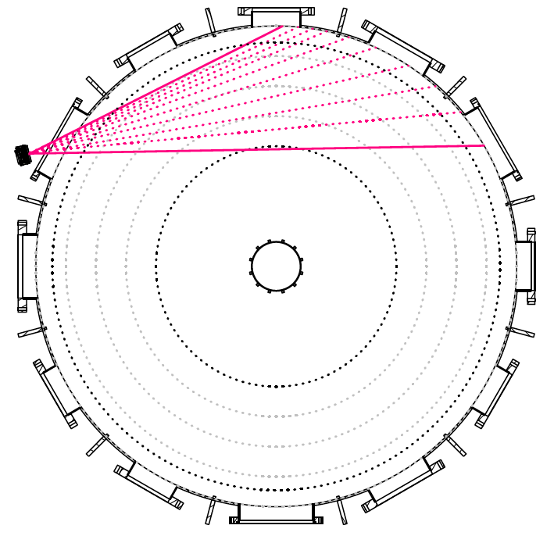
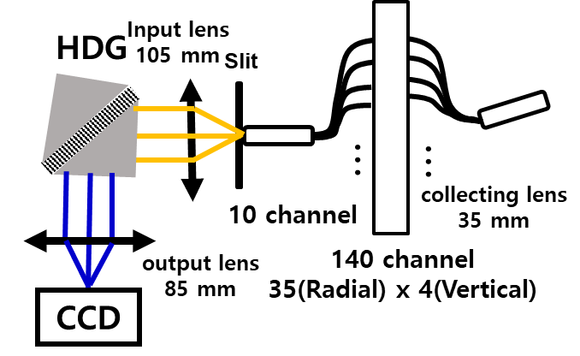

2. Plasma current ramp-up phases
2.3. Target discharge and simulation results
Target discharge and validation diagnostics
Typical pure Ohmic discharge in VEST (Shot#37430)
  Toroidal field at R~0.4 m: 0.18 T
  Neutral prefill pressure (H₂): 0.04-0.05 mTorr
  Validation diagnostics
Toroidal view
Ion Doppler spectroscopy (T_{i})
Line of sight
0.39 – 0.71 m
(Only using 0.39 m)
TS local points
0.475, 0.425, 0.37, 0.31, 0.255 m
Polychromator + Fast digitizer
$$25.4 °$$
Laser system
Thomson scattering (T_{e}, N_{e})
Optical filterscope (H_{α}, CIII)

Slide 13
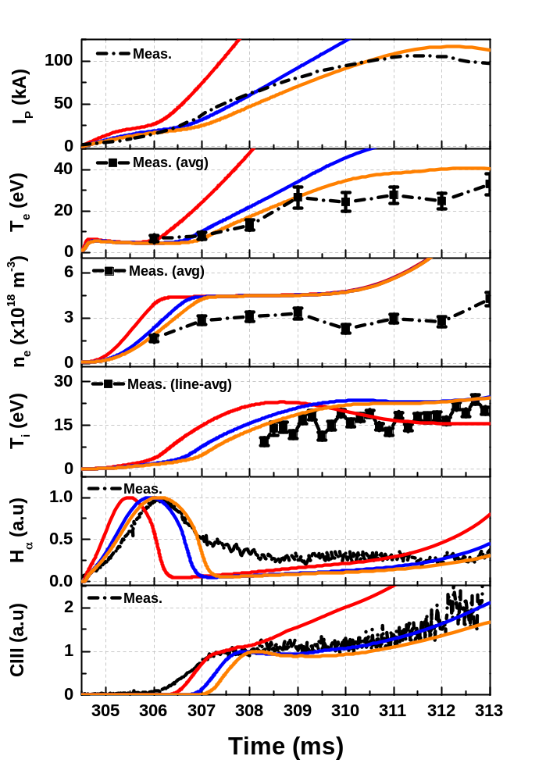
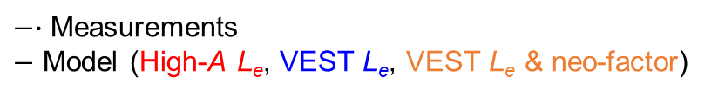
2. Plasma current ramp-up phases
2.3. Target discharge and simulation results
Start-up model results
$−∙$ Measurements
$−$ Model (High-A L_{e}, VEST L_{e}, VEST L_{e} & neo-factor)
Extremely high and fast evolution especially in I_{P} and T_{e} compared to measurements with high-A L_{e} model due to the low external inductance
Invalid in low aspect ratio plasmas
Relaxed evolution parameters compared to those of High-A L_{e} results due to reduced plasma inductance
Difficult to simulate the degradation of I_{P} observed in the measurement
I_{P} degradation
Reasonable agreements by considering neoclassical enhancement factor

Slide 14
3. Plasma burn-through phases
3.1. Townsend model with full electromagnetic simulation
3.2. Preliminary results with Townsend model

Slide 15
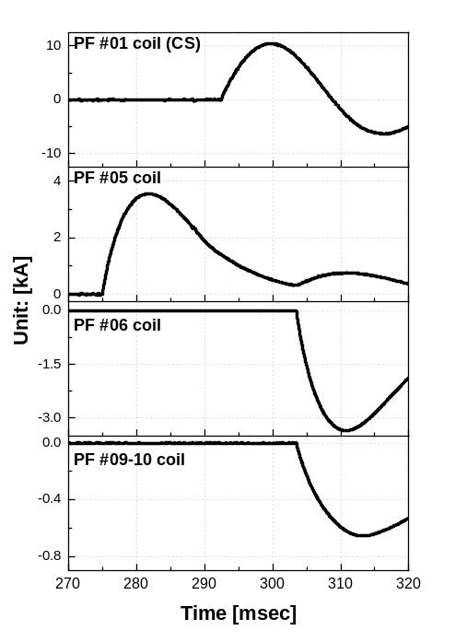
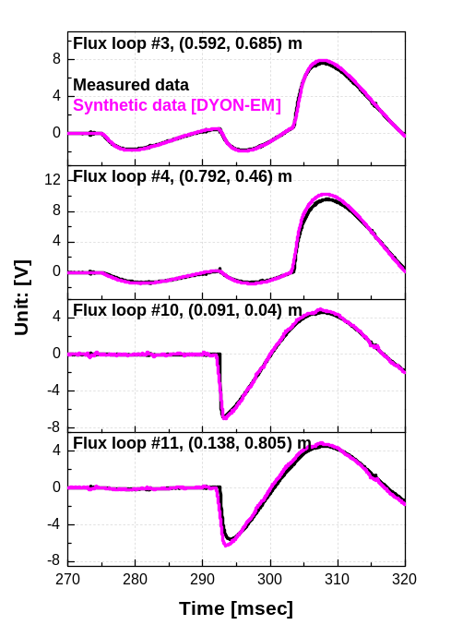
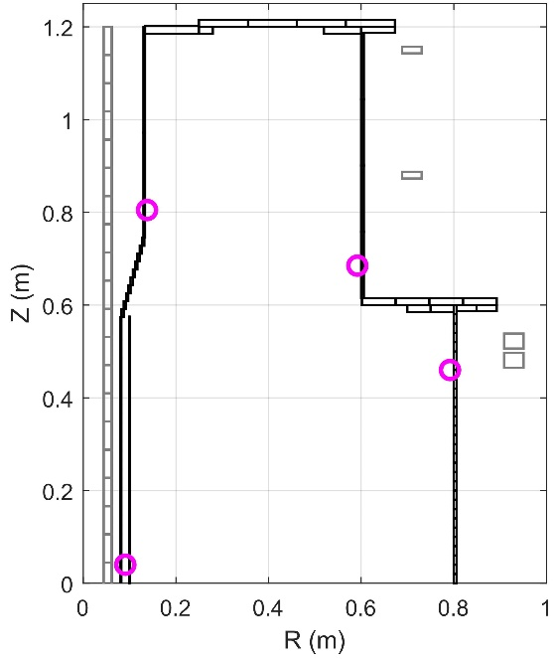
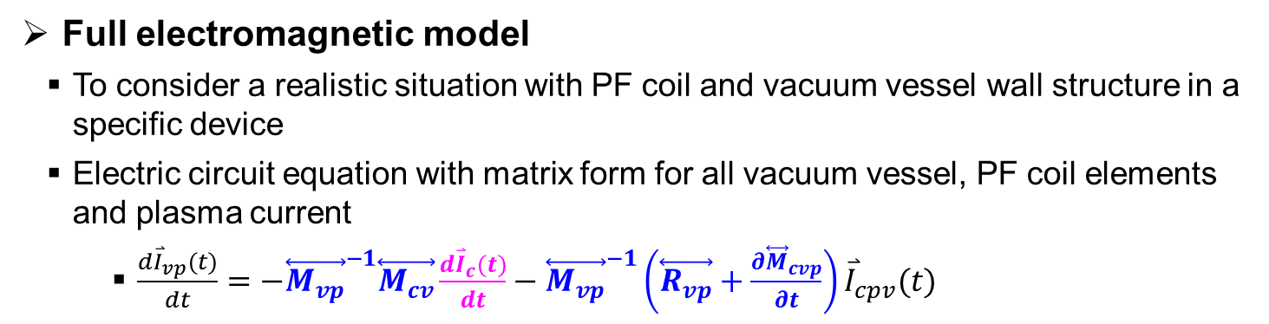
3. Plasma current ramp-up phases
3.1. Townsend model with full electromagnetic simulation
Full electromagnetic model
  To consider a realistic situation with PF coil and vacuum vessel wall structure in a specific device
  Electric circuit equation with matrix form for all vacuum vessel, PF coil elements and plasma current
    $\frac{d{\overset{⃑}{I}}_{vp}(t)}{dt}=−{\overset{⃡}{M_{vp}}}^{−1}\overset{⃡}{M_{cv}}\frac{d{\overset{⃑}{I}}_{c}(t)}{dt}−{\overset{⃡}{M_{vp}}}^{−1}\left(\overset{⃡}{R_{vp}}+\frac{∂{\overset{⃡}{M}}_{cvp}}{∂t}\right){\overset{⃑}{I}}_{cpv}(t)$
[Nucl. Fusion 62 (2022) 126012]
v: vessel
c: PF coil
p: plasma
Load PF & wall geometry, generate circuit matrix
Load PF coil current waveform
Synthetic flux loop data
PF #01
PF #05
[Shot#34497]
Validation of electromagnetic model of DYON in vacuum discharge of VEST
PF #06
Solving
Circuit eqs.
PF #09-PF #10
Flux loops

Slide 16
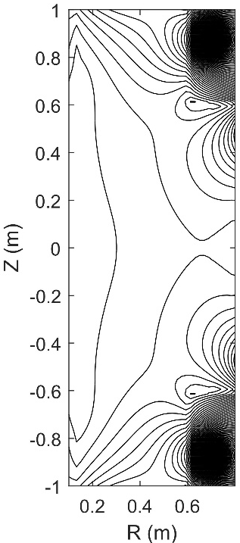
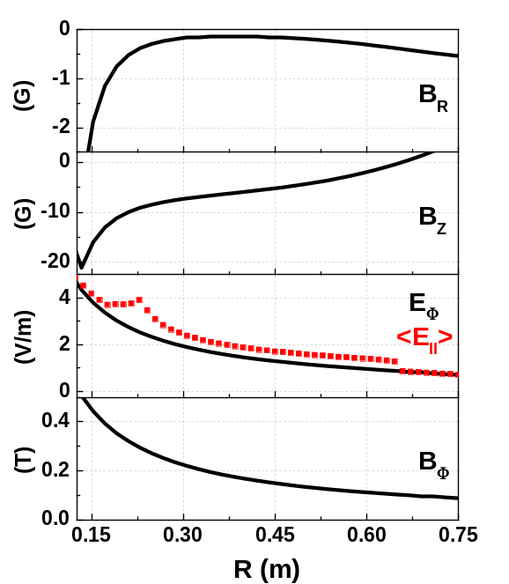
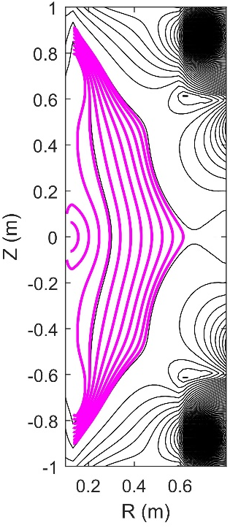
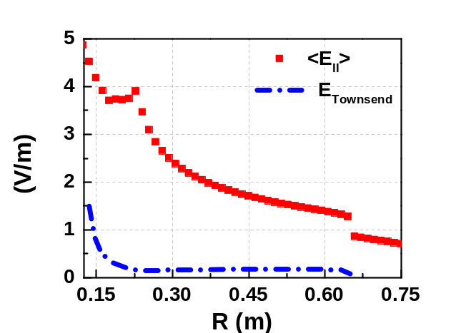
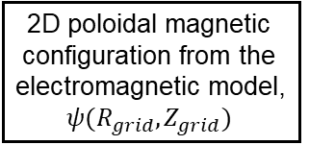
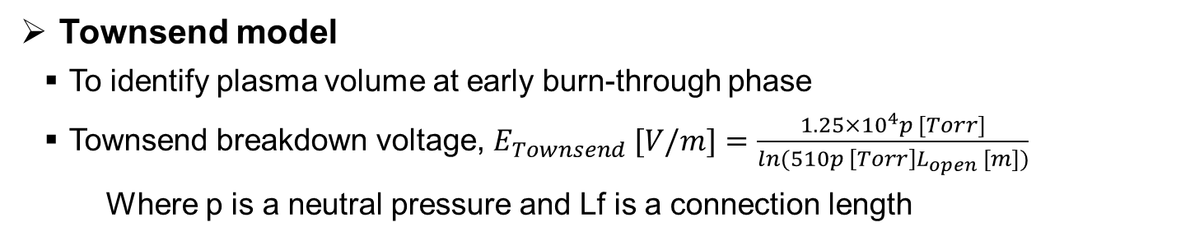
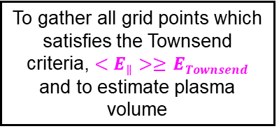
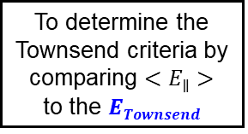
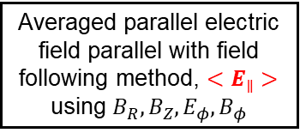
3. Plasma current ramp-up phases
3.1. Townsend model with full electromagnetic simulation
Townsend model
  To identify plasma volume at early burn-through phase
  Townsend breakdown voltage, $E_{Townsend} [V/m]=\frac{1.25×{10}^{4}p [Torr]}{ln(510p \left[Torr\right]L_{open} [m])}$
    Where p is a neutral pressure and Lf is a connection length
[Nucl. Fusion 62 (2022) 126012]
To gather all grid points which satisfies the Townsend criteria, $<E_{∥}>≥$ $ETownsend$
and to estimate plasma volume
2D poloidal magnetic configuration from the electromagnetic model, $ψ(R_{grid},Z_{grid})$
Averaged parallel electric field parallel with field following method, $<E_{∥}>$ using $B_{R}, B_{Z},E_{φ}, B_{φ}$
To determine the Townsend criteria by comparing $<E_{∥}>$
to the $ETownsend$

Slide 17
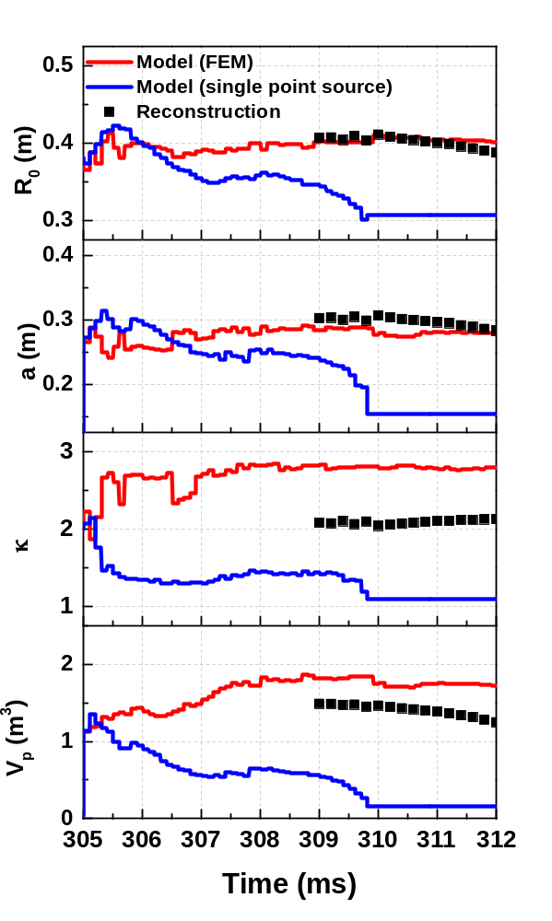
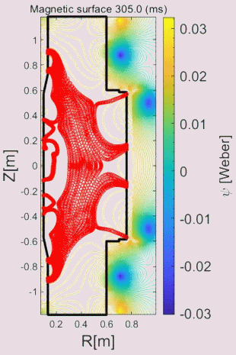
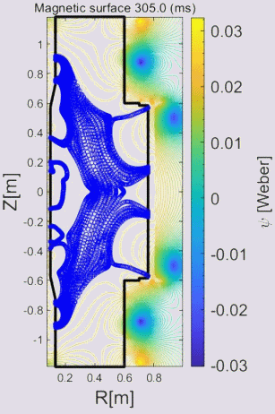
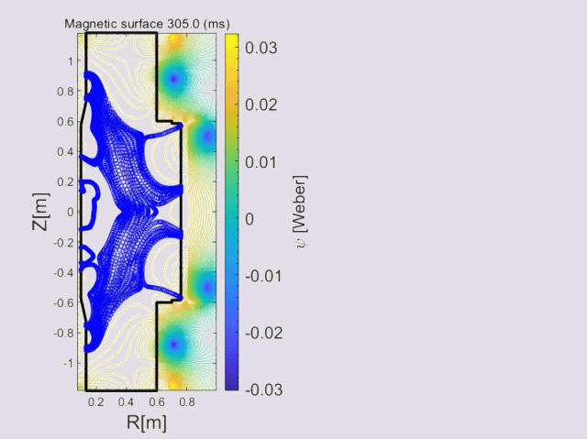

3. Plasma current ramp-up phases
3.2. Townsend model with full electromagnetic simulation
Model results with finite element current distribution vs point source
Magnetic flux evolutions
Finite element current distribution
Single point source current

Slide 18
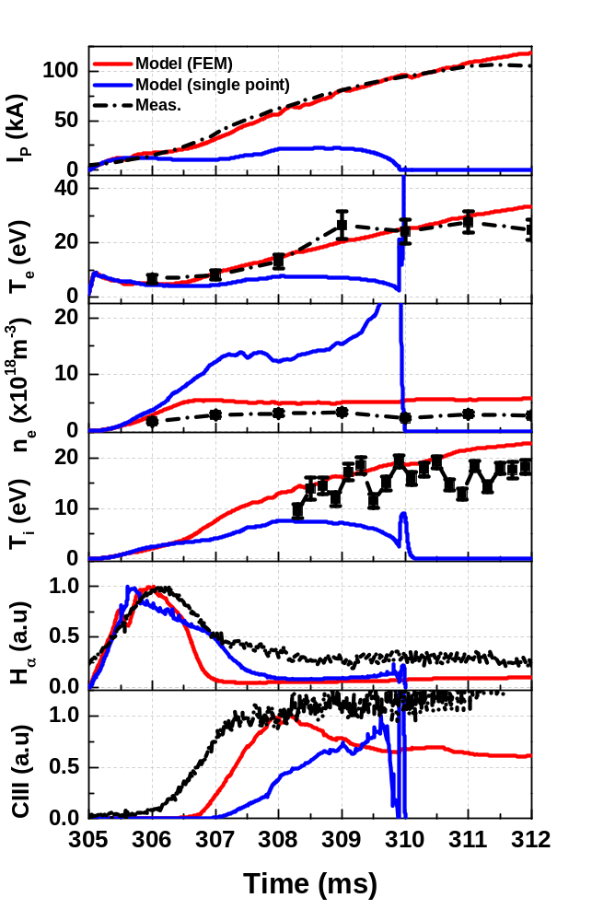
3. Plasma current ramp-up phases
3.2. Townsend model with full electromagnetic simulation
Model results with finite element current distribution vs point source
Magnetic flux evolutions
Finite element current distribution
Single point source current

Slide 19
4. Reproduction of two Ohmic discharges
with different loop voltage using the reduced startup model
4.1. High current with short pulse and Low current with long pulse Ohmic discharges
4.2. Prefill neutral pressure and Loop voltage scanning

Slide 20
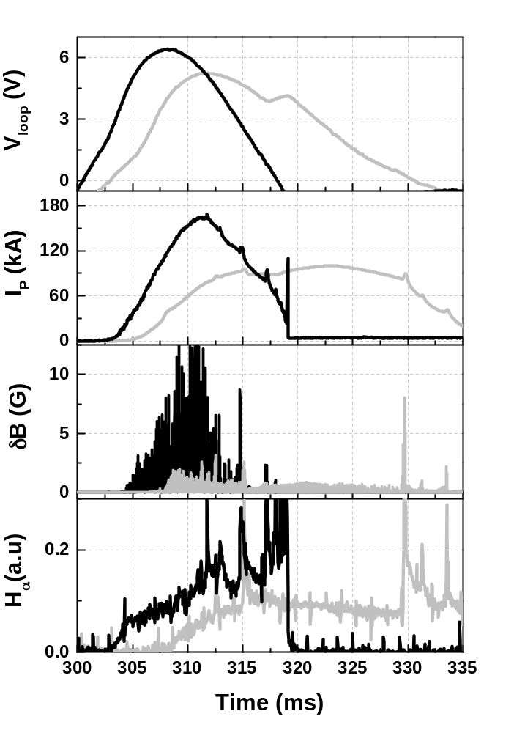
4. Validation of Ohmic discharges with reduced model
4.1. High I_{P} with short pulse and Low I_{P} with long pulse OHs
OKAY
Ohmic discharges with different loop voltage waveforms
Shot#32315: High I_{P} with short pulse
Shot#32302: Low I_{P} with long pulse
Operation conditions & feature of two discharges
 | High I_{P} with short pulse | Low I_{P} with long pulse
Toroidal field (T) | 0.174
Operating pressure (mTorr) | 0.015 | 0.005
Wall condition method | HeGDC with boronization
Loop voltage | Left figure | Left figure
Plasma size | R₀~0.43 m and κ~2 | R₀~0.35 - 0.4 m and κ~1.75
H_{α} signal | No clear burn-through peak due to the significant H recycling
Mirnov signal | Strong | Weak

Slide 21
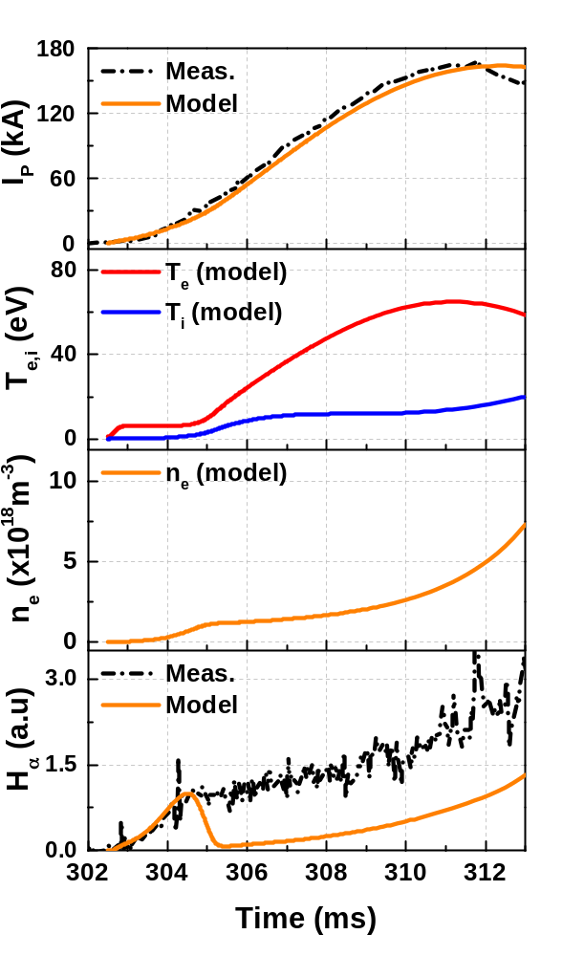
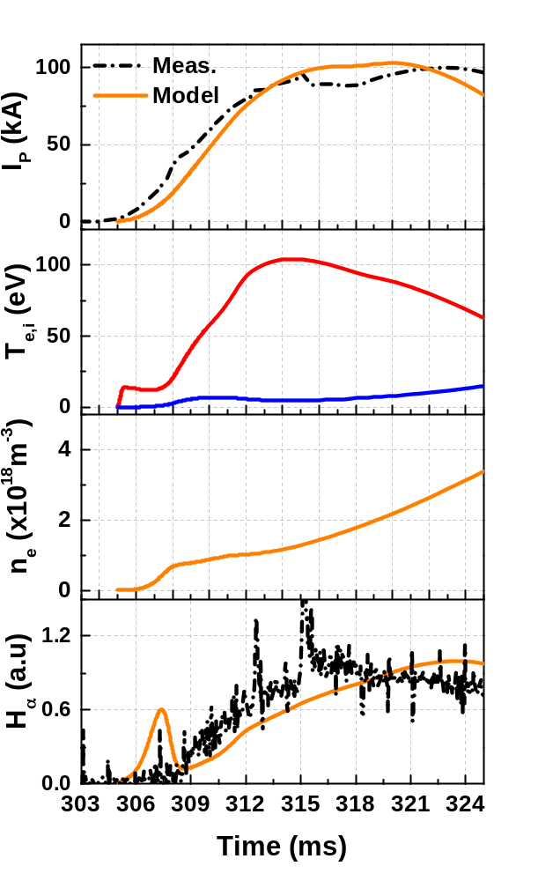
4. Validation of Ohmic discharges with reduced model
4.1. High I_{P} with short pulse and Low I_{P} with long pulse OHs
High I_{P} with short pulse
Low I_{P} with long pulse
Reproduction of plasma current evolution with reasonable agreements
Quantitative validation of Te & ne evolution in future Ohmic discharges
Discrepancy in Ha emission signal between measurement and model

Slide 22
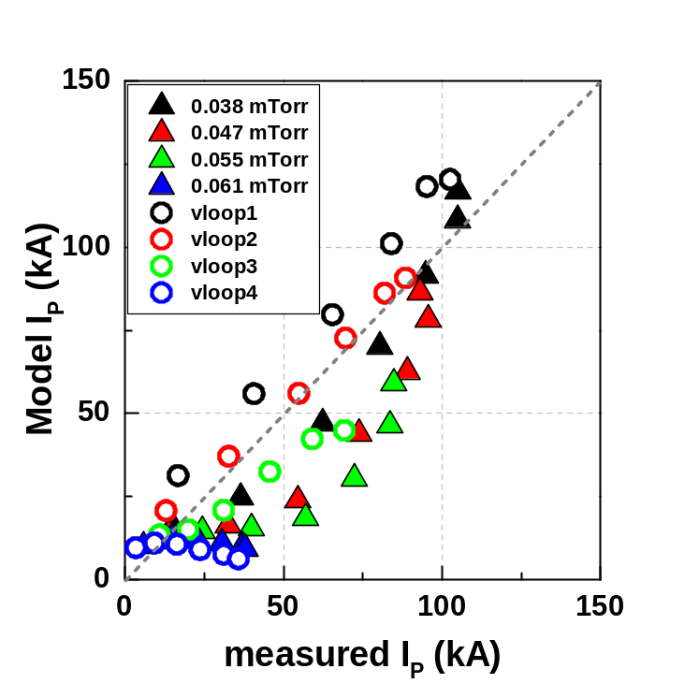
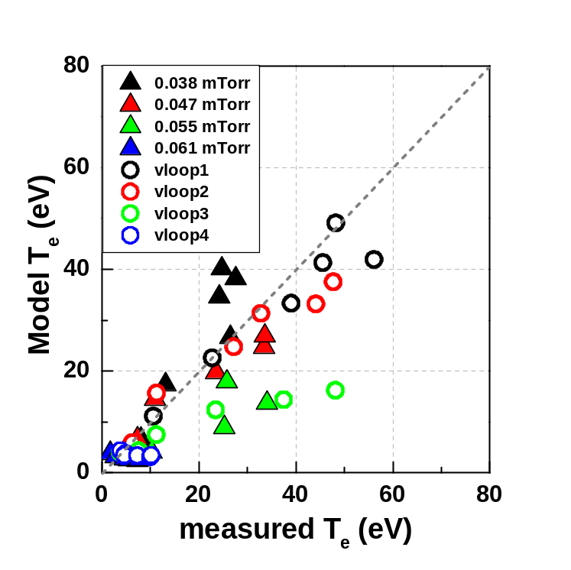
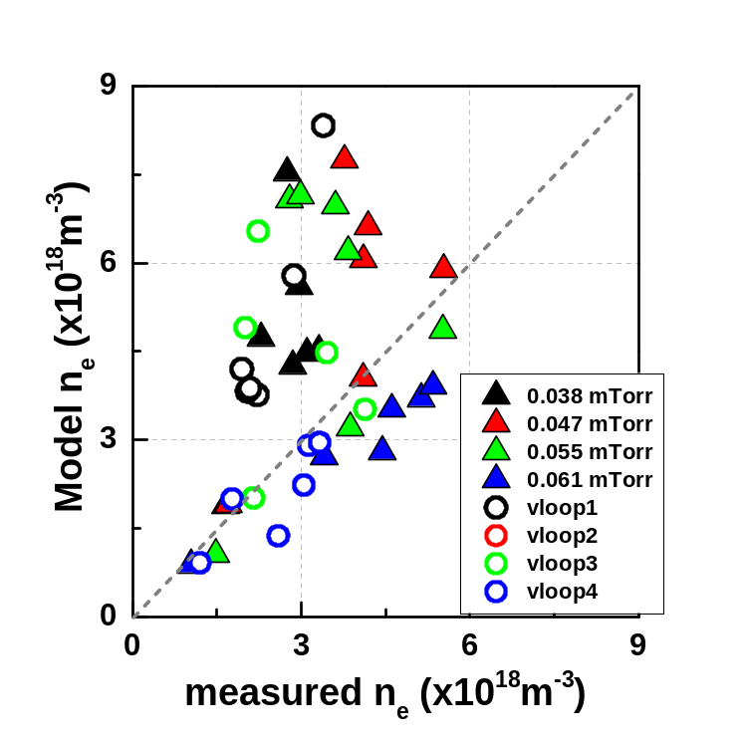
4. Validation of Ohmic discharges with reduced model
4.2. Prefill neutral pressure and loop voltage scanning
Experiment set-up
 | Scanning experiments (1) | Scanning experiments (2)
Adjustment parameters | Prefill neutral pressure Equilibrium field | Loop voltage by central solenoid Equilibrium field
Fixed parameters | Loop voltage by central solenoid Toroidal magnetic field | Prefill neutral pressure Toroidal magnetic field
Simulation results with statistical comparison

Slide 23
5. Summary and Future works

Slide 24
5. Summary and Future works
Summary
  Improvements of circuit parameter models (L_{e} for low-A plasmas and neoclassical factor) for reliable plasma current evolution
  Development of Townsend breakdown model with coupled a full electromagnetic model in order to estimate the plasma volume
  Reproduction of an elongated ST plasma (I_{P}, T_{e}, n_{e}, T_{i}, H_{α}, CIII and plasma shape) with reasonable agreements using the full electromagnetic model
  Statistical validation of the startup model (w/o electromagnetic model) with different prefill neutral and loop voltage parameters
Future works
  Experimental validation of Townsend breakdown model
    Plasma volume estimation using fast camera images and electrostatic probe
  Reproduction of Ohmic start-up with various operating conditions using full electromagnetic start-up model
  Prediction of VEST-Upgrade Ohmic discharge

Slide 25
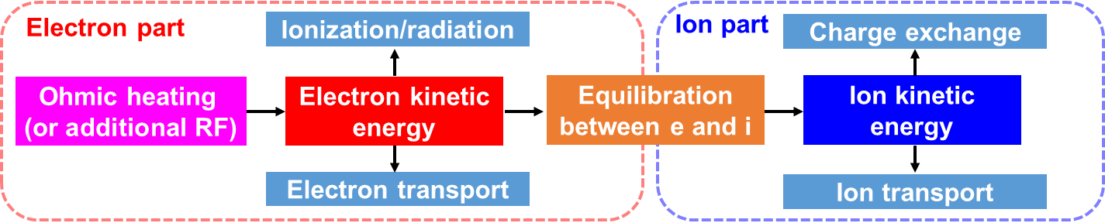

1. Introduction
1.2. Research objectives
DYON simulator
Power balance, particle balance & circuit equation

Slide 26




4. Parameters scanning experiments and simulation results
4.1. Boronization wall condition effect in VEST
Ohmic discharge w/o boronization coating
Ohmic discharge with boronization coating
Neutral pressure increase due to the severe H retention during boronization GDC
Neutral pressure decrease when burn-through
Clear hydrogen burn-through peak
Uncertain hydrogen
burn-through peak

Slide 27



Slide 28


4. Validation of Ohmic discharges with reduced model
4.1. High I_{P} with short pulse and Low I_{P} with long pulse OHs
High I_{P} with short pulse
Low I_{P} with long pulse
Difficult to simulate the unclear hydrogen burn through peak observed in experiments

Slide 29



4. Validation of Ohmic discharges with reduced model
4.2. Neutral pressure scanning
0.038 mTorr O → O
0.047 mTorr O → O
0.055 mTorr O → O
Lagging why??

Slide 30




4. Validation of Ohmic discharges with reduced model
4.2. Neutral pressure scanning
0.061 mTorr O → X
0.073 mTorr X → X
Case4 (0.061 mTorr)
Experiments: burn-through ok
Model: burn-through fail
Other cases are consistent

Slide 31



4. Validation of Ohmic discharges with reduced model
4.2. Loop voltage scanning
Loop voltage1 O → O
Loop voltage2 O → O
Loop voltage3 O → O

Slide 32




4. Validation of Ohmic discharges with reduced model
4.2. Loop voltage scanning
Loop voltage4 O → X
Loop voltage5 X → X
Case4
Experiments: burn-through ok
Model: burn-through fail
Other cases are consistent

Slide 33



4. Validation of Ohmic discharges with reduced model
4.2. Volume averaged value
Necessity
Electron temperature and density by Thomson scattering are local measurements
For comparison with DYON calculation, volume averaged quantities are needed
T_{e} and N_{e} from TS and flux information from equilibrium reconstruction are needed
Processing
  TS scattering data mapping at flux coordinates by using eq. data
  Interpolation of Ne, Te data in real dimension (R,Z)
  Calculation of volume averaged quantities
Upper limit
Lower limit
Shot#37441 @ 307 ms
R (m)
R (m)

