Slide 1
Improvements to the High-Field-Side Transient CHI System on QUEST
Kengoh KURODA¹, Roger RAMAN², Makoto HASEGAWA¹, Takumi ONCHI¹, Kazuaki HANADA¹,
Masayuki ONO³, John ROGERS², Ryuya IKEZOE¹, Hiroshi IDEI¹, Takeshi IDO¹, Osamu MITARAI⁴,
Masayoshi NAGATA⁵, Nobuhiro NISHINO⁶, Shoji KAWASAKI¹, Takahiro NAGATA¹, Aki HIGASHIJIMA¹,
Shun SHIMABUKURO¹, Ichiro NIIYA¹, Izumi SEKIYA¹, Yuya OTSUKA¹, Kaori KONO¹, Kazuo NAKAMURA¹,
Akira EJIRI⁷, Sadayoshi MURAKAMI⁸
¹Kyushu Univ., ²UW, ³PPPL, ⁴Institute for Advanced Fusion and Physics Education,
⁵Univ. of Hyogo, ⁶Bauhutte, ⁷Univ. of Tokyo, ⁸Kyoto Univ.
The 21st International Spherical Torus Workshop (ISTW 2022)
October 31- November 4, 2022

Slide 2
Outline
Description of Transient Coaxial Helicity Injection (T-CHI) Start-up in QUEST
Test of the High Field Side Transient CHI startup in a modified system
  - The results show very favorable current generation scaling to high B_{T} STs
Future plans on a remodeled HFS T-CHI system
Conclusions

Slide 3
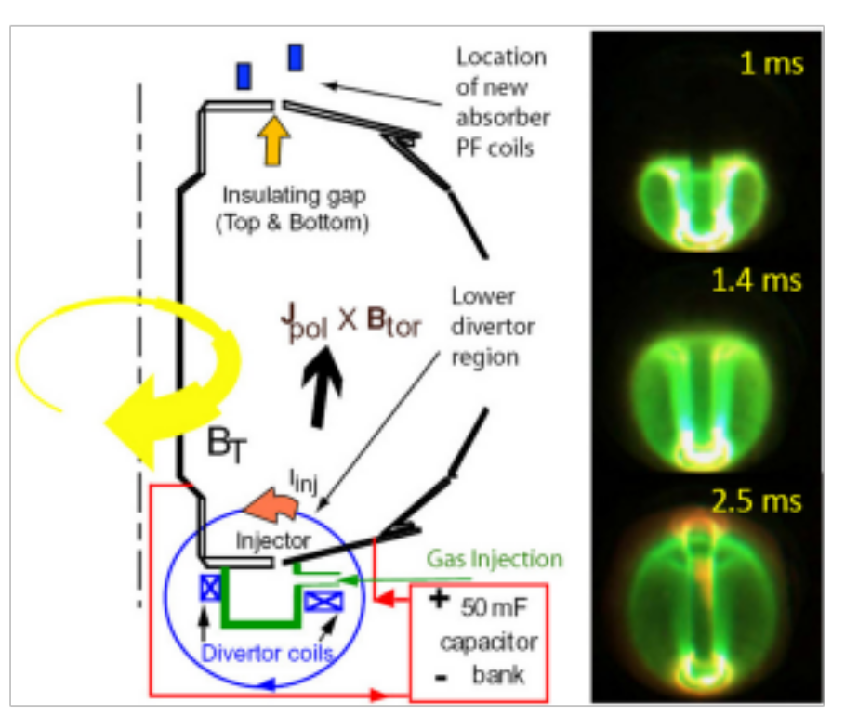
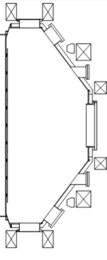
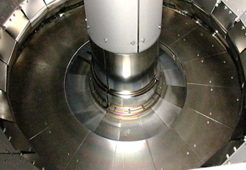
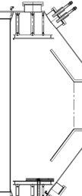
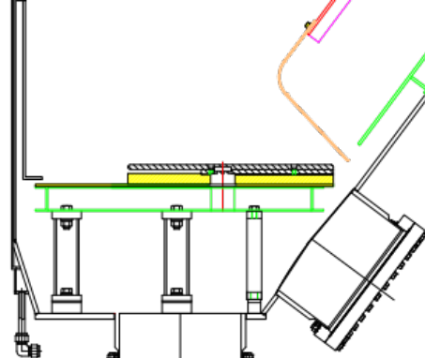
Transient Coaxial Helicity Injection (T-CHI) in QUEST
T-CHI current start-up, using a new configuration electrode installed in QUEST has been tested through a collaborative research project between University of Washington, PPPL and Kyushu University.
NSTX configuration
QUEST configuration
T-CHI insulator is not part of vessel vacuum break as on NSTX and HIT-II
PF coil
Bias electrode
Ceramic break
Lower divertor
Plasma Phys. Control. Fusion 60, 115001 (2018)
Bias electrode
Initial type of QUEST electrode (2016), which was designed for LFS injection.
Ceramic break
Phys. Plasmas 18, 092504 (2011)
Demonstration of T-CHI current start-up (formation of CFS) by using the simple electrode to facilitate the application of T-CHI in the device

Slide 4
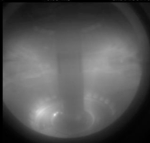
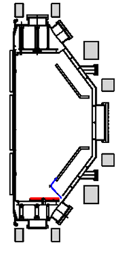
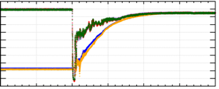
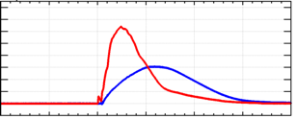
The first application on QUEST employed Low-field-side (LFS) injection
LFS injection configuration
Result of LFS T-CHI
・PF 5-2 coil is capable of forming appropriate injector flux in outer region.
・Flux evolves stably. The evolution is replicable depending on PF condition.
・ Frequency of absorber arc is low.
=> However, keeping narrow footprint is difficult. To keep the narrow footprint, additional flux shaping coil is needed near the LSF region (marked with a red square).
PF3-1
PF3-2
PF2
PF4-1
B_{TF}
PF1
PF4-2
Footprint
PF7
0
PF4-3
V_el 1-3 [kV]
Absorber region
PF6
Injector region
V_cap 1-2 [kV]
PF5-1
PF5-2
-2
80
I_inj [kA]
Injector region where injector flux is formed is located on LFS.
I_tor [kA]
0
0 ms
2ms
Plasma Phys. Control. Fusion 60, 115001 (2018)
Plasma Fusion Res. 16 2402048 (2021)

Slide 5
Implemented High-field-side (HFS) injection to resolve issues with with LFS injection
HFS injection configuration
Merits and issues in HFS T-CHI
・Narrow footprint can be kept.
・Current multiplication (I_tor/I_inj) is higher than the value of LFS T-CHI.
・PF5-1 coil is too far away from electrode to form sufficient injector flux in the inner injector region.
・Absorber arcs are easier
・Gas system needs to be installed in an inaccessible inner region, where the T-CHI plasma needs to be robustly generated before an absorber arc can occur
PF3-1
PF3-2
Direction of B_{TF} is reversed.
PF2
PF4-1
B_{TF}
PF1
Absorber arc
PF4-2
PF4-3
PF7
PF6
Injector region
Absorber region
PF5-1
I_inj [kA]
PF5-2
I_tor [kA]
Injector region is located on HFS.
36
37
38
39
40
[ms]
Plasma Fusion Res. 16 2402048 (2021)

Slide 6
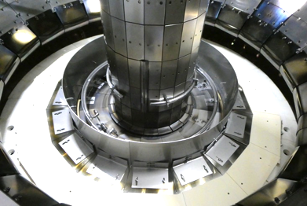
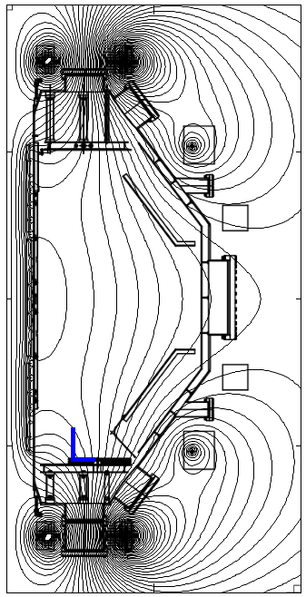
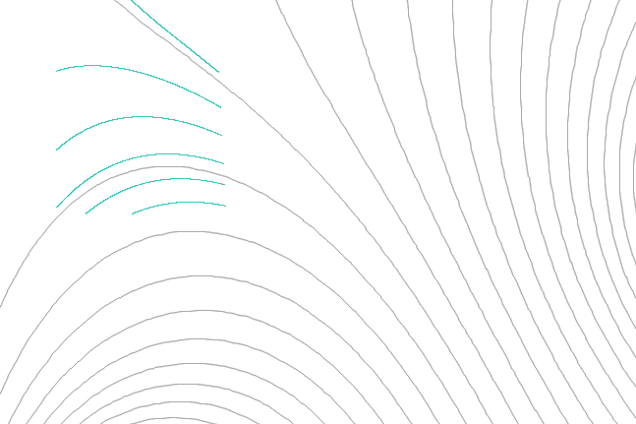
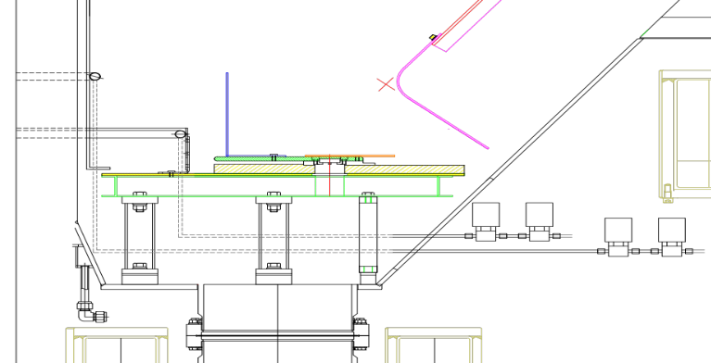
Modified system for HFS T-CHI
Improved gas system
Evaluation configuration
Temporary solutions for HFS T-CHI
・Improved gas system including gas manifolds and cylinder electrode was installed in the injector region.
・Outer parts of electrode was covered by ceramic plates.
・HFS T-CHI was tested in an evaluation configuration, in which injector flux was formed by using PF5-1 coil together with PF4 (solenoid) coil.
PF3-1;
PF3-2;
PF2;
B_{TF}
Bias electrode
(Cylindrical)
PF4;
Gas
manifold #2
Bias
electrode
Gas
manifold #1
Ceramic
cover
PF6;
PF5-1;
PF5-2;
Journal of Fusion Energy, “Improvements to the High-Field-Side Transient CHI System on QUEST ”(in press)

Slide 7
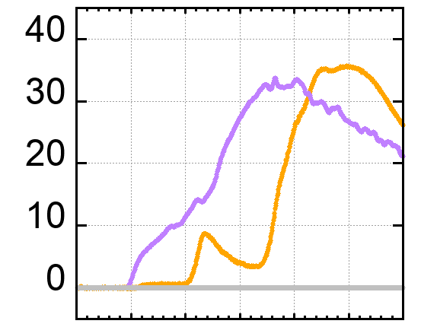
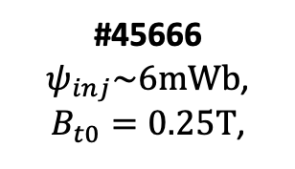
Discharge grows to fill the vessel before occurrence of an absorber
Evaluation configuration
#45666
#45666
$ψ_{inj}\sim 6mWb$,
$B_{t0}=0.25T$,
t1; 0.09 ms
t2; 0.21 ms
PF3-1;
PF3-2;
PF2;
Bubble
burst
B_{TF}
V_e [kV]
PF4;
t3; 0.28 ms
t4; 0.34 ms
Bias
electrode
t4
t3
I_tor [kA]
t2
PF6;
t1
PF5-1;
PF5-2;
I_inj [kA]
0
[ms]
Absorber arc
Journal of Fusion Energy, “Improvements to the High-Field-Side Transient CHI System on QUEST ”(in press)

Slide 8
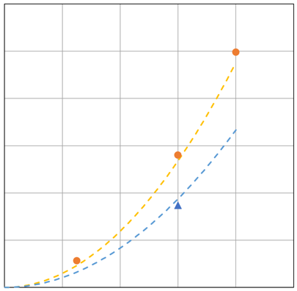
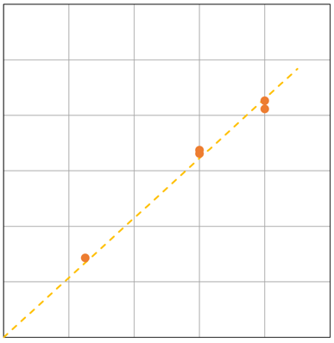





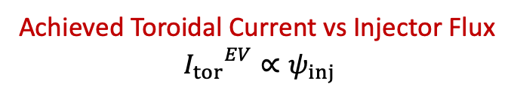

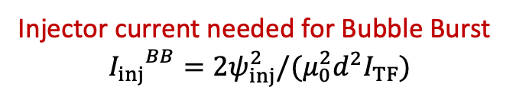



FS studies indicate attractive current generation scaling ( I_{inj} $∝$ 1/B_{T} & I_{p} $∝$ Inj. Flux )
Discharges with different flux magnitudes ($ψ_{inj}$, $I_{TF}$) but under identical flux evolution configuration
Evaluation configuration
Injector current needed for Bubble Burst
$${I_{inj}}^{BB}=2ψ_{inj}^{2}/(μ_{0}^{2}d^{2}I_{TF})$$
Achieved Toroidal Current vs Injector Flux
$${I_{tor}}^{EV}∝ψ_{inj}$$
PF3-1;$×α$
PF3-2 ;$×α$
30
60
Ψ_inj~8mWb
(I_TF=560kA)
PF2 ;$×α$
#45652
Ψ_inj~8mWb
I_inj 25kA
25
I^{BB}_inj(Ψ),
(I_TF=560kA)
50
I_tor~43kA
(#45653)
B_{TF} ;$×β$
#45666
Ψ_inj~6mWb
(I_TF=800kA)
33.7kA
20
40
#45657
Ψ_inj~6mWb
I_inj~14kA
I_tor~41kA
(#45652)
PF4 ;$×α$
I_inj ^{BB} [kA]
I^{BB}_inj(Ψ),
(I_TF=800kA)
I_tor^{EV}[kA]
15
30
#45614
Ψ_inj~2.5mWb
(I_TF=560kA)
Bias
electrode
#45657
Ψ_inj~6mWb
(I_TF=560kA)
I_tor~33.1kA
10
20
I_tor~14.3kA
#45614
Ψ_inj~2.5mWb
I_inj~2.8kA
#45666
Ψ_inj~6mWb
I_inj~8.7kA
PF6 ;$×α$
5
10
PF5-1 ;$×α$
PF5-2 ;$×α$
0
0
0
2
4
6
8
10
0
2
4
6
8
10
Ψ_inj [mWb]
Ψ_inj [mWb]
Journal of Fusion Energy, “Improvements to the High-Field-Side Transient CHI System on QUEST ”(in press)

Slide 9
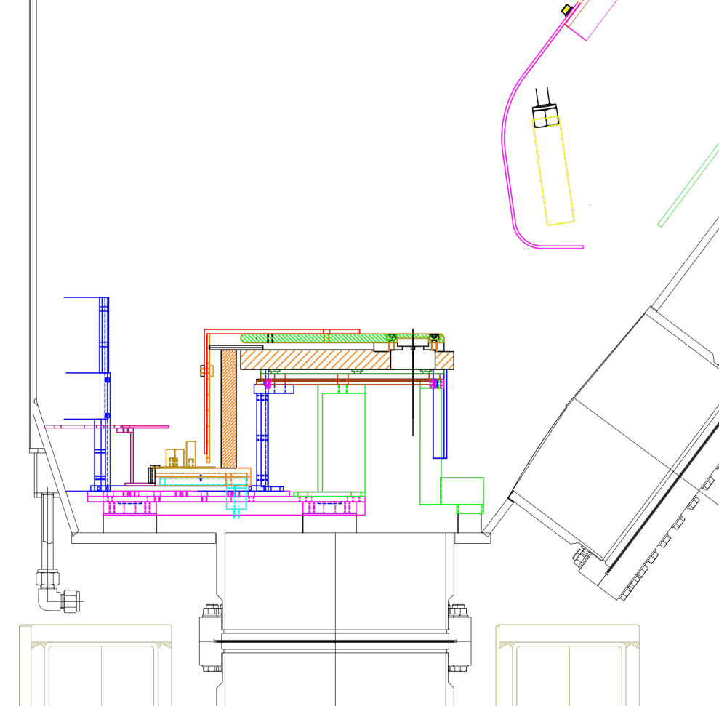
Introducing the permanent system for HFS CHI on QUEST
Divertor electrode
A large-scale redesigned system was
implemented in November of 2021.
The T-CHI electrode was redesigned as a divertor electrode that is compatible with non-CHI QUEST operations
New electrode position is lower than the original position and there is an empty space between inner wall and electrode, in which higher injector flux (>12mWb) is formed without using PF4 (solenoid) coil.
NSTX-type gas manifold was installed.
Injector flux
> 12mWb
Bias electrode
Gas manifold
Initial results
Due to the NSTX-type gas manifold, the breakdown occurred robustly even on higher injector flux configuration.
Because the discharge occurred robustly in the injector region, undesirable arc seemed to be prevented in the absorber region.
Higher toroidal current was achieved on higher injector flux configuration (testing of the new configuration is in progress)
Ceramic break
gas nozzles
x 4-8
PF5-1
PF5-2
IEEE Trans. Plasma Sci., “Design Considerations for the Implementation of a High-Field-Side Transient CHI System on QUEST”,(Early Access)

Slide 10
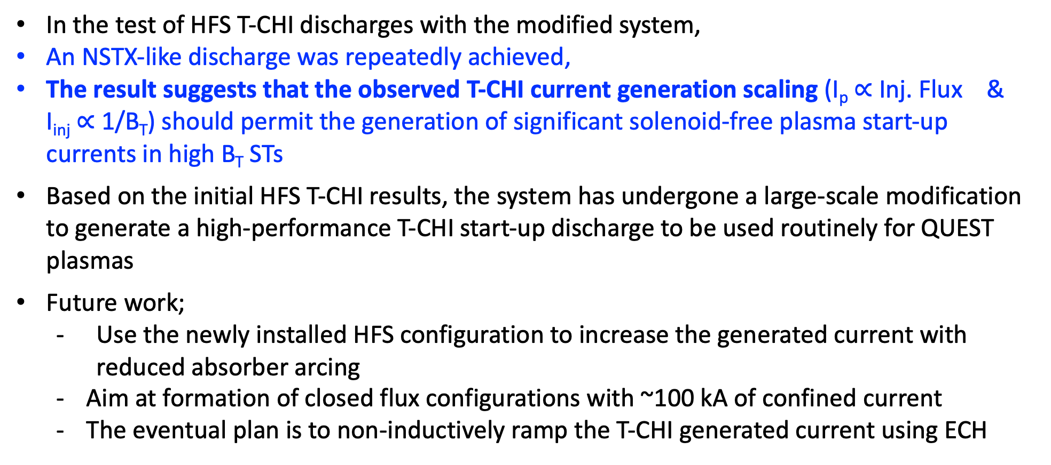
Summary: Transient CHI studies on QUEST suggest attractive current generation scaling to future devices
In the test of HFS T-CHI discharges with the modified system,
An NSTX-like discharge was repeatedly achieved,
The result suggests that the observed T-CHI current generation scaling (I_{p} $∝$ Inj. Flux & I_{inj} $∝$ 1/B_{T}) should permit the generation of significant solenoid-free plasma start-up currents in high B_{T} STs
Based on the initial HFS T-CHI results, the system has undergone a large-scale modification to generate a high-performance T-CHI start-up discharge to be used routinely for QUEST plasmas
Future work;
  - Use the newly installed HFS configuration to increase the generated current with reduced absorber arcing
  Aim at formation of closed flux configurations with ~100 kA of confined current
  The eventual plan is to non-inductively ramp the T-CHI generated current using ECH

Slide 11
Thank you for your attention.

