Slide 1
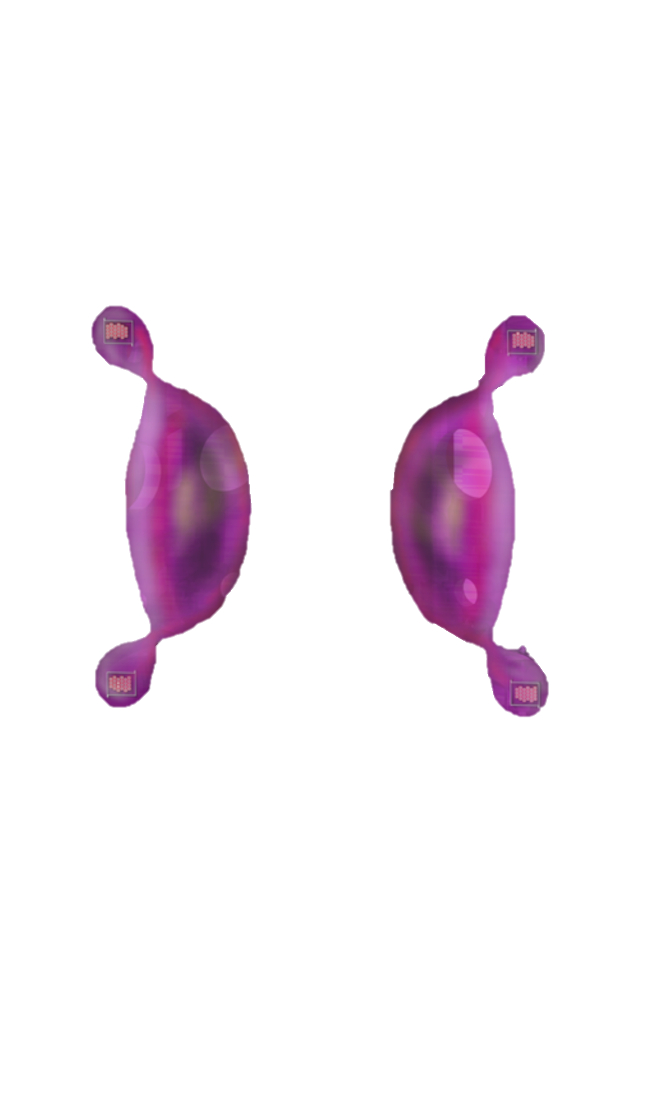
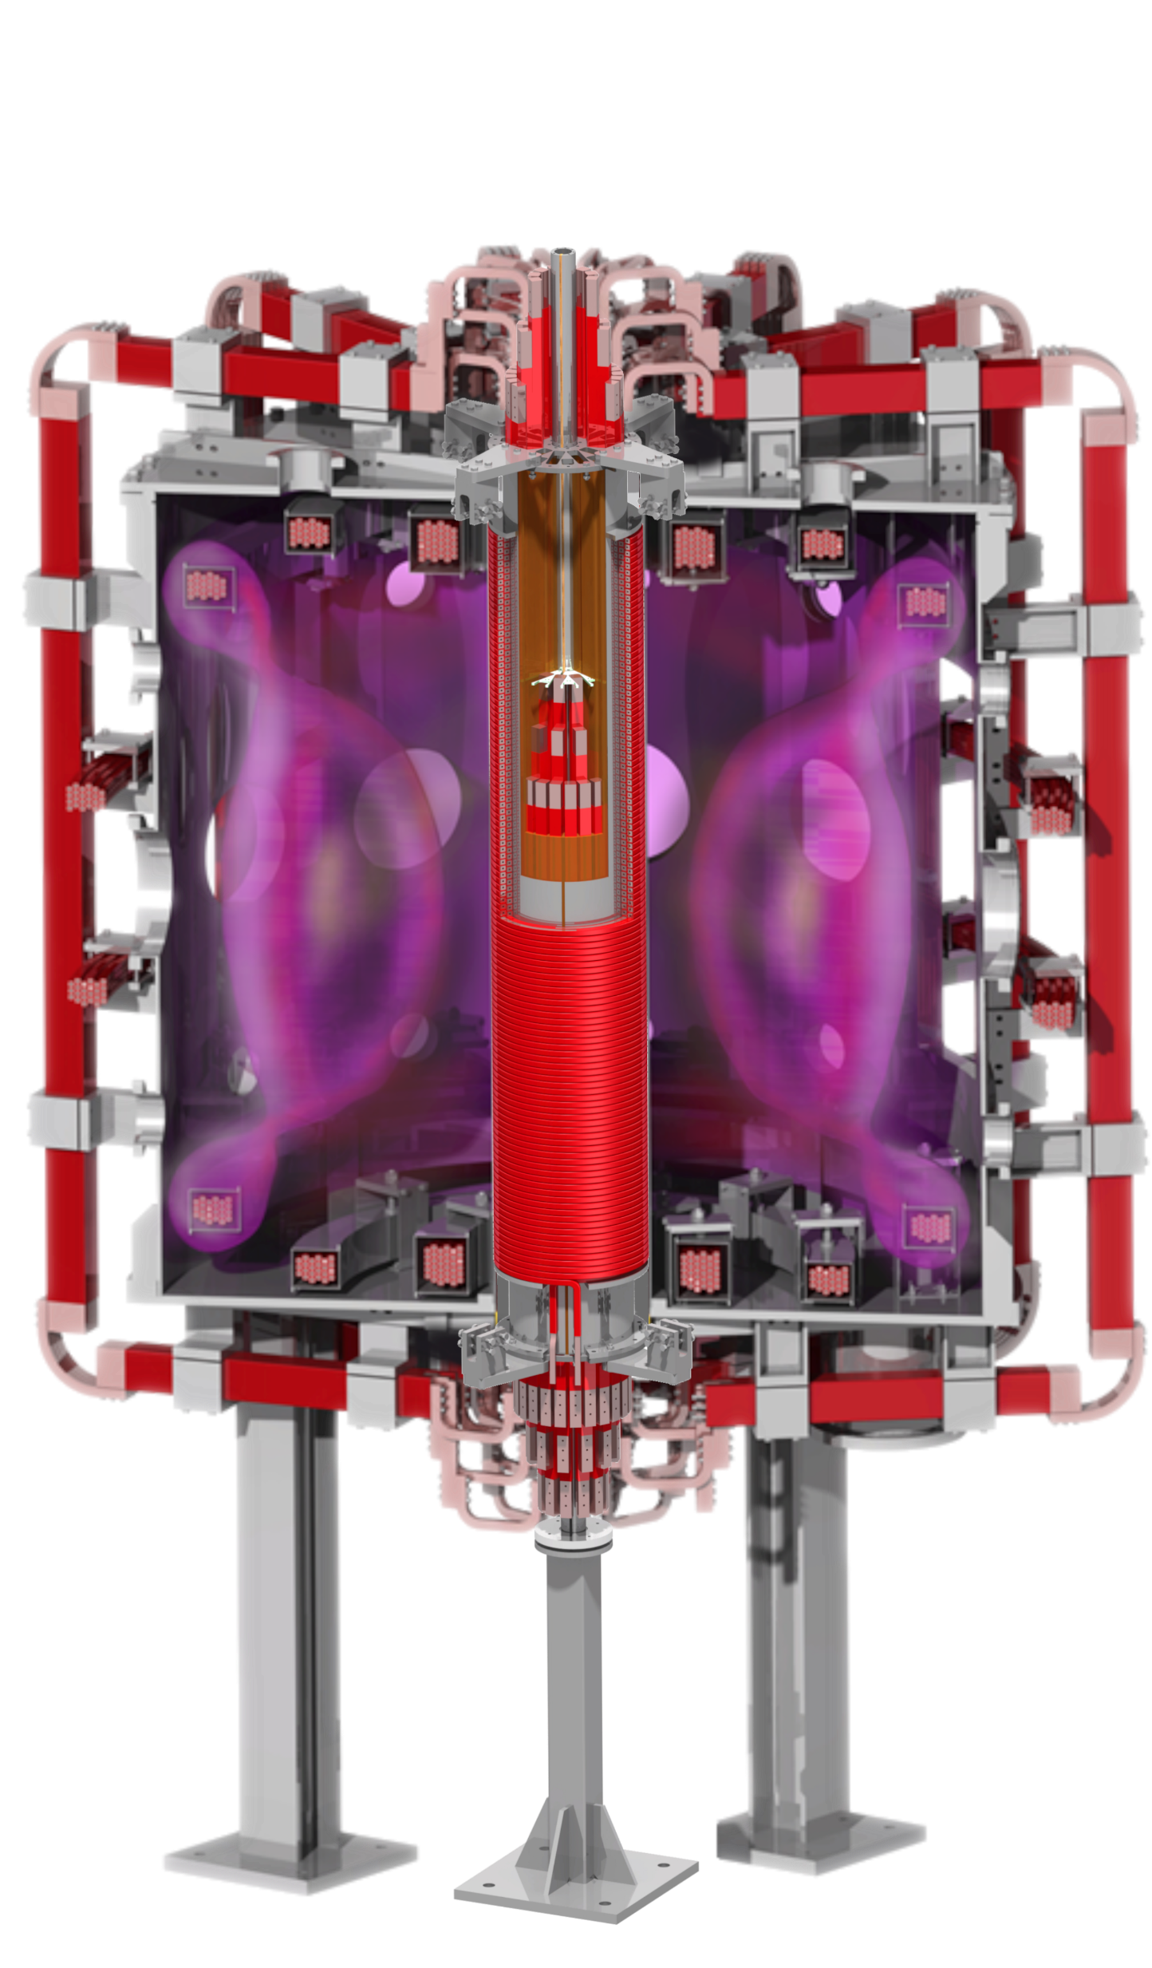
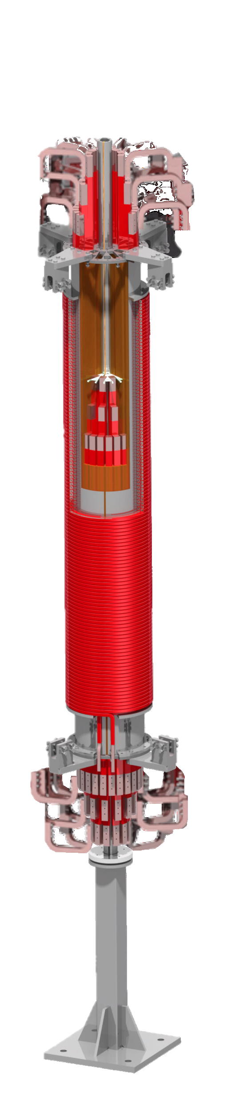
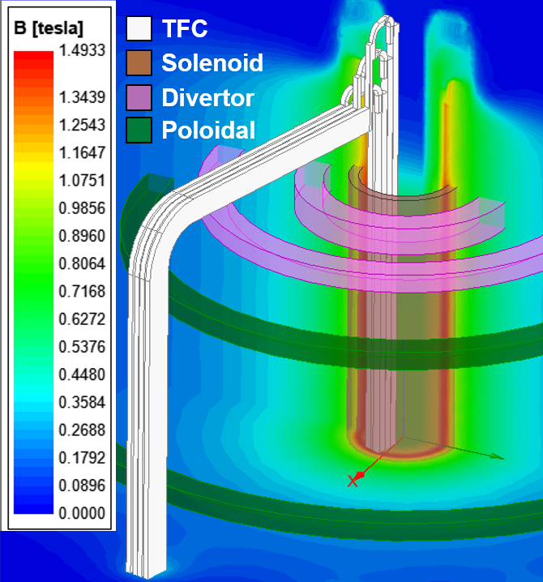
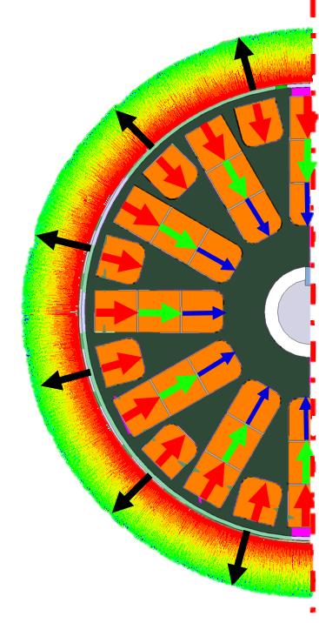
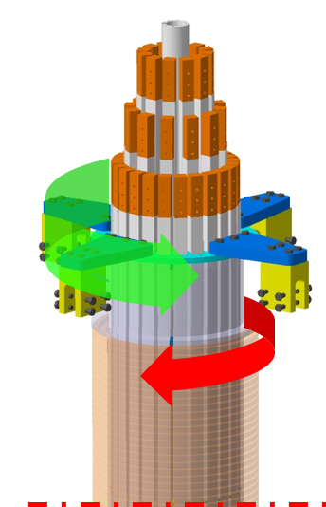
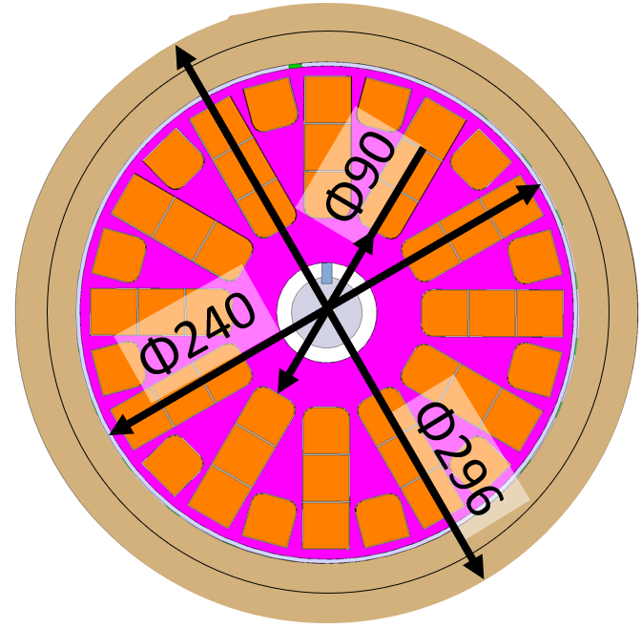
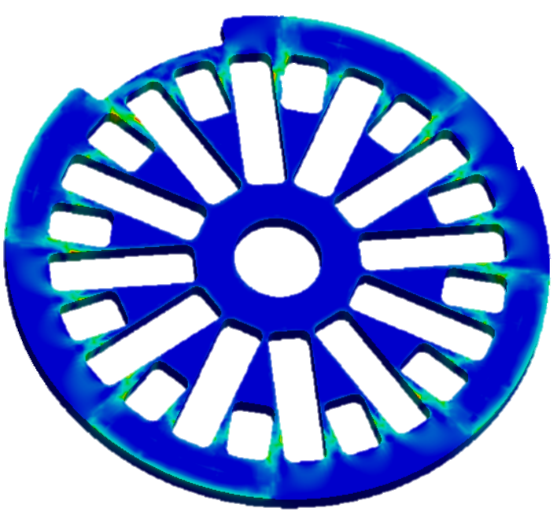

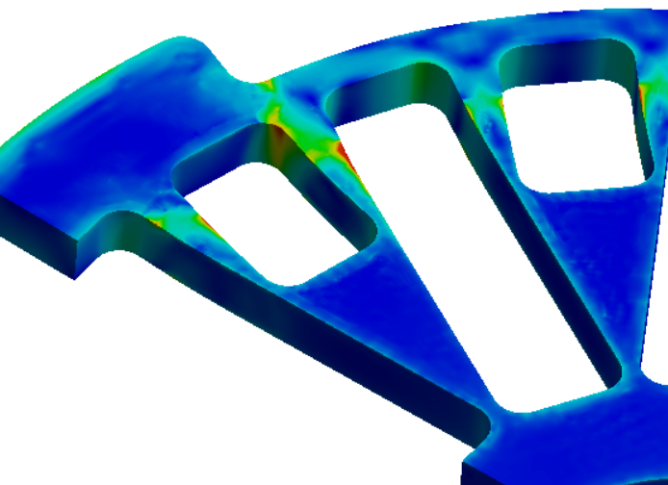
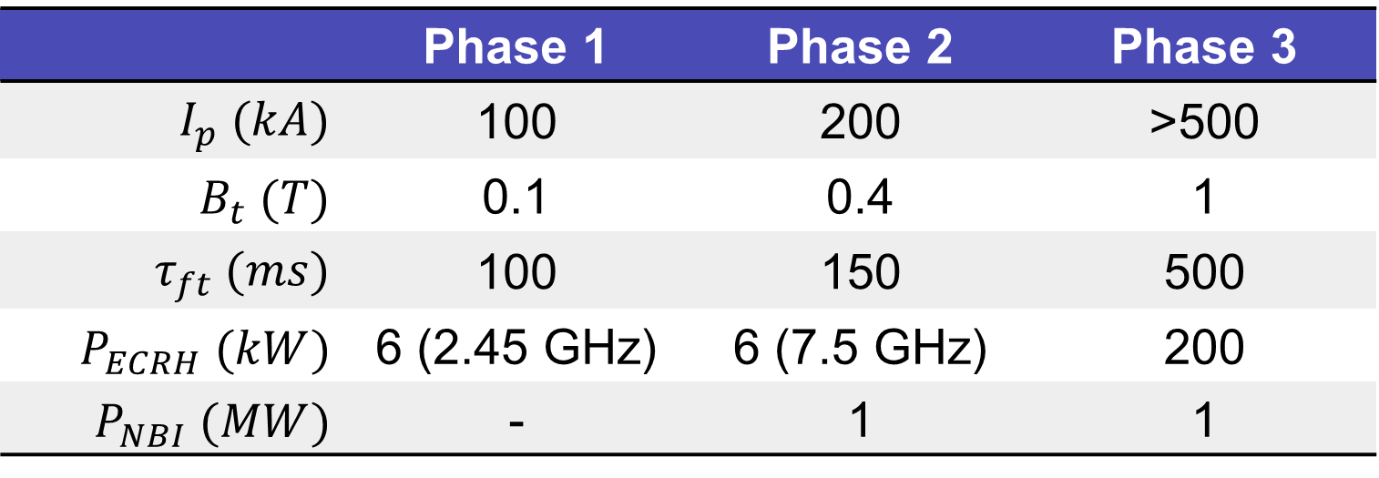
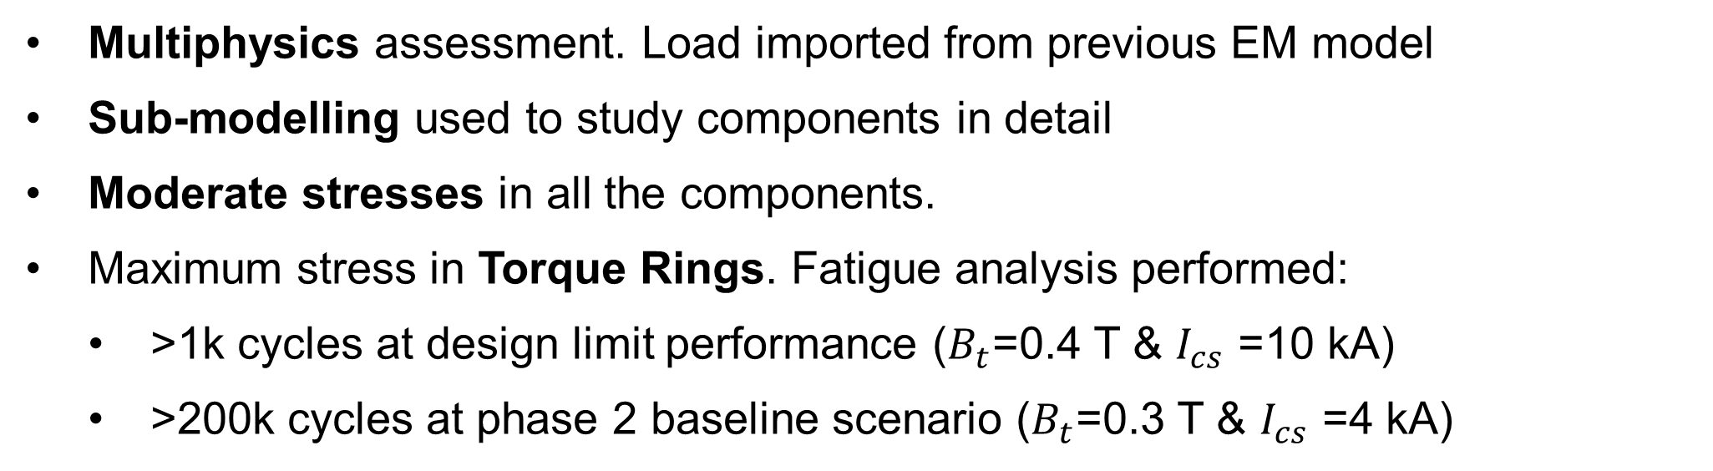
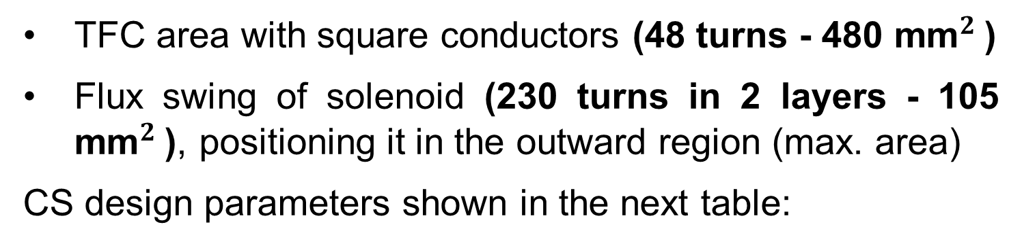
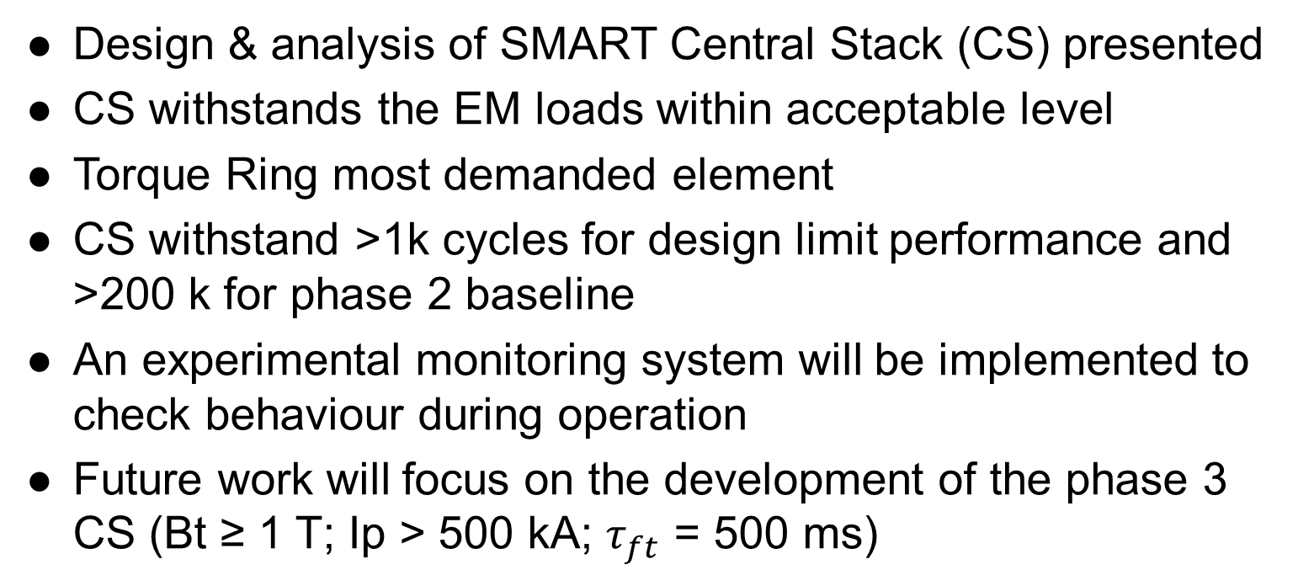
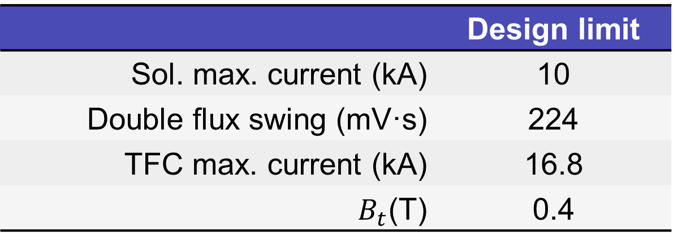
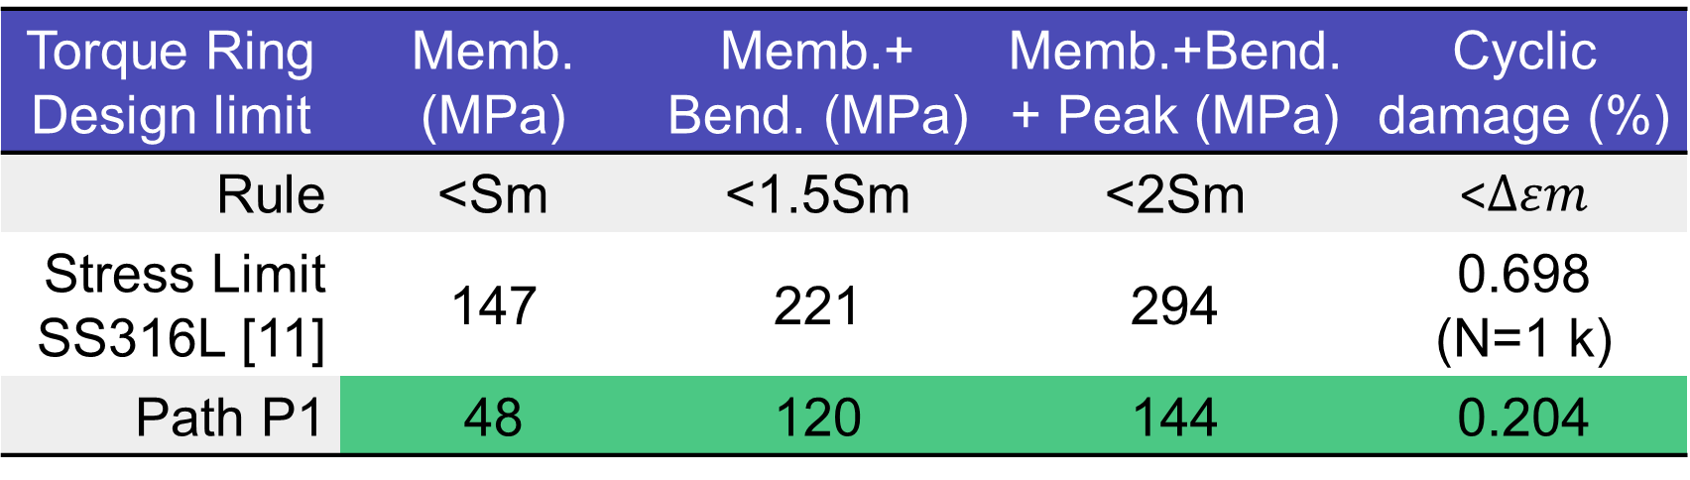
Motivation
Electromagnetic Analysis
Spherical Tokamaks (ST) offer an attractive path to fusion reactors [1]:
Compactness
High Beta
High elongation
High power density
Negative Triangularity is a potential game changer [2]:
Core confinement – L-mode with H-mode like pressure
Edge – No pedestal -> No ELMs
Power handling – Divertor larger radii
PEEK Electrical break
ElectroMagnetic (EM) loads obtained using ANSYS Maxwell
3D electrostatic FEM model of SMART magnetic system
Current input from reference shot [9] & design limit scenario
Pre-breakdown instant studied (max current in Solenoid)
The SMall Aspect Ratio Tokamak (SMART) is a new spherical tokamak (R=0.4 m, a=0.25 m; A<2) currently being assembled at the University of Seville. It will explore positive vs negative triangularity (-0.5<δ<0.5), high elongation (κ<2.3) and single/double null divertor plasmas [3, 4]. Its mission includes:
Epoxy Moulding
Training of next generation of fusion physicists and engineers
Study plasma confinement and stability in positive vs. negative triangularity
Develop novel diagnostic and plasma control techniques
Develop alternative exhaust techniques
SMART operation will cover three phases:
Torque Ring
G10 Spacer
IPL
Loads generated:
In Plane Loads (IPL): magnetic pressure. Interaction of the coil current with its own magnetic field. Expand TFC and solenoid. Self-equilibrated
Out of Plane Loads (OPL): interaction of TFC vertical current with Solenoid end radial field. Torque self-equilibrated
OPL
Central Pole
Solenoid
ARM
Reaction
 | Phase 1 | Phase 2 | Phase 3
$$I_{p} (kA)$$ | 100 | 200 | >500
$$B_{t} (T)$$ | 0.1 | 0.4 | 1
$$τ_{ft} (ms)$$ | 100 | 150 | 500
$P_{ECRH} (kW)$ | 6 (2.45 GHz) | 6 (7.5 GHz) | 200
$P_{NBI} (MW)$ | - | 1 | 1
Wrapping Cylinder
 | Design limit
TFC IPL | 1.5 MN
TFC OPL | 7.4 kNm
Sol. radial Load | 1.6 MN
Sol. comp. Load | 120 kN
This poster presents the analysis and design of the SMART Central Stack for operation up to phase 2. A new design will be implemented for phase 3.
EM torque
TFC
Central Stack Design
Structural Analysis
The SMART Central Stack (CS) includes the Toroidal Field Coil (TFC) inner legs and the Solenoid creating an individual component [5]. Its configuration maximizes:
Solenoid
Structural criteria based on ITER SDC-IC [10]
FEM model in ANSYS Mechanical to study the structural integrity of the system
TFC area with square conductors (48 turns - 480 mm${}_{ }^{2}$)
Flux swing of solenoid (230 turns in 2 layers - 105 mm${}_{ }^{2}$), positioning it in the outward region (max. area)
CS design parameters shown in the next table:
Multiphysics assessment. Load imported from previous EM model
Sub-modelling used to study components in detail
Moderate stresses in all the components.
Maximum stress in Torque Rings. Fatigue analysis performed:
  >1k cycles at design limit performance ($B_{t}$=0.4 T & $I_{cs}$ =10 kA)
  >200k cycles at phase 2 baseline scenario ($B_{t}$=0.3 T & $I_{cs}$ =4 kA)
 | Design limit
Sol. max. current (kA) | 10
Double flux swing (mV·s) | 224
TFC max. current (kA) | 16.8
$B_{t}$(T) | 0.4
The SMART solenoid produces the flux swing required to ramp-up the plasma current up to 200 kA. The volt-seconds remaining after the ramp will sustain the flat-top for 150 ms. Longer pulses are feasible with [6]:
Non-inductive start up
Non-inductive current drive: 30% BS and 15% NBCD foreseen in optimized scenario
Solenoid current waveform
Torque Arms
Unit: MPa
10
Design time @ -5 ms
5
P1
Current (kA)
0
-5
-10
-50
0
50
100
150
200
Time (ms)
Attending the mechanical design, the central stack is 2.6 m height, 296 mm diameter and 800 kg. It is independent from the Vacuum Vessel (VV) and easily adjustable, avoiding tight tolerances. Explaining from the inward parts:
TFC Flexible Joints
Torque Ring Design limit | Memb. (MPa) | Memb.+ Bend. (MPa) | Memb.+Bend.+ Peak (MPa) | Cyclic damage (%)
Rule | <Sm | <1.5Sm | <2Sm | <$∆εm$
Stress Limit SS316L [11] | 147 | 221 | 294 | 0.698 (N=1 k)
Path P1 | 48 | 120 | 144 | 0.204
Central pole supported by pedestal (adjustable in height)
Torque rings (x2) and spacers (x2 of epoxy G10) attached to pole
48 TFC inner bars inserted and guided by rings. Insulation 50 μm of kapton + 200 μm of TUFQUIN TFT (20 kV of strength for 2 kV maximum expected)
TFC Inner Bars
Solenoid wrapped around a 2 mm thickness cylinder. Insulation 185 μm of Kapton (50 kV of strength with 6 kV maximum expected)
Once assembled, CS solidified with epoxy (SR1720)
Torque rings connected to VV lid ribs with 4 torque arms (aluminium 7075 T6) each. Easily adjustable for centering the CS in the VV
Pedestal
Summary and Conclusions
References
[1] M. Gryaznevich et al, PRL 1998
[2] A. Marinoni et al, NF 2021
[3] S. J. Doyle et al, PREX 2021
[4] A. Mancini et al, FED 2021
[5] M. Agredano-Torres et al, FED 2021
[6] A. Mancini et al, 32nd SOFT 2022
[7] P. H. Titus et al, 18th IEEE SFE 1999
[8] C. Neumeyer et al, 20th IEEE SFE 2003
[9] S. J. Doyle et al, FED 2021
[10] V. Barabash et al, ITER SDC-IC 2012
[11] V. Barabash et al, ITER SDC-IC-Appx. A 2013
Design & analysis of SMART Central Stack (CS) presented
CS withstands the EM loads within acceptable level
Torque Ring most demanded element
CS withstand >1k cycles for design limit performance and >200 k for phase 2 baseline
An experimental monitoring system will be implemented to check behaviour during operation
Future work will focus on the development of the phase 3 CS (Bt ≥ 1 T; Ip > 500 kA; $τ_{ft}$ = 500 ms)
TFC flexible joints (lamellae) connect electrically inner and outer TFC bars decoupling mechanical effects (EM loads, thermal exp.) usually problematic in other machines [7, 8].
Conducting components are longitudinally cut to avoid flux consumption (PEEK break).
Component materials not specified are SS316L (support) or oxygen free copper (conductors).

